Slide 1
Expenses Confirmation Session

Slide 2
Today’s Topics
What is a Confirmation Session?
Spend Authorization and Expense Reports
Questions
FDM Overview
System Demonstration

Slide 3
A Confirmation Session is

An Introduction to Workday key concepts
A demonstration of the system configurations of business processes that have been built so far
A visualization of the system for the end users
An opportunity for you to see the features of the system and share that information with your colleagues
Notes:
A Confirmation Session:
Introduces Workday key concepts
A demonstration of the system configurations of business processes that have been built so far
Provides you, as an end user, with a visualization of the system
Opportunity for you to see the features of the system and share that information with your colleagues

Slide 4
A Confirmation Session is not

Time for redesign
Formal testing
Validating customer data
Training of SME’s or any other Customer staff
Notes:
A Confirmation Session:
Introduces Workday key concepts
A demonstration of the system configurations of business processes that have been built so far
Provides you, as an end user, with a visualization of the system
Opportunity for you to see the features of the system and share that information with your colleagues

Slide 5
Driver Worktags
Inherited & Related Worktags
Revenue & Spend Categories
Ease of Use Features
Notes:
For those not familiar The FDM is a set of codes used to classify & record financial transactions. Under PeopleSoft Financial Management System we had a very simple chart using only fund account and department. With Workday the quantity of financial attributes has been expanded to allow for improved financial management & reporting. Workday refers to these attributes as Worktags.

Slide 6



Worktags
Cost Center
Cost Center
Division
Fund
Program
Expense Items
Project
Drivers
Related
& Optional
Location
Gift
Activity
Grant
Spend Category
Revenue Category

Slide 7
The 5 Must Haves
Cost Center
Fund (source of funding)
Ledger Account (higher summarized level for budgeting)
Program (NACUBO categories-used in external reporting & will always default)
Revenue or Spend Category (details)
Worktags
Notes:
Lets review the Worktags you will see. Some will be familiar and some will be brand new. Most transactions will require 5 separate Worktags. For most people the cost center (formerly department in PeopleSoft) will be used to initiate a transaction. This code will be different than the current PeopleSoft department The fund is important for financial reporting. We will still have most funds. For example Fund 10 as in PeopleSoft will be noted as F10 in Workday and will be used to denote the Unrestricted Operating Fund. The ledger account is very similar to the predecessor account in PeopleSoft. However, it is at much higher summarized level than the PeopleSoft account. This is the level that we will maintain our budgets. Program is used for external reporting and will always default. The National Association for Colleges and University Business Officers (NACUBO) determines the program classifications for consistency in reporting.
Revenue and Spend Categories are similar to the attributes we have currently in PeopleSoft. Revenue categories are currently detail codes in PeopleSoft and Spend Categories are very similar to the spend categories used by Procurement today in PeopleSoft. We will talk about that more later.

Slide 8
Inherited and Related Worktags
If you select one Worktag, Workday completes related Worktags for you:
For example: A user inputs a grant worktag, and Workday completes the appropriate:
      Fund
      Division
      Cost Center
      Program Code
Notes:
So far we have discussed, Fund, Cost Center, Ledger Account, Spend Category, Revenue Category, Program, Gift, Grant, Project and Expense Item. This a far too much for all to ever remember but there are a lot of tricks in Workday to help you remember all of this. Inherited and Related Worktags will help to complete the transaction and help to comfirm that you have included the correct combination. When an employee initiates a transaction the employee’s home cost center will default in. We have designed many combinations of default worktags. For example if you select a grant worktag, Workday the appropriate Fund, Division, Cost Center and program code will default in as inherited/related worktags. Don’t worry if you pick the wrong combination. Workday will let you know.

Slide 9
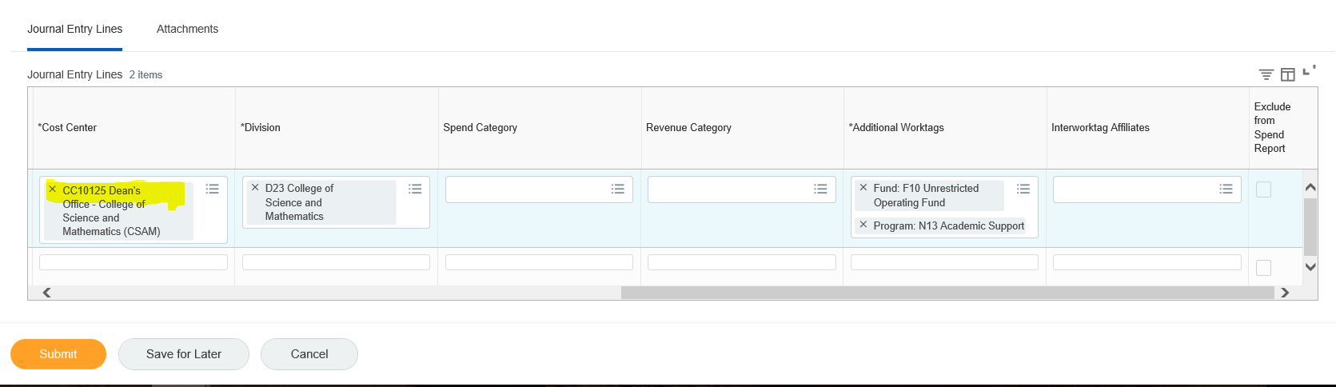
Inherited Worktags

Slide 10
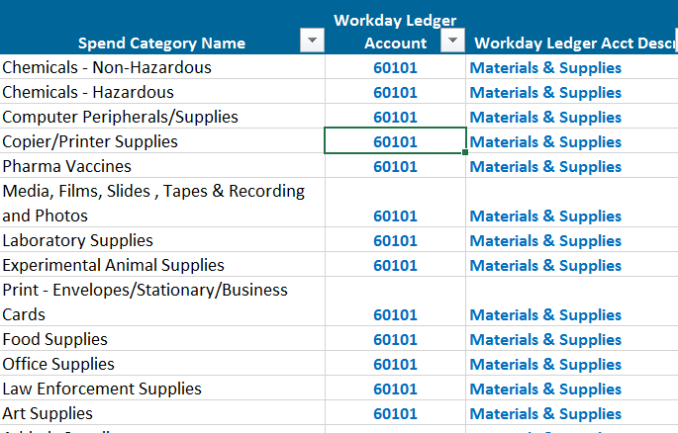
Spend Category To Ledger Account
Spend Category Ledger Account
Users select the spend category and Workday derives the ledger account
Notes:
The user selects the Spend Category and the ledger account is assigned. There are many detailed spend categories. As you can see users can track expenses in Workday at a detail level but budget at a higher level in the ledger account. All the spend categories listed above are all supplies related but they map to Ledger Account Materials & Supplies and the budget account Materials & Supplies. The website will have list of common spend categories and mapping to ledger accounts.

Slide 11
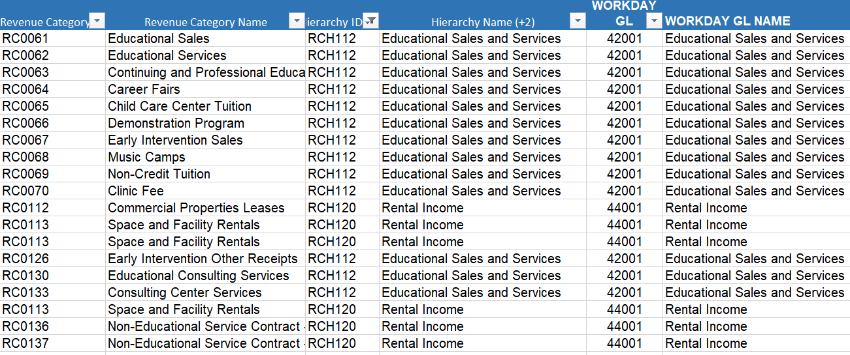
Revenue Category To Ledger Account
Rev Category Ledger Account
Users select the revenue category and Workday derives the ledger account
Notes:
Revenue Categories in Workday are equivalent to detail codes in PeopleSoft. If a user selects a revenue category Workday will derive the ledger account. For example there are 13 different revenue categories that map to one Educational Sales Revenue Hierarchy which maps to one ledger account. This is also the same for rental income and athletic revenue.

Slide 12
Spend Authorizations and Expense Reports
Confirmation Session
June 10, 2019

Slide 13
Spend Authorization and Expense Report Agenda
Agenda
  Overview
  Key Features
  New System Features
Demo of Configuration of Business Processes
  Spend Authorization (pre-approval)
  Expense report (overnight travel, reimbursement)
Q & A

Slide 14
Overview
Workday Spend Authorizations and Expenses :
    Plan: Project start up and planning initiated
    Architect: Design and configuration
    Configure and Prototype:
      Confirmation Session: Where we are today
    Test: End to End testing (July 1 – August 30, 2019)
    Deploy: End User Training (Fall 2019)
    Go Live: (January 2020)
Notes:
The following are the various phases of the Workday Recruiting project.
We have gone through the Planning and Architect phase.
During the Architect phase our Sierra Cedar partners designed and configured a tenant based on information we provided regarding our current processes and what the future state should look like.
A tenant is a prototype of the system that is used for the purposes of configuration and testing.
We are now in the configure and prototype stage of the project. More specifically, we are conducting Confirmation Sessions like the one today. I will talk about what a Confirmation Session is in the next slide.
As we go further in the project we will conduct end user training and testing. Those of us involved in the project have already started testing.
Ultimately we will Go Live in mid-August.

Slide 15
Key Features – Spend Auth. and Expense Report
Current
Complete manual authorization form & obtain signatures (TR-1)
Collect & scan paper receipts
Prepare expense report spreadsheet (attach receipts)
Obtain manual signatures for Expense Report
Manually search for per diem meal and mileage rates, must provide screenshot as attachment
Future
Approvals are online
Spend Authorization encumbers funds when submitted
Manage receipts as they are acquired quickly and easily
  Snap a photo
  Upload online or via mobile device
Online spend authorization links to the Expense Report
Meals per diem for domestic city & mileage rates auto-populate
Notes:
Snap a photo or upload receipt either online or via mobile device with visibility into automated workflow approvals

Slide 16
New System Features
Per Diem cash advance options on Spend Authorizations
Business purpose field allows for reporting
Auto approval routing for International Travel
Payment election options
Prepare reports on behalf of non-workers and employees
Corporate travel card data auto-populates in system
Notes:
University compliance policy is embedded in the system through custom validations of:
Required documents (TR-1/Spend Authorizations, supporting attachments)
Per diem rates
Approval flows – domestic vs international
System messages for missing/incorrect data

Slide 17
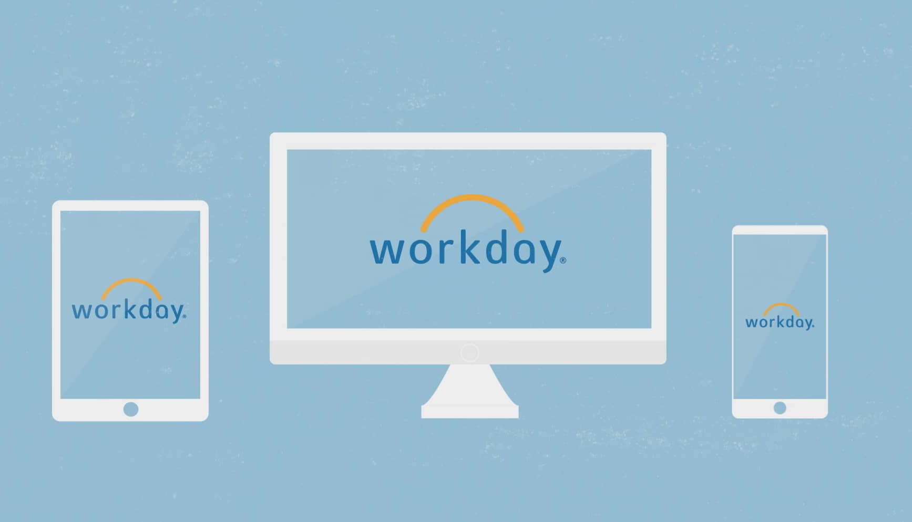
Demo
Notes:
Let’s get started with the demo. We do have limited time. However, if you have a question regarding something we are demonstrating, please stop us.

Slide 18
Helpful Links
Send questions after this session to Workday2020@Montclair.edu
Project website https://www.montclair.edu/information-technology/workday-2020-project/
Notes:
Have a Role
Have a Support Model

Slide 19

Q & A

Slide 20
THANK YOU!
Please complete the survey
Montclair.edu/workday-2020-project

