Slide 1
Procurement Confirmation Session

Slide 2
Today’s Topics
What is a confirmation session?
Procurement Overview
Questions
System Demonstration
FDM Overview

Slide 3
A Confirmation Session is

An Introduction to Workday key concepts
A demonstration of the system configurations of business processes that have been built so far
A visualization of the system for the end users
An opportunity for you to see the features of the system and share that information with your colleagues
Notes:
A Confirmation Session:
Introduces Workday key concepts
A demonstration of the system configurations of business processes that have been built so far
Provides you, as an end user, with a visualization of the system
Opportunity for you to see the features of the system and share that information with your colleagues

Slide 4
A Confirmation Session is not

Time for redesign
Formal testing
Validating customer data
Training of SME’s or any other Customer staff
Notes:
A Confirmation Session:
Introduces Workday key concepts
A demonstration of the system configurations of business processes that have been built so far
Provides you, as an end user, with a visualization of the system
Opportunity for you to see the features of the system and share that information with your colleagues

Slide 5
Driver Worktags
Inherited & Related Worktags
Revenue & Spend Categories
Ease of Use Features
Notes:
For those not familiar The FDM is a set of codes used to classify & record financial transactions. Under PeopleSoft Financial Management System we had a very simple chart using only fund account and department. With Workday the quantity of financial attributes has been expanded to allow for improved financial management & reporting. Workday refers to these attributes as Worktags.

Slide 6



Worktags
Cost Center
Cost Center
Division
Fund
Program
Expense Items
Project
Drivers
Related
& Optional
Location
Gift
Activity
Grant
Spend Category
Revenue Category

Slide 7
The 5 Must Haves
Cost Center
Fund (source of funding)
Ledger Account (higher summarized level for budgeting)
Program (NACUBO categories-used in external reporting & will always default)
Revenue or Spend Category (details)
Worktags
Notes:
Lets review the Worktags you will see. Some will be familiar and some will be brand new. Most transactions will require 5 separate Worktags. For most people the cost center (formerly department in PeopleSoft) will be used to initiate a transaction. This code will be different than the current PeopleSoft department The fund is important for financial reporting. We will still have most funds. For example Fund 10 as in PeopleSoft will be noted as F10 in Workday and will be used to denote the Unrestricted Operating Fund. The ledger account is very similar to the predecessor account in PeopleSoft. However, it is at much higher summarized level than the PeopleSoft account. This is the level that we will maintain our budgets. Program is used for external reporting and will always default. The National Association for Colleges and University Business Officers (NACUBO) determines the program classifications for consistency in reporting.
Revenue and Spend Categories are similar to the attributes we have currently in PeopleSoft. Revenue categories are currently detail codes in PeopleSoft and Spend Categories are very similar to the spend categories used by Procurement today in PeopleSoft. We will talk about that more later.

Slide 8
Inherited and Related Worktags
If you select one Worktag, Workday completes related Worktags for you:
For example: A user inputs a grant worktag, and Workday completes the appropriate:
      Fund
      Division
      Cost Center
      Program Code
Notes:
So far we have discussed, Fund, Cost Center, Ledger Account, Spend Category, Revenue Category, Program, Gift, Grant, Project and Expense Item. This a far too much for all to ever remember but there are a lot of tricks in Workday to help you remember all of this. Inherited and Related Worktags will help to complete the transaction and help to comfirm that you have included the correct combination. When an employee initiates a transaction the employee’s home cost center will default in. We have designed many combinations of default worktags. For example if you select a grant worktag, Workday the appropriate Fund, Division, Cost Center and program code will default in as inherited/related worktags. Don’t worry if you pick the wrong combination. Workday will let you know.

Slide 9
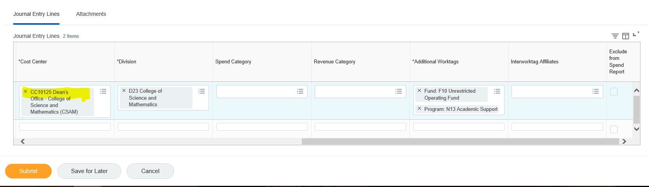
Inherited Worktags

Slide 10
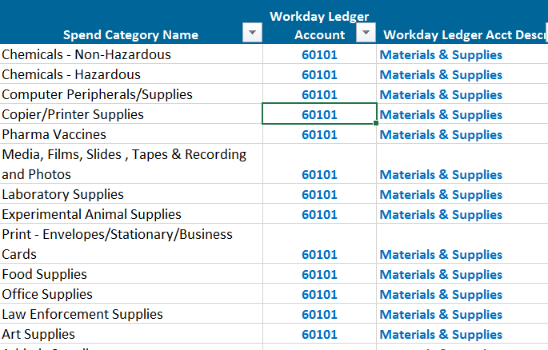
Spend Category To Ledger Account
Spend Category Ledger Account
Users select the spend category and Workday derives the ledger account
Notes:
The user selects the Spend Category and the ledger account is assigned. There are many detailed spend categories. As you can see users can track expenses in Workday at a detail level but budget at a higher level in the ledger account. All the spend categories listed above are all supplies related but they map to Ledger Account Materials & Supplies and the budget account Materials & Supplies. The website will have list of common spend categories and mapping to ledger accounts.

Slide 11
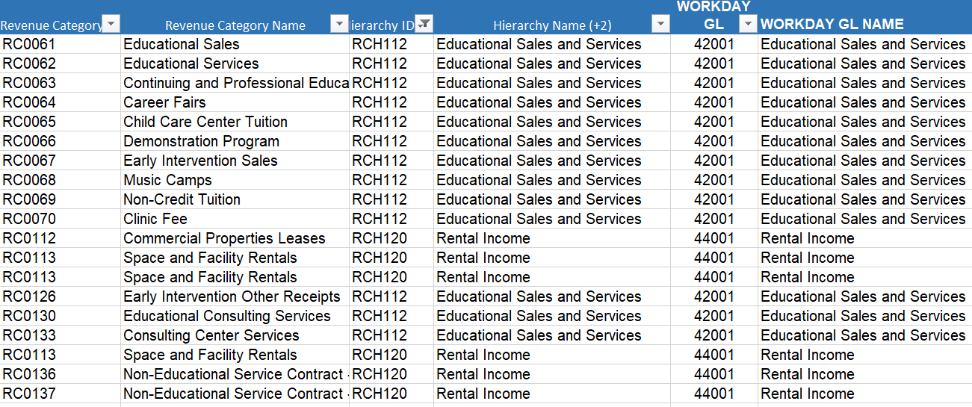
Revenue Category To Ledger Account
Rev Category Ledger Account
Users select the revenue category and Workday derives the ledger account
Notes:
Revenue Categories in Workday are equivalent to detail codes in PeopleSoft. If a user selects a revenue category Workday will derive the ledger account. For example there are 13 different revenue categories that map to one Educational Sales Revenue Hierarchy which maps to one ledger account. This is also the same for rental income and athletic revenue.

Slide 12
Procurement
Confirmation Session
June 13, 2019

Slide 13
Procurement Agenda
Key Concepts
Benefits
Business Process/Approvals
Demo of Configuration
Create a Requisition
Spend Categories
Approvals
Issue a Purchase Order
Receipt of Goods or Service

Slide 14
Benefits
PEOPLESOFT (Current) | WORKDAY (Future)
No overview of Supplier Spend | One-stop Dashboard (spend/req/PO)
Limited reports | Access to detail reporting
No direct support links within the system | Link directly to Policies and Procedure and job aids
Category/Account Code - Manually input, search and select | Spend categories hierarchy – less errors, simple words
Follow your breadcrumbs | Keyword search
Notes:
This slide shows some of the highlights that Workday brings to MSU.
The left side shows the features of PeopleSoft, the right side is Workday.
Reporting – more views, and specific details
Links – information contained within the system itself
Codes - Two different codes from two different systems vs Unified codes in this system

Slide 15
New Terminology
PeopleSoft | Workday
Requisitioner | Requester
Requisition | Create Requisition
Purchasing Methodologies | Requisition Types
Special Requests | Request Non-Catalog Items
Dispatch PO | Issue PO
Punch-Out | Connect to Supplier Website
Receive | Create Receipt
Voucher Invoice | Invoice
Returns | Returns
Payment | Payment
Category | Spend Category
Quick Invoice | Supplier Invoice Request
Lifecycle | Process
Notes:
New Terminology – left vs right
Three examples
If not exact, then similar terms

Slide 16
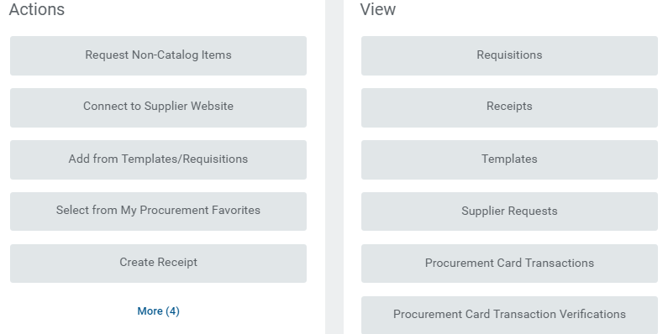
Procurement Application Screen
Notes:
Application Screen
Actions vs View - What you can do and how you can find it
Similar to Human Resources requests for time….

Slide 17
Procure to Pay Workflow
Supplier
Requisitioner
Cost Center Manager
Cost Center Manager does not approve gifts
Grant Accounting
Information Technology
Print
Project Manager
Chemicals
Gift Manager
There can be multiple Special Approvers
NEW
Spend Category Buyer
Procurement Directors
Vice President of Finance (Contract Authority)
Vice President of Finance (Contract Authority) & University President
NEW
Reqs ≥ $33,300
Reqs ≥ $500,000
Reqs ≥ $1,000,000
PO Created/Issued
Create Receipt
Invoice
Payment
Notes:
Workflow
Speak to the process and highlight the NEW areas (Starred)
Two new special approvers – chemicals and gifts
AND President now approvers anything $1 Million and more

Slide 18
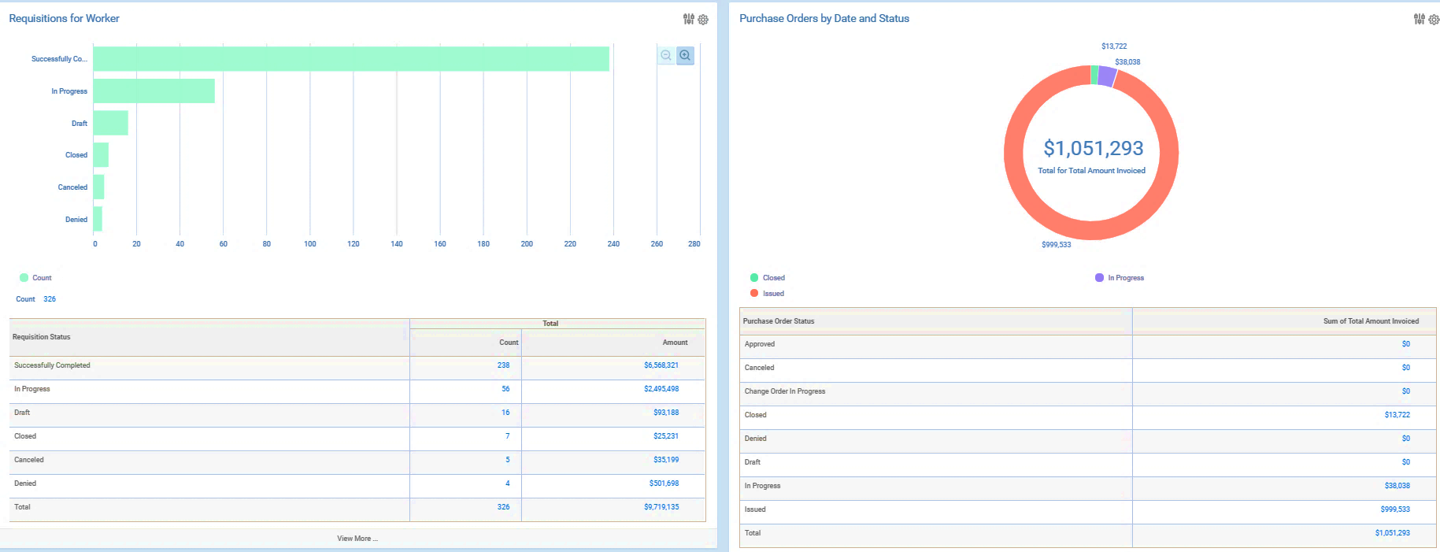
Requester’s Dashboard
Notes:
Dashboard
Glimpse into the requesters dashboard

Slide 19
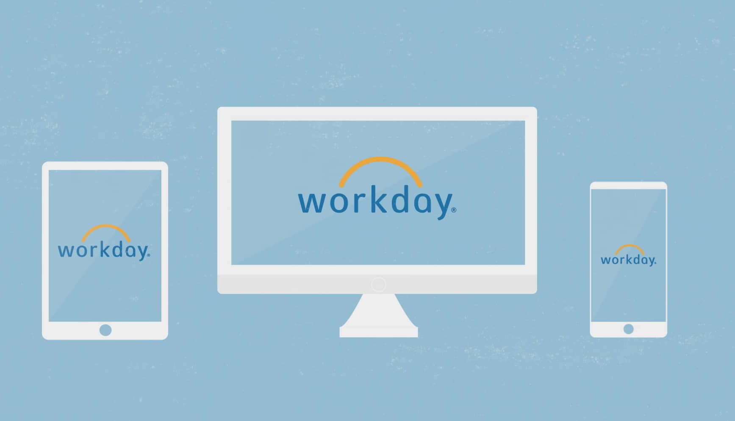
Demonstration
Notes:
Let’s get started with the demo. We do have limited time. However, if you have a question regarding something we are demonstrating, please stop us.

Slide 20

Questions

Slide 21
Helpful Links
https://www.montclair.edu/information-technology/workday-2020-project/
Notes:
Have a Role
Have a Support Model

Slide 22
THANK YOU!
Please complete the survey
Montclair.edu/workday-2020-project

