Slide 1
Workday 2020 Finance Preview
Foundation Data Model Overview
Budgets
Procurement
Expenses including Travel
Grant Reports

Slide 2
A Preview Session is

An Introduction to Workday key concepts
A demonstration of the system configurations of business processes that have been built so far
A visualization of the system for the end users
An opportunity for you to see the features of the system and share that information with your colleagues
Notes:
A Confirmation Session:
Introduces Workday key concepts
A demonstration of the system configurations of business processes that have been built so far
Provides you, as an end user, with a visualization of the system
Opportunity for you to see the features of the system and share that information with your colleagues

Slide 3
A Preview Session is not

Time for redesign
Formal testing
Validating customer data
Training of SME’s or any other Customer staff
Notes:
A Confirmation Session:
Introduces Workday key concepts
A demonstration of the system configurations of business processes that have been built so far
Provides you, as an end user, with a visualization of the system
Opportunity for you to see the features of the system and share that information with your colleagues

Slide 4
PeopleSoft Chart of Accounts vs Workday Foundation Data Model (FDM)
PEOPLESOFT (Current) | WORKDAY (Future)
Department | Cost Center
Fund | Fund
Account | Account (higher summarized level for budgeting)
Project (Capital or Grant) | Project (Capital or Grant)
 | Program (NACUBO categories used in external reporting & will always default in)
 | Revenue or Spend Category (details)

Slide 5
Ease of Use Features
Driver Worktags
Inherited & Related Worktags
Revenue & Spend Categories
Notes:
For those not familiar The FDM is a set of codes used to classify & record financial transactions. Under PeopleSoft Financial Management System we had a very simple chart using only fund account and department. With Workday the quantity of financial attributes has been expanded to allow for improved financial management & reporting. Workday refers to these attributes as Worktags.

Slide 6



Worktags
Cost Center
Division
Fund
Program
Expense Items
Project
Drivers
Related
& Optional
Location
Gift
Activity
Grant
Spend Category
Revenue Category

Slide 7
Budget Overview
Budget concepts and procedure will remain the same
Budgets checked against pool
Online transfers in Workday with approval routing
Budget planning will remain in Adaptive
Same schedule and procedure – new chart of accounts
Budget reports
Variance report – subtotal by pool, drill down functionality
Example - R002 Budget Variance – shows parent and child level data

Slide 8
Procurement Overview
PEOPLESOFT (Current) | WORKDAY (Future)
No overview of Supplier Spend | One-stop Dashboard
Limited reports | Access to detail reporting
No support links | Link directly to Policies and Procedure and job aids
Category/Account Code - Manually input, search and select | Spend categories hierarchy – less errors, simple words
Follow your breadcrumbs | Keyword search

Slide 9
Procure to Pay Workflow
Supplier
Requisitioner
Cost Center Manager
Cost Center Manager does not approve gifts
Grant Manager
Information Technology
Print
Project Manager
Chemicals
Gift Manager
There can be multiple Special Approvers
NEW
Spend Category Buyer
Procurement Directors
Vice President of Finance (Contract Authority)
Vice President of Finance (Contract Authority) & University President
NEW
Reqs ≥ $34,400
Reqs ≥ $500,000
Reqs ≥ $1,000,000
PO Created/Issued
Create Receipt
Invoice
Payment

Slide 10
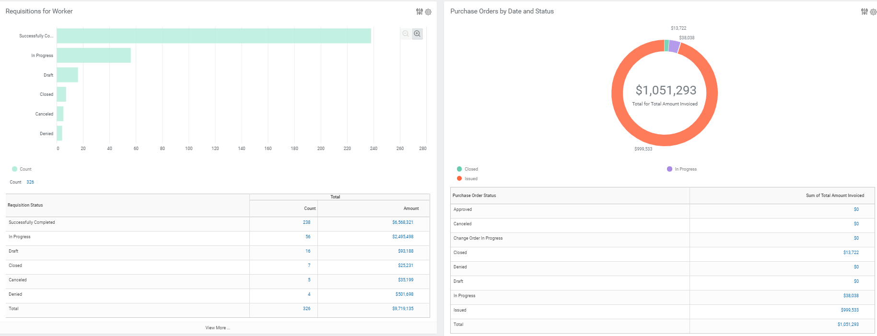
Requester’s Dashboard

Slide 11

Demonstration
Notes:
Let’s get started with the demo. We do have limited time. However, if you have a question regarding something we are demonstrating, please stop us.

Slide 12
Expense Reporting Overview
PEOPLESOFT (Current) | WORKDAY (Future)
Complete manual authorization form & obtain signatures (TR-1) | Approvals are online
Collect & scan paper receipts | Spend Authorization encumbers funds when submitted
Prepare expense report spreadsheet (attach receipts) | Manage receipts as they are acquired quickly and easily: Snap a photo Upload online or via mobile device
Obtain manual signatures for Expense Report | Online spend authorization links to the Expense Report
Manually search for per diem meal and mileage rates, must provide screenshot as attachment | Meals per diem for domestic city & mileage rates auto-populate
Notes:
Snap a photo or upload receipt either online or via mobile device with visibility into automated workflow approvals

Slide 13
New Expense Report Features
Per Diem cash advance options on Spend Authorizations
Business purpose field allows for reporting
Auto approval routing for International Travel
Payment election options
Prepare reports on behalf of non-workers and employees
Corporate travel card data auto-populates in system
Notes:
University compliance policy is embedded in the system through custom validations of:
Required documents (TR-1/Spend Authorizations, supporting attachments)
Per diem rates
Approval flows – domestic vs international
System messages for missing/incorrect data

Slide 14
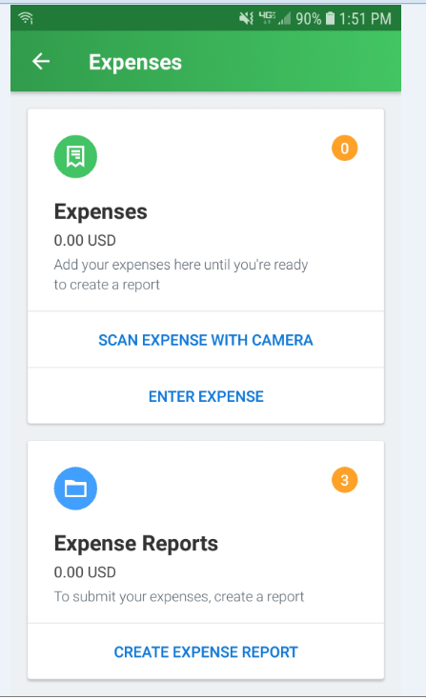
Mobile Application View
Notes:
Let’s get started with the demo. We do have limited time. However, if you have a question regarding something we are demonstrating, please stop us.

Slide 15
Grant Report Example
Grant Dashboard – overview information for grants
Grant Summary Report

Slide 16
Questions?
Email - workday2020@Montclair.edu
Website - Montclair.edu/workday-2020-project.

