Slide 1

Montclair State University CITI Registration Instructions
Contact:
Allisun Romain, Compliance Coordinator
(973) 655-7785
romaina@montclair.edu

Slide 2
Registration Instructions for
New Users

Slide 3
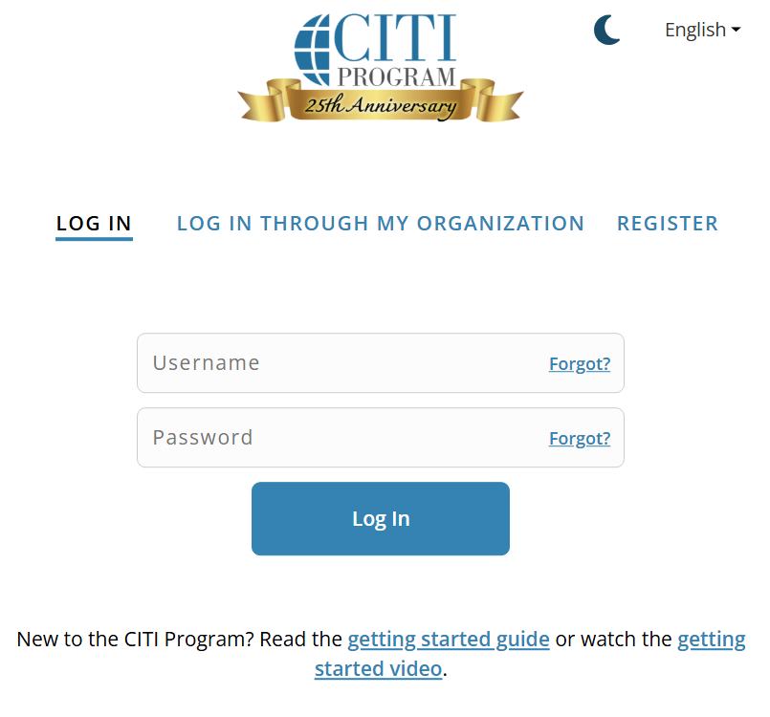
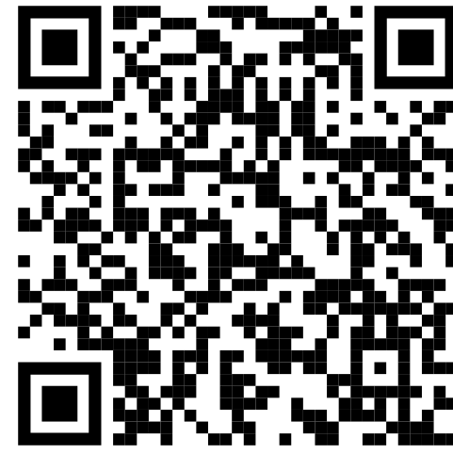
Getting Started
You can can reach the CITI homepage by pasting the following into your browser:
https://www.citiprogram.org/index.cfm?pageID=14&languagePreference=English&region=1
…or scan here!
This is the CITI login page. Toggle over the “Register” tab to create a new account.
…or scan here!

Slide 4
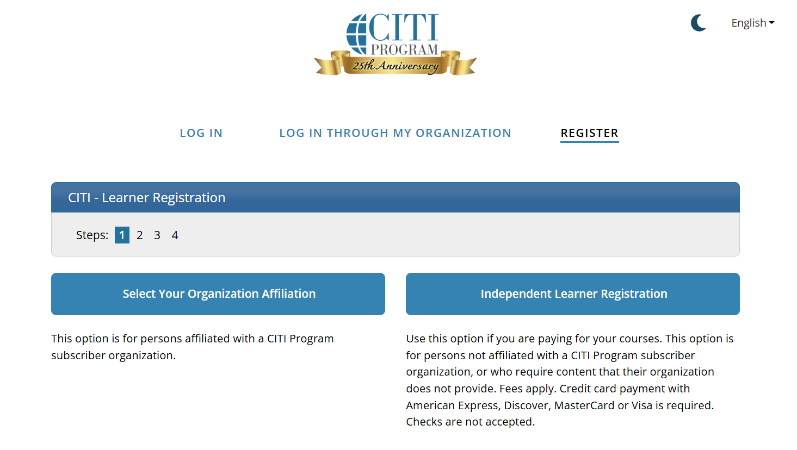
Click here to search for Montclair State University.

Slide 5
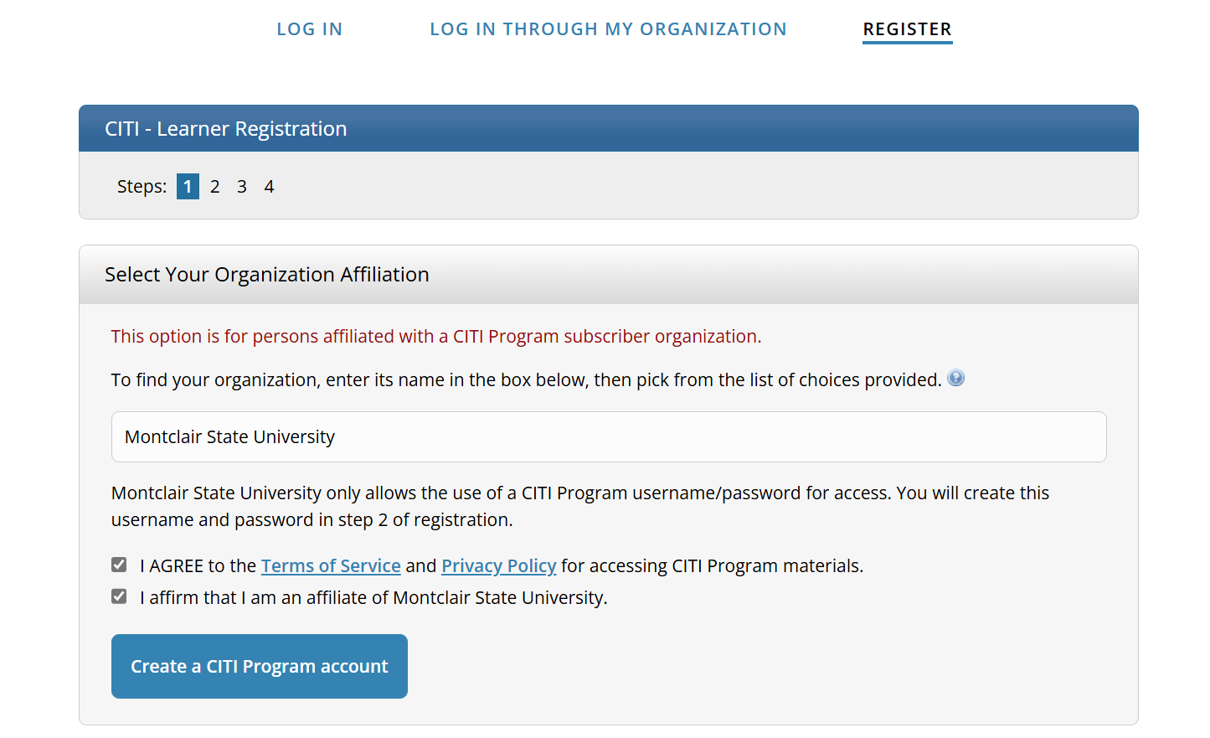
Search and select Montclair State University.
Check off both boxes.

Slide 6
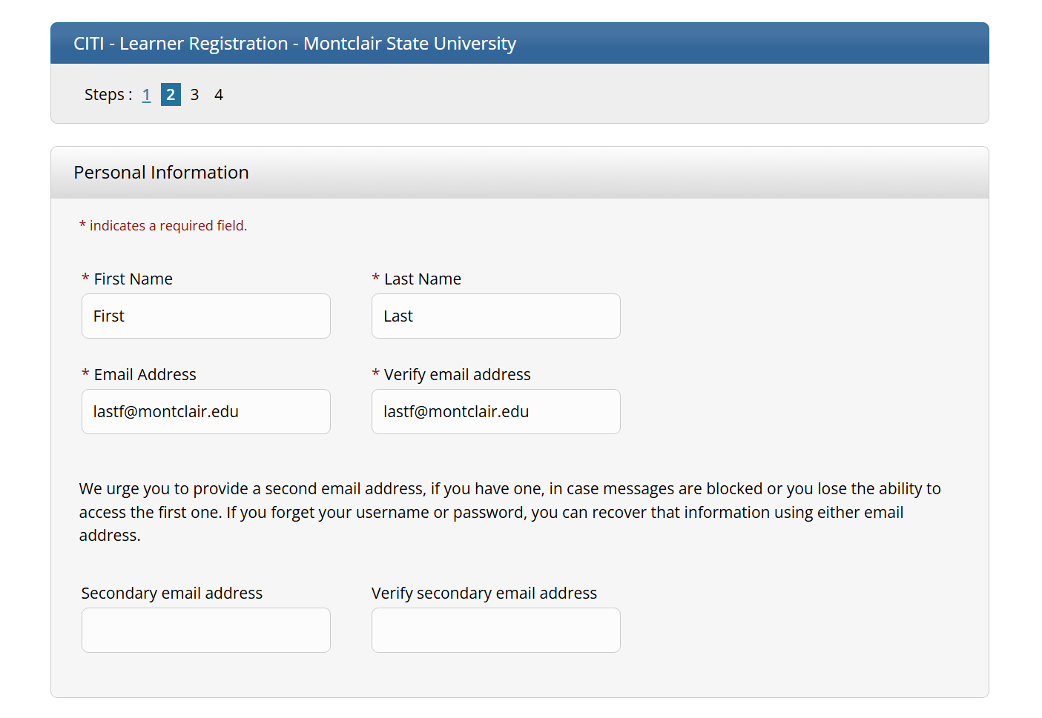
Enter your first name, last name, and email address. The email address you enter here should be your Montclair email address.
You may enter a personal email address here.

Slide 7
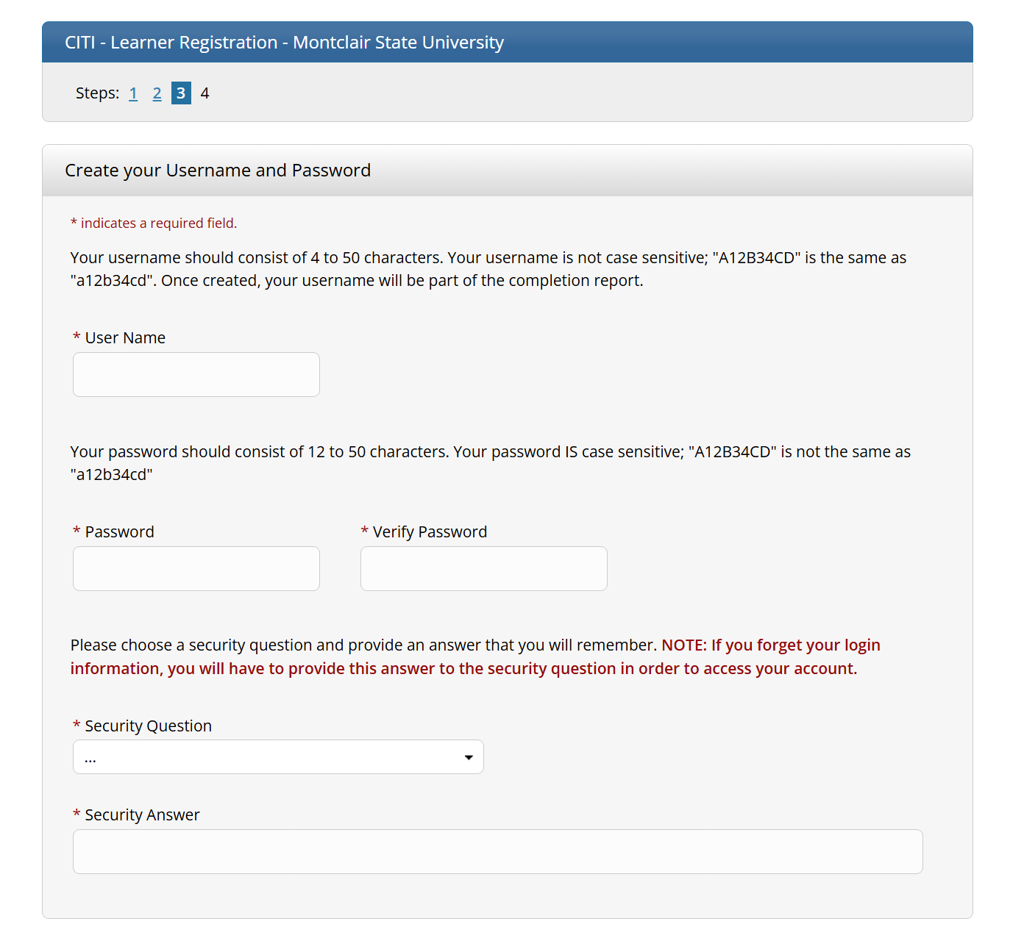
You must create a username and password that you will use to login to CITI.
Although it is not mandatory, we suggest making your username your Montclair netID.
Please also select a security question and enter an answer that you will remember.

Slide 8
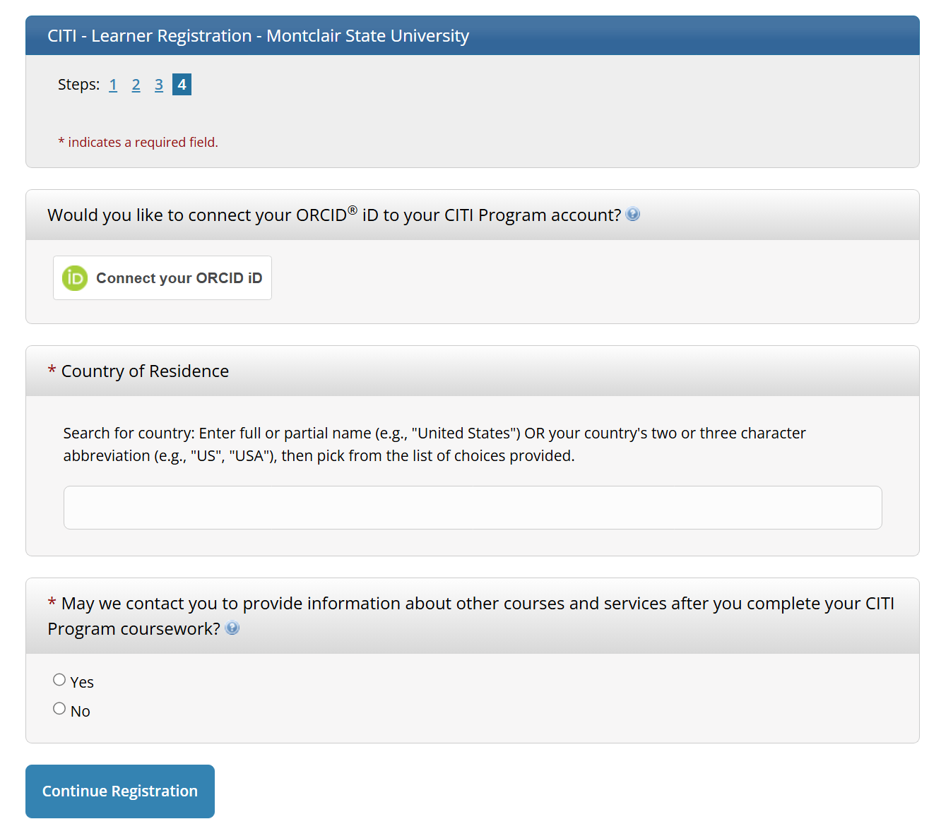
You can ignore this (unless you have an ORCID account that you’d like to connect).
Enter your country of residence.
Choose your contact preferences.

Slide 9
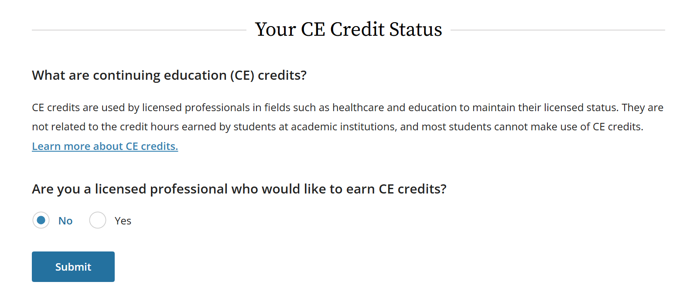
Select “No.”

Slide 10
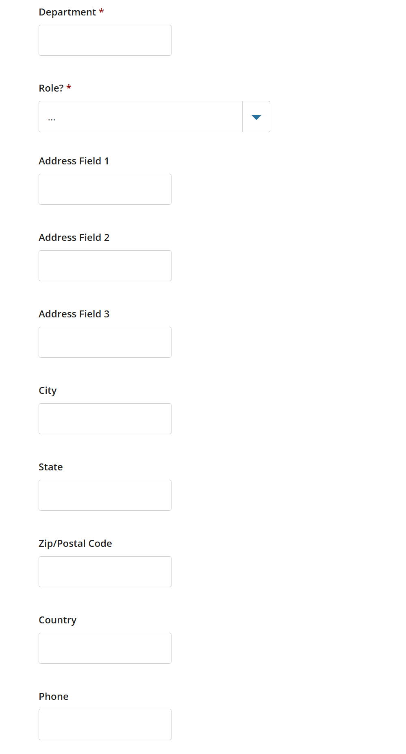
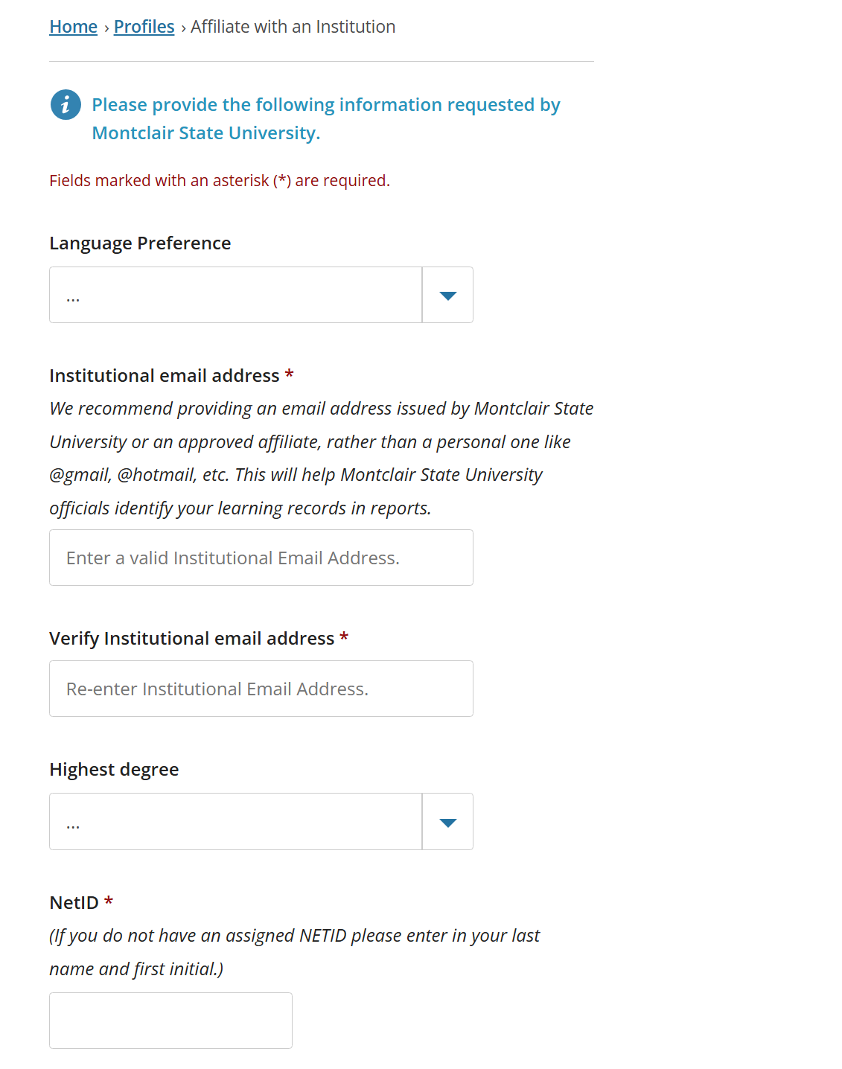
Select your language preference.
Once again, enter and verify your Montclair email address.
Select your highest earned degree at time of account registration.
Enter your Montclair netID.

Slide 11
Enter your information. Only the sections with a red asterisk are mandatory.

Slide 12
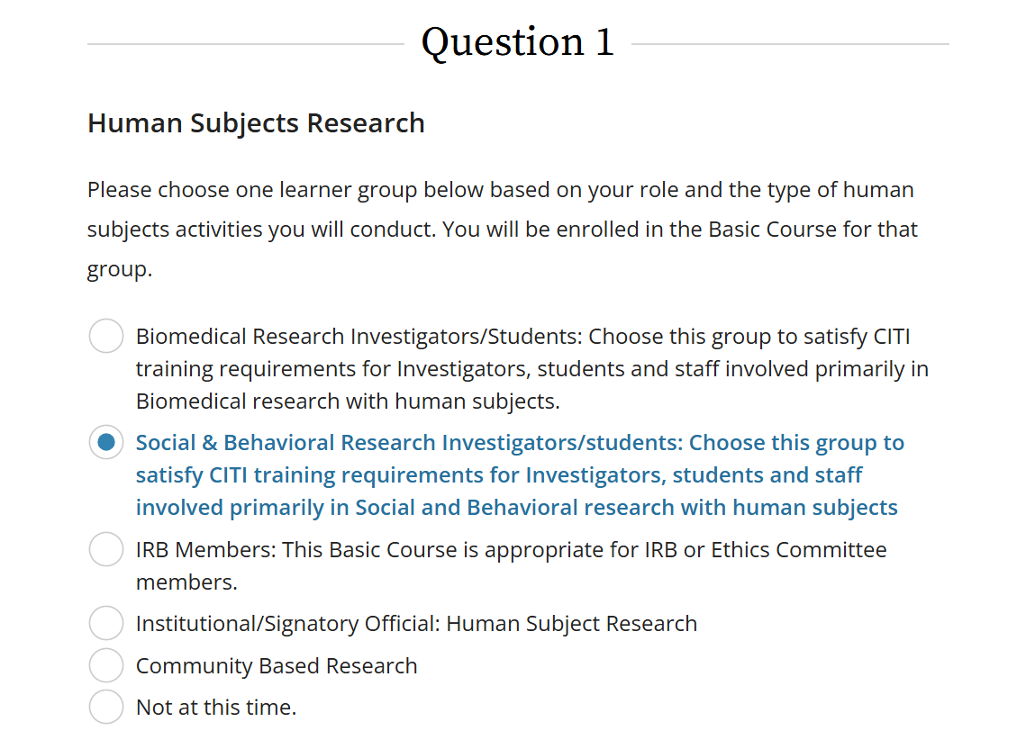
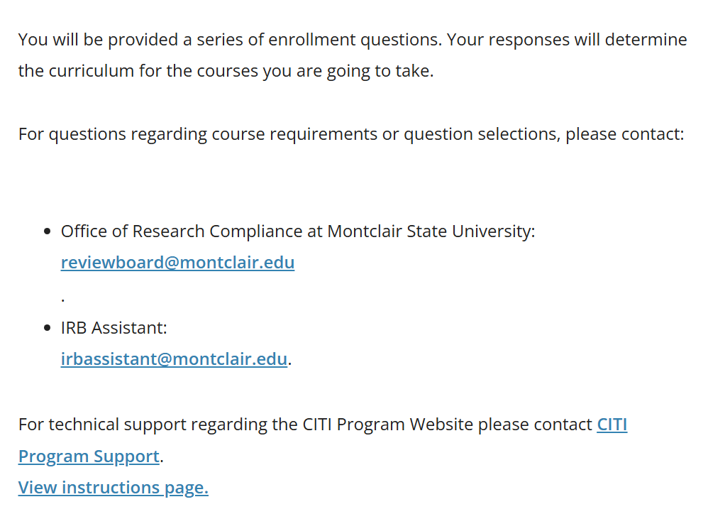
This page will determine what CITI courses you register for. The IRB requires you to complete only one course, which is circled in red above. However, you are free to select as many courses as you’re interested in taking, although many may not pertain to your area of research.

Slide 13
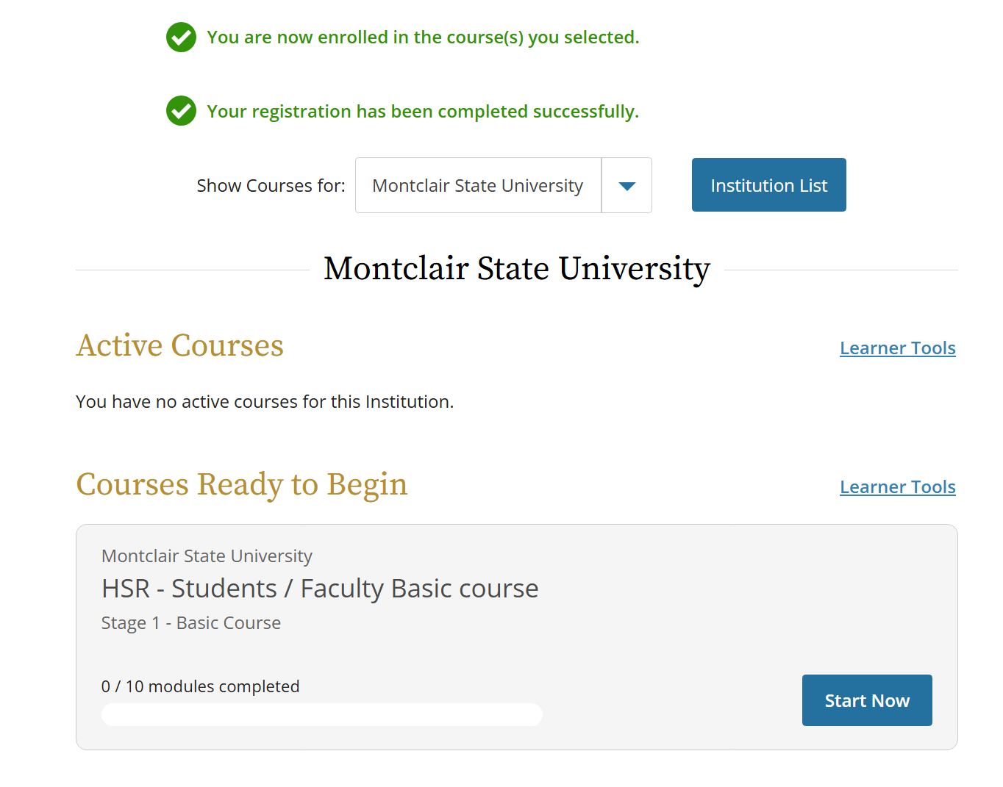
Once you register for the Social Behavior HSR course (and any other courses you choose to take), you will be taken to your course dashboard, where all of your courses ready to begin will appear. Please note that the “HSR - Students/Faculty Basic course” is the IRB required course, and thus the first course you should complete. It is made up of 10 modules.
Once all modules are completed with a final passing score of over 80%, you will have the opportunity to download both your completion report (transcript of course work) and your completion certificate (“diploma” to reflect course completion).

Slide 14
Registration Instructions for
Returning Users

Slide 15
For Returning CITI Users (if you previously had a CITI account affiliated with another institution)
You can can reach the CITI homepage by pasting the following into your browser:
https://www.citiprogram.org/index.cfm?pageID=14&languagePreference=English&region=1
This is the CITI login page. Toggle over the “Log In” tab to log into CITI using your previous institution’s credentials.
…or scan here!

Slide 16
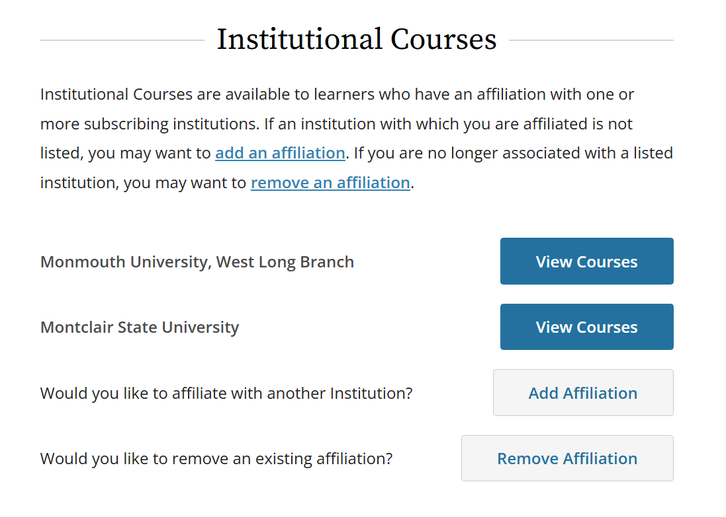
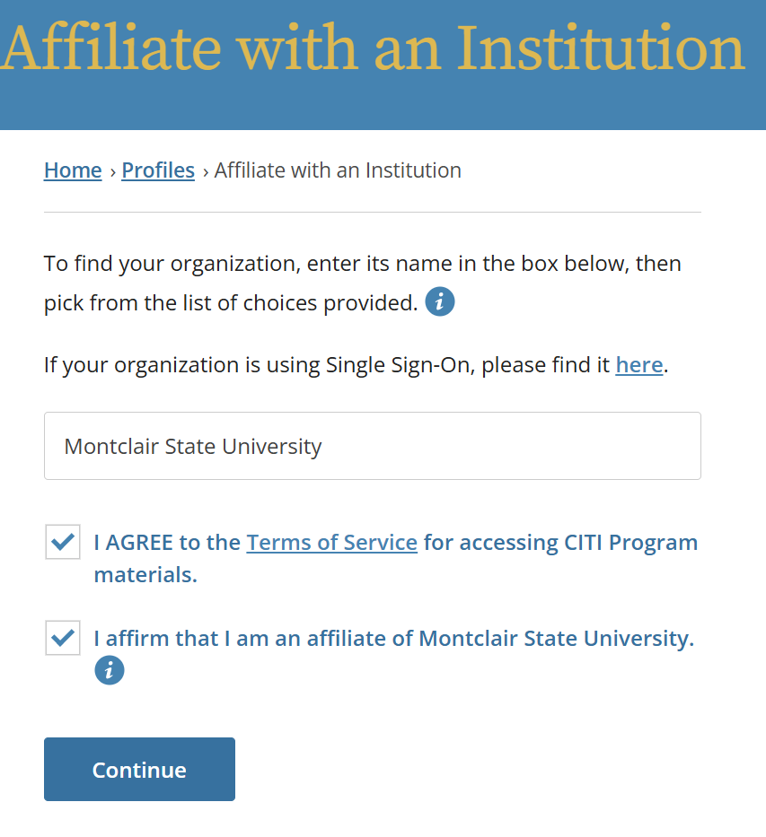
Your dashboard will display all of the institutions you are affiliated with, as well as the courses you are registered for/have completed within each. To add Montclair as an institution, select “Add Affiliation,” search and select Montclair State University, and check off both boxes as seen above.

Slide 17

Completing your Montclair Affiliation…
Once you affiliate with Montclair, you will not have to reset your CITI login information. However, you will have to enter some basic contact information, as well as register for courses. Please refer to previous slides for instructions. If you have already completed a Social/Behavioral Human Subjects Research course as a part of your previous institution, you will still need to complete Montclair’s required training in order to conduct research.

Slide 18
Other CITI Tips
You do not need to complete all 10 modules of the required course at the same time - CITI will remember where you left off if you log out and wish to complete the course at a later time
You only need to complete the required modules
Based on the type of research you are doing, additional modules may be assigned to you at a later date by the IRB
You need a combined overall score of 80% for all modules in order to pass the course
You can retake any single module that you get a low score in

