Slide 1
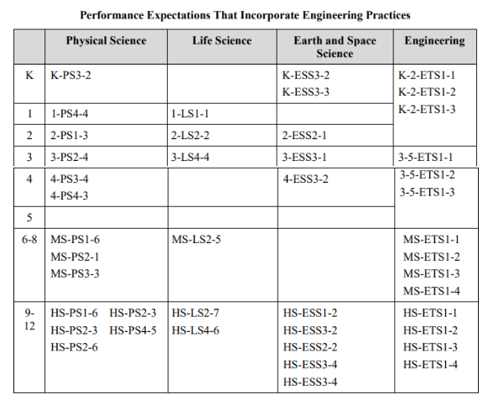
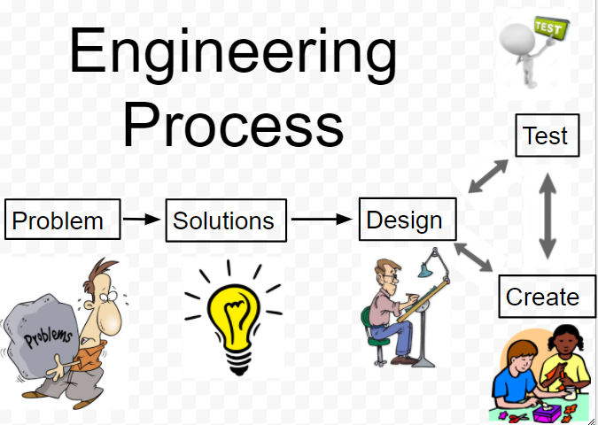
Title: K-8 NGSS Aligned Engineering Design Projects
Join us to see multiple K-8 engineering design projects that have been implemented over the last 3 years. These projects will provide you with ideas and context for us to discuss how to incorporate engineering design into your classroom. You will be supplied with classroom materials for the projects that are shared. Project Topics will include: Stormwater Runoff, Ocean Plastic Pollution, Air Pollution and Erosion Control Measures.

Slide 3
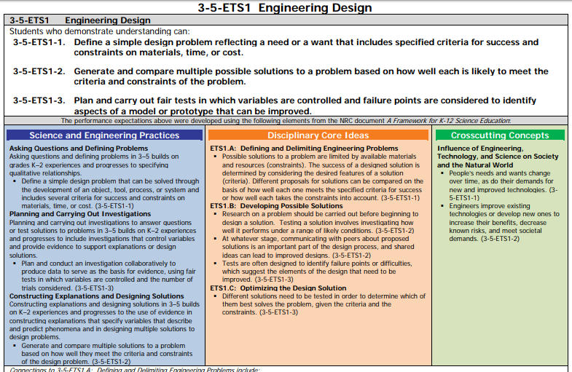

Slide 4
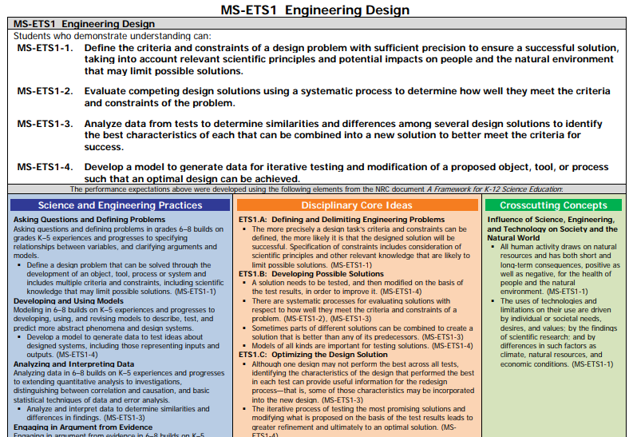

Slide 6
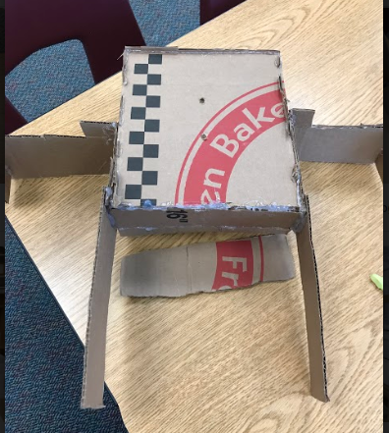
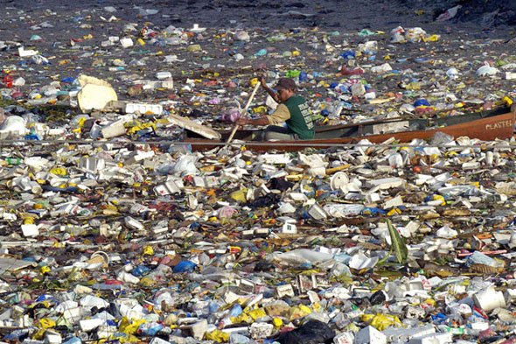
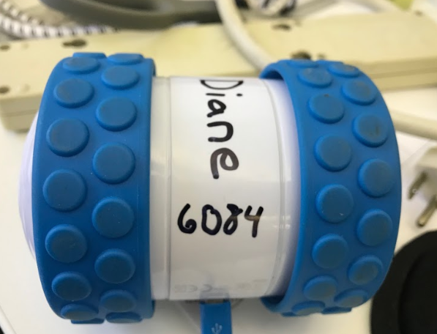
Plastic Bots
5th Grade and Middle School NGSS Aligned
Thank you Franklin Lakes Middle School Teachers

Slide 7
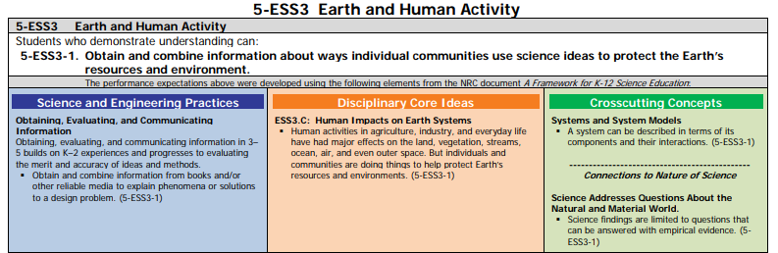

Slide 8
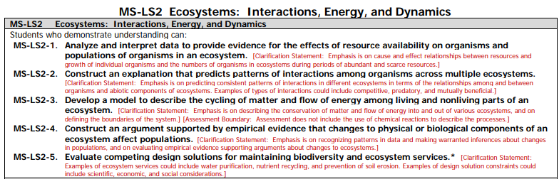

Slide 9
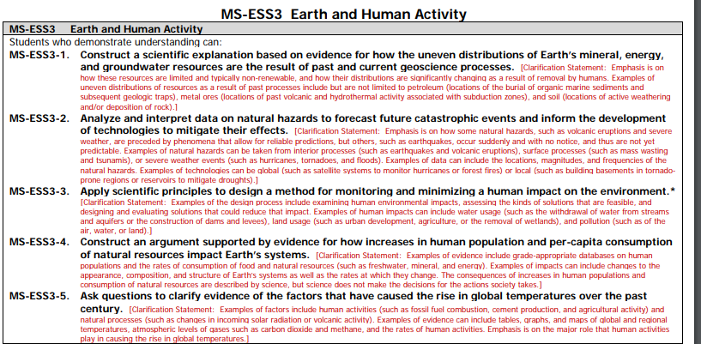

Slide 11
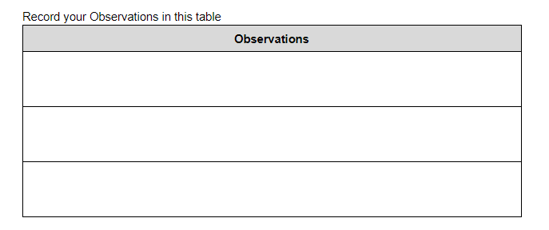

Slide 13
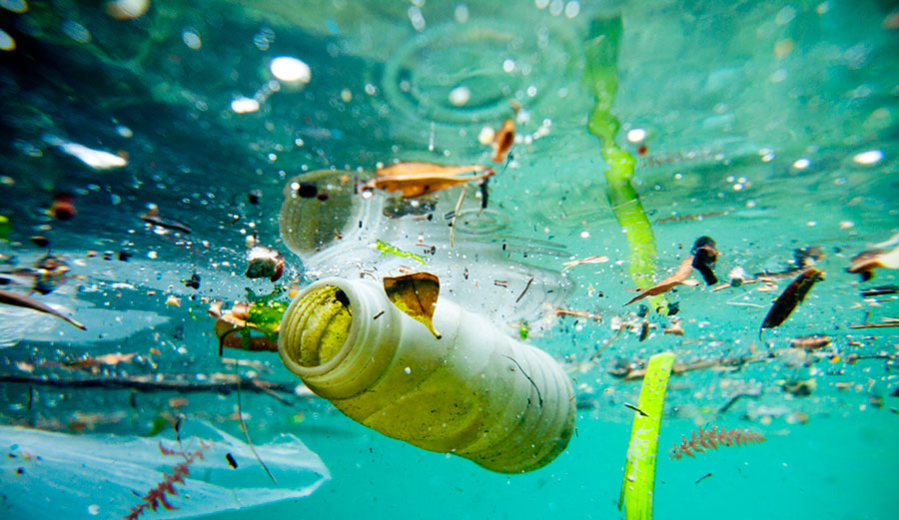

Slide 14


Slide 15
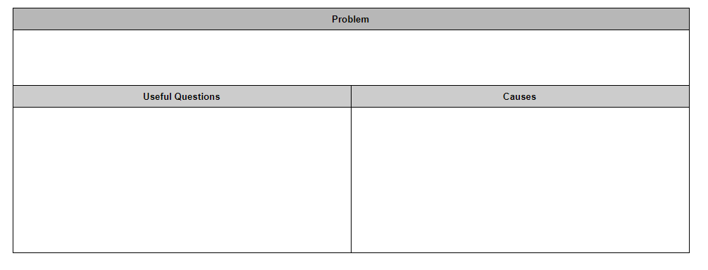
Plastic heavily pollutes the world’s oceans.

Slide 17
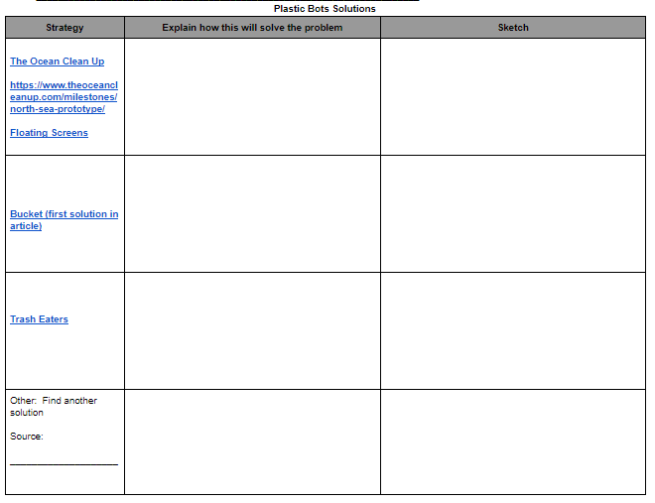
Notes:
Click on the link for resources that will help the students learn about the current solutions that exist. Students can also search for additional resources or other solutions.

Slide 19
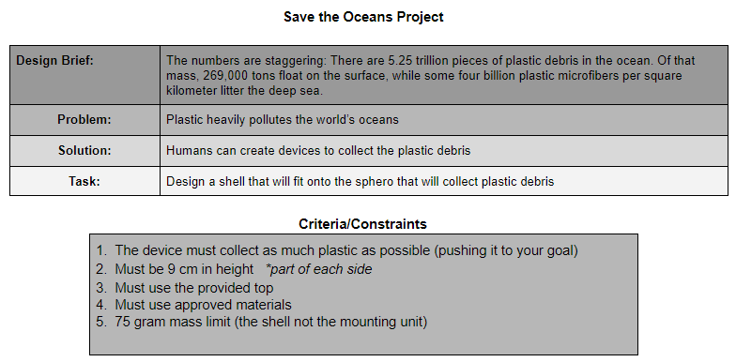

Slide 20
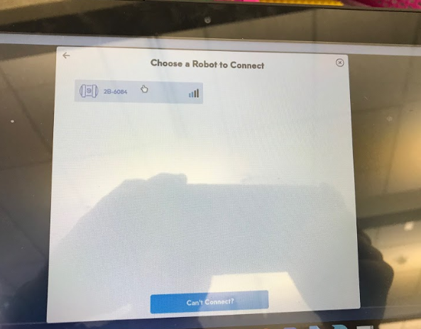

Slide 21
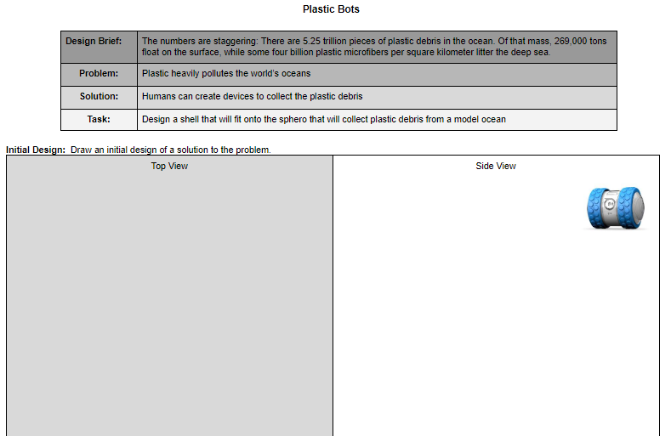

Slide 22
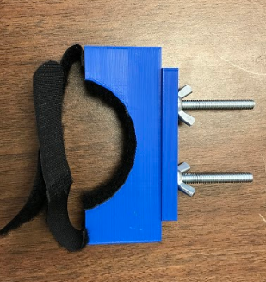

Slide 23
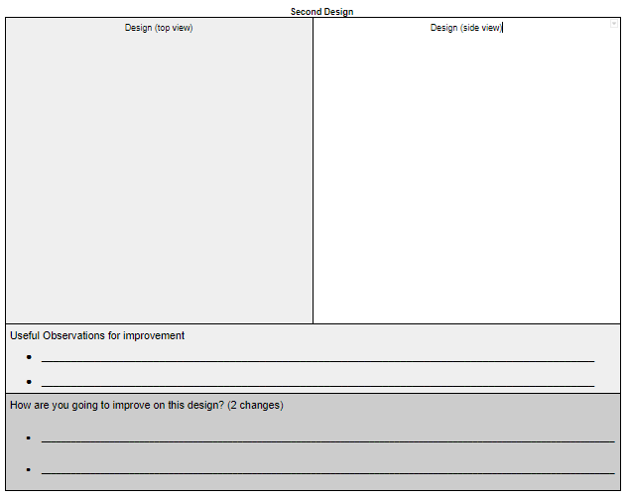

Slide 24
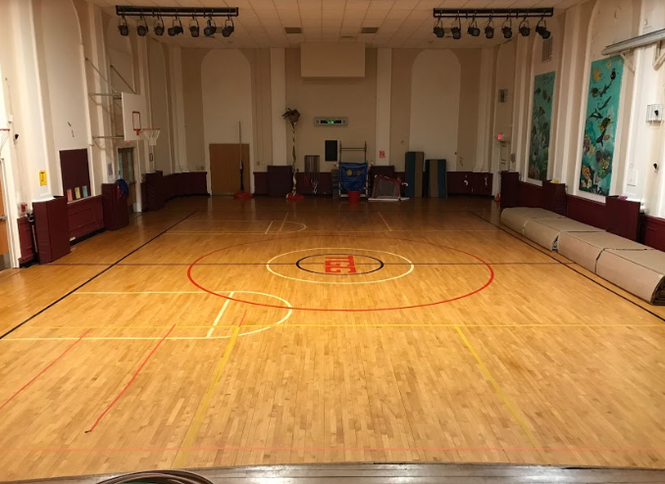
https://drive.google.com/open?id=1pKI8HilVsIjGf4e14afGJtVJqxCE1y-D

Slide 25
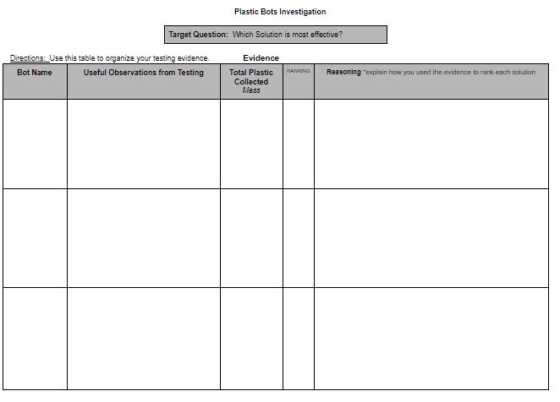

Slide 26
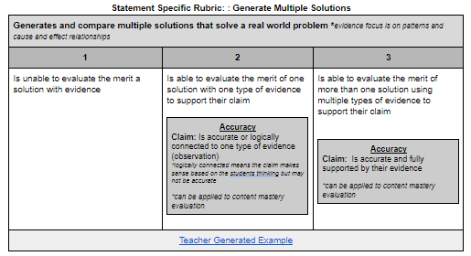

Slide 27
https://drive.google.com/open?id=1pKI8HilVsIjGf4e14afGJtVJqxCE1y-D

Slide 29
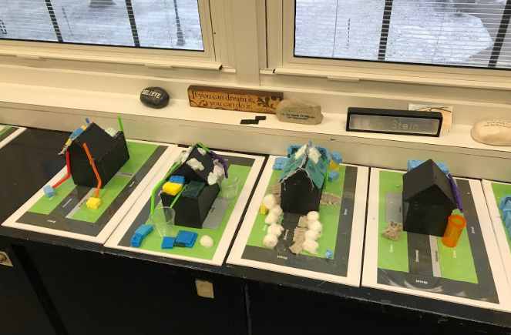
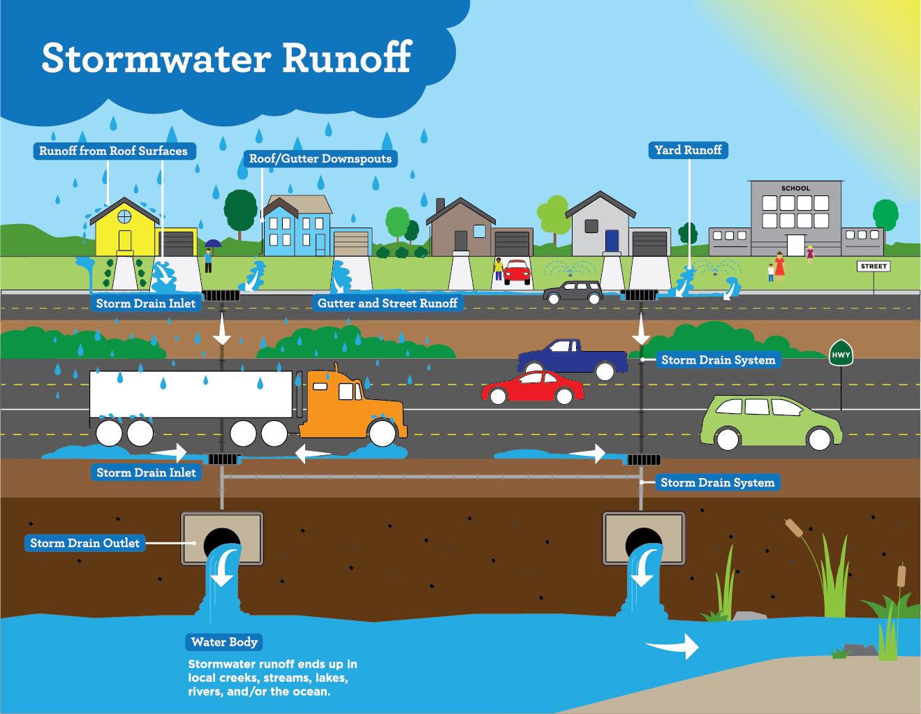
Stormwater Runoff
4th Grade and Middle School NGSS Aligned

Slide 30
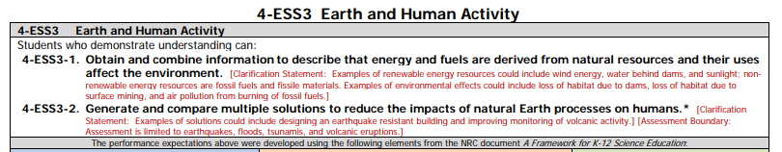
Stormwater Runoff Project

Slide 31
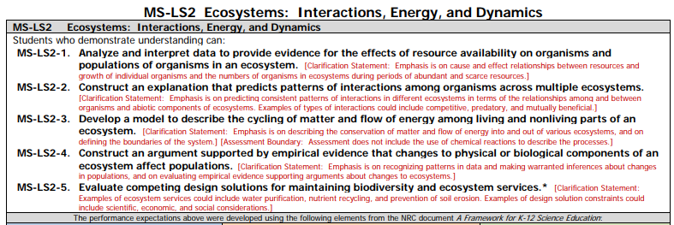
Stormwater Runoff Project

Slide 34
4th Grade
Human engineered systems move water quickly to waterways which increases the risk of flooding.

Slide 35
Middle School
Human engineered systems move water quickly to waterways which has a negative impact on local stream biodiversity.

Slide 37
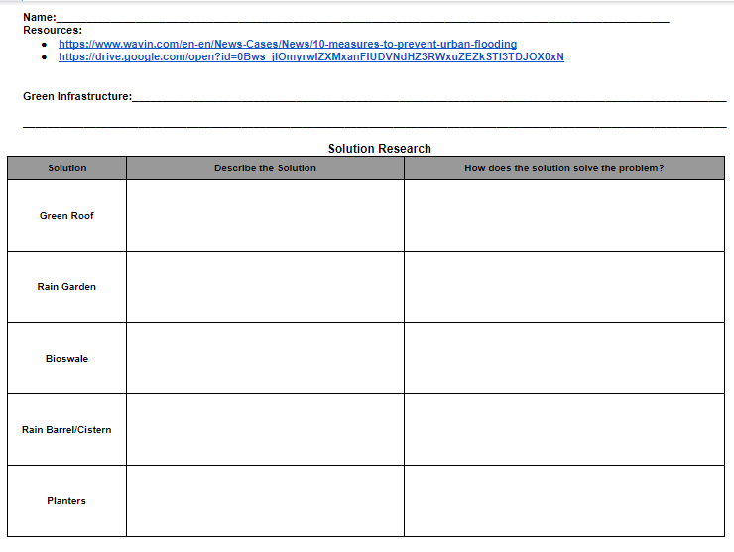

Slide 39
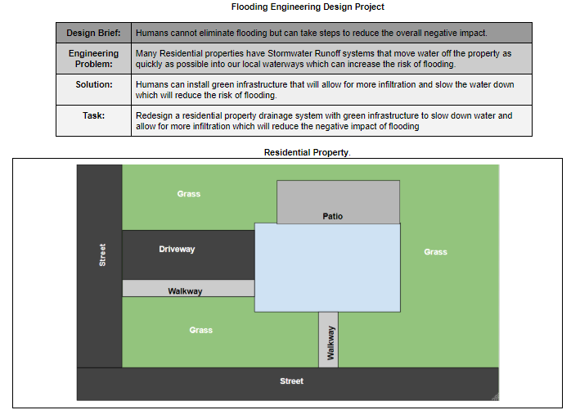

Slide 40
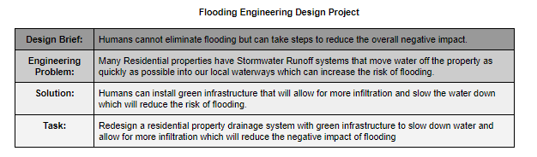
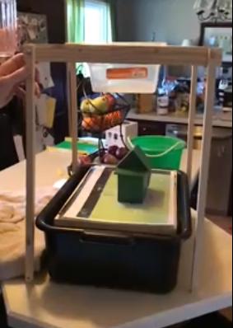
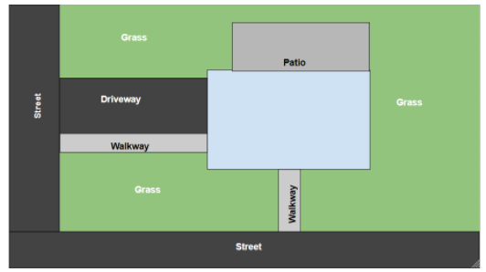
Testing Video
Model Break Down

Slide 41
House goes here!

Slide 42
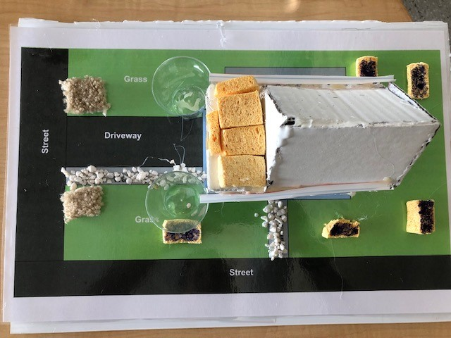
Planters
Cistern
Rain
Gardens
Green Roof
Permeable Pavements
Cistern

Slide 43
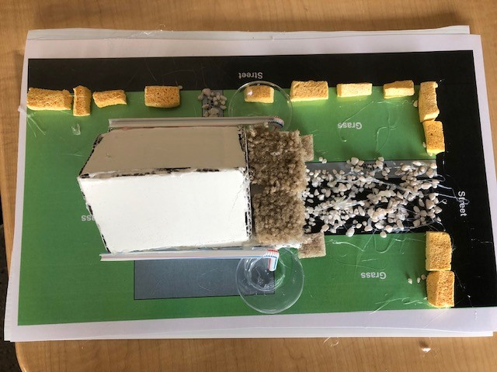
Erin, Saaketh, and Katelyn
Rain Garden
Rain Barrels
Permeable Pavement
Green Roof
Planters

Slide 45
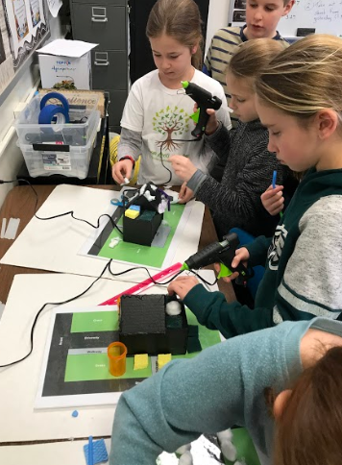
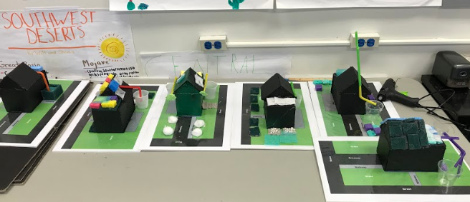

Slide 46
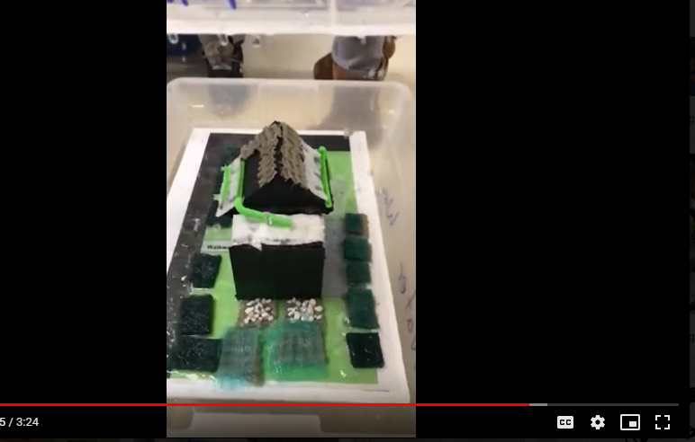
https://drive.google.com/drive/my-drive

Slide 47
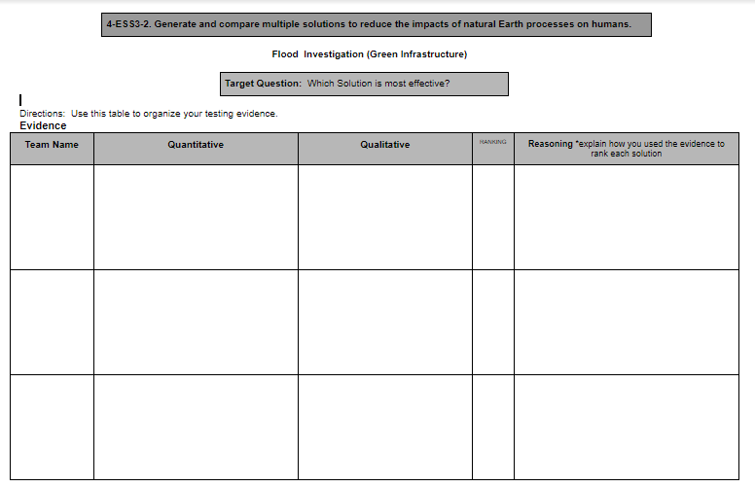
The water hitting the roof of the house was captured by a rain barrel
This group was most effective because...
Hunter
950 ml
R
A
N
K
Record evidence from these teams

Slide 48
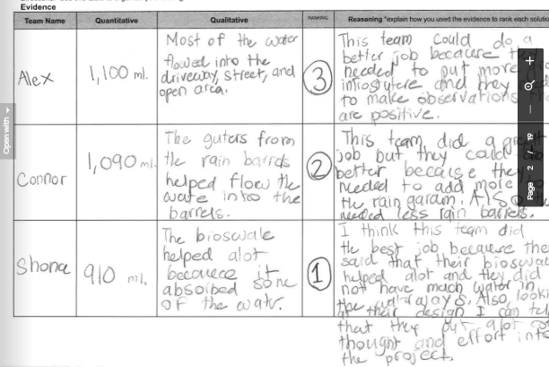

Slide 50
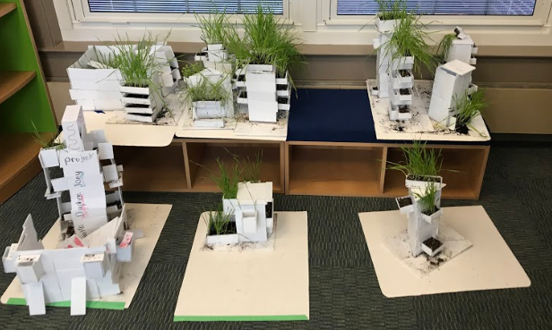
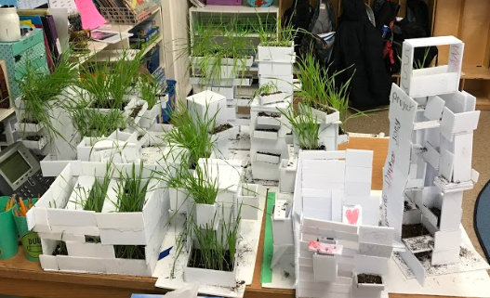
Air Pollution

Slide 53
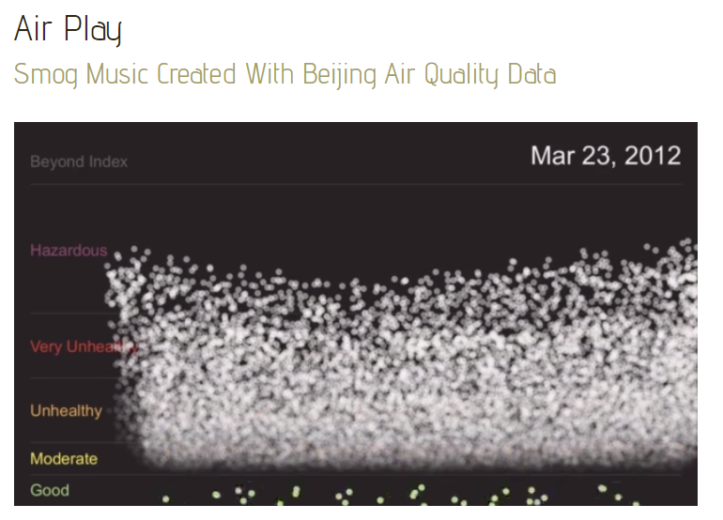
https://datadrivendj.com/tracks/smog/

Slide 54
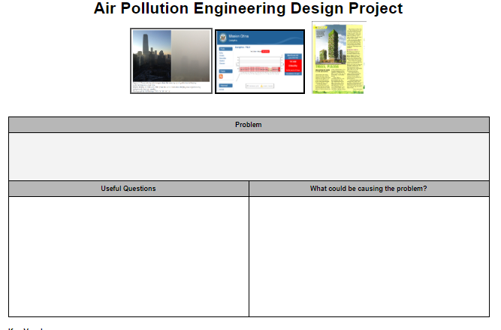

Slide 55
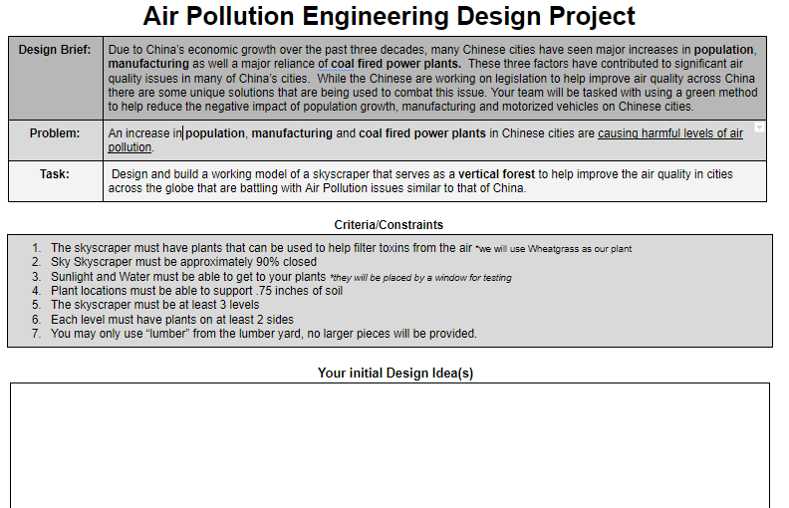

Slide 56
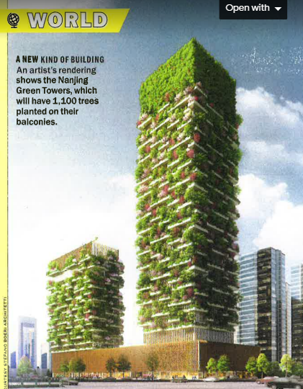
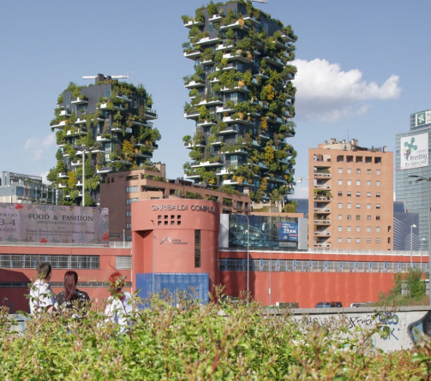

Slide 57
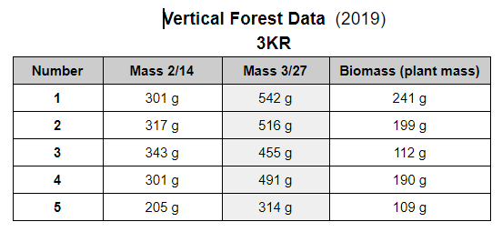

Slide 58
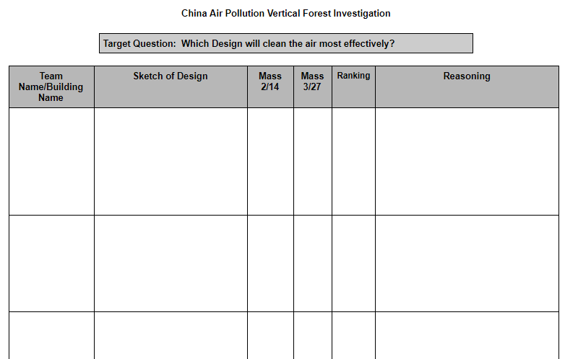

Slide 60
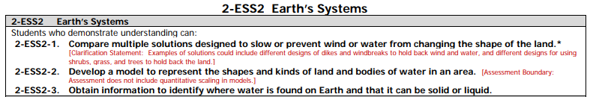
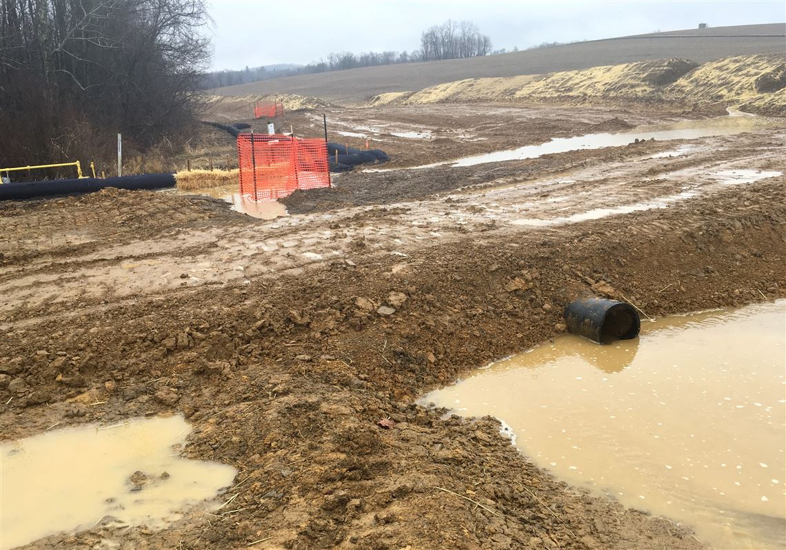
Erosion Control Methods

Slide 61
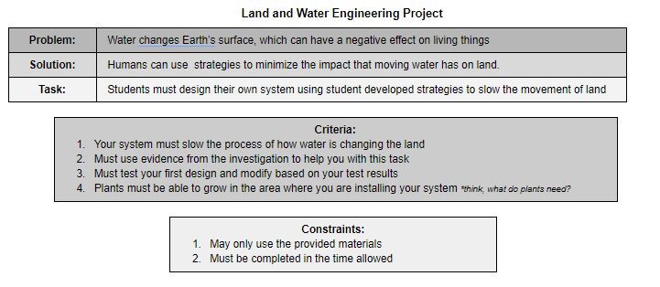

Slide 62


Slide 63


Slide 65


Slide 66


Slide 67

Silt Fencing

Slide 68

Erosion Control Blanket

Slide 69

Mulch Sock

Slide 70


Slide 71



Slide 72


Slide 73


The Dam Project
Link to project

