Slide 1
Montclair State University
Affirmative Action
Requirements
Notes:
Explain why they are here, BEST METHODS

Slide 2
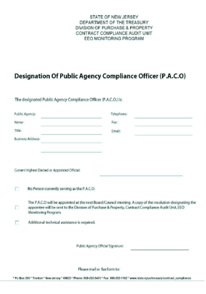


Public Agency Compliance Officer (P.A.C.O.)
Montclair State University’s P.A.C.O. is Barbara Milton, Director of Equal Opportunity, Affirmative Action and Diversity.
For capital projects the Director of Construction Procurement and Accounting will provide compliance guidance to the Office of Capital Planning and Project Management.
For the procurement of goods and services the Director of Procurement, Goods and Services maybe contacted.
Contracts
Notes:
Every year the University must formally designate a PACO by January 10th. This individual is responsible to ensure MSU is meeting AA requirements.

Slide 3
Affirmative Action
Strict adherence to the Affirmative Action law is critical to the public procurement process.
Why?
  The State of New Jersey and MSU support equal employment opportunities for qualified minorities and women
  Required by law
  Yearly Audits
  Penalties
Notes:
We will be charged $1000 per day for being out of compliance.

Slide 4
EEO/AA Procedures in Awarding Public Contracts
Public Agency
Include mandatory language in advertisements for receipt of bids, solicitations and/or request for proposals
Include appropriate mandatory language in contracts and bid specifications (In Waiver of Advertising Packet)
Obtain required EEO/AA evidence from supplier or contractor
Notes:
End User just sends AA language and obtains evidence.

Slide 5
EEO/AA Procedures in Awarding Public Contracts
Supplier
Goods, Professional Services, General Services Contracts
Subject to mandatory language of Exhibit A
Selected suppliers must submit one of the following forms of evidence:
  1. Copy of Letter of Federal Approval, or
  2. Certificate of Employee Information Report, or
  3. Complete Form AA-302 (Employee Information Report)
EEO/AA evidence must be submitted after notification of award, but prior to signing of the contract.
Notes:
Most users will follow this slide.

Slide 6
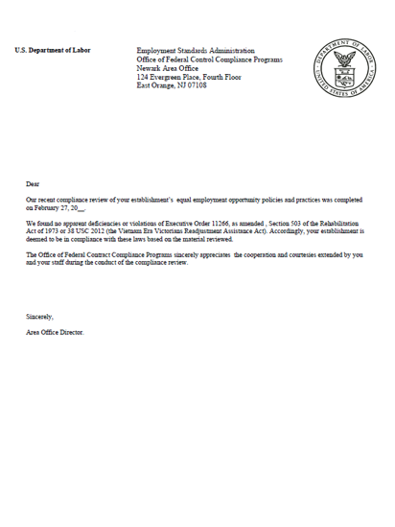
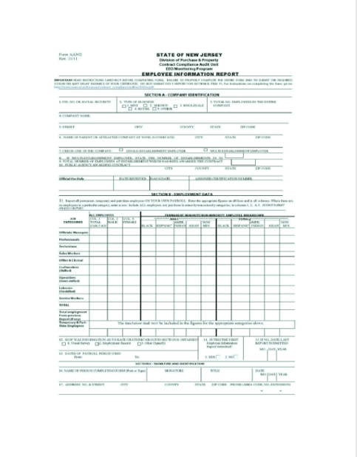
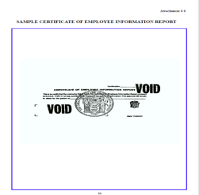

Affirmative Action Evidence
EMPLOYEE INFORMATION REPORT
FORM (AA-302)
FEDERAL LETTER OF APPROVAL
CERTIFICATE OF EMPLOYEE INFORMATION REPORT
Notes:
Employee Information Report is acceptable for the first contract/PO/cumulative $ over $33,000 after this a certificate must be obtained from the supplier.
Less than 50 employees the AA certificate is valid for 7 years. More than 50 the certificate is only valid for 3 years. Sole proprietors also file for a AA certificate.

Slide 7
EEO/AA Procedures in Awarding Public Contracts
Contractor
Construction Contracts
Subject to mandatory language of Exhibit B
Additional mandatory language EO 151 and P.L.2009, c.335 (State Agencies, Independent Authorities, Colleges & Universities Only)
Selected construction contractors must submit the following form of evidence:
  Complete Form AA-201 (Initial Project Workforce Report)
  Submit Form AA-202 (Monthly Project Workforce Report) once a month for the duration of the contract to the Dept. of Labor and to the Public Agency Compliance Officer
EEO/AA evidence must be submitted after notification of award, but prior to signing of a construction contract

Slide 8



EMERGENCY CONTRACTS
In an emergency, a Public Agency may award a contract without an approved affirmative action program.
Public Agency must document that an actual or imminent emergency exists and requires an immediate award of a contract for construction or the delivery of goods and services, including professional services, and to delay would endanger public health, safety, welfare, or property.
The contractor shall be required to comply with the EEO/AA regulations prior to receiving payment.
The Public Agency is required to provide the supplier with the appropriate language (Exhibit A or Exhibit B) and obtain the proper Affirmative Action evidence.
Notes:
These requirements are the same for all required documentation. PUBLIC HEALTH, SAFTEY, WELFARE OR PROPERTY…..

Slide 9

Training Fund Requirements
INDEPENDENT AUTHORITIES
Colleges and Universities
STATE AGENCIES
State agencies are required to allocate ½ of 1% of the total construction cost, equal to or greater than $1 million, towards a training fund.
State agency must forward the training funds to the department of labor and workforce development, immediately upon award of the contract.
It must also provide the division with a training fund letter certifying that the funds have been allocated and released to the department of labor and workforce development.

Slide 10
Sanction Process
If the results of an audit are found to be unsatisfactory, the Public Agency will be issued an advisement letter outlining the deficiencies.
If the Public Agency fails to take corrective measures, monetary penalties may be issued.

