Slide 1
FAITH BASED AND FEMINIST NGOs: FORGING A COMMON AGENDA
JULIA BERGER | University of Kent
MAHA MAROUAN | Pennsylvania State University
AMERICAN ACADEMY OF RELIGION ANNUAL CONFERENCE 2016
Notes:
-The title of my presentation is…
-My research looks broadly at the role of religion in international affairs—it asks the question: how do we understand this role? What normative assumptions shape our understanding of this role? And even the kinds of questions that we ask. Are there phenomena we might be missing, not seeing because the frameworks and assumptions we bring to the table don’t allow us to see them?
-In the paper I’ll be presenting this morning, I’ll be looking at the engagement of an NGO—active for a long time at the United Nations—the Bahá’í International Community’s UN Office, in the arena of gender equality. From a study of its 70 year engagement in this discourse I will distill insights that shed new light on the question of religious agency/ religious actors in international affairs.

Slide 2
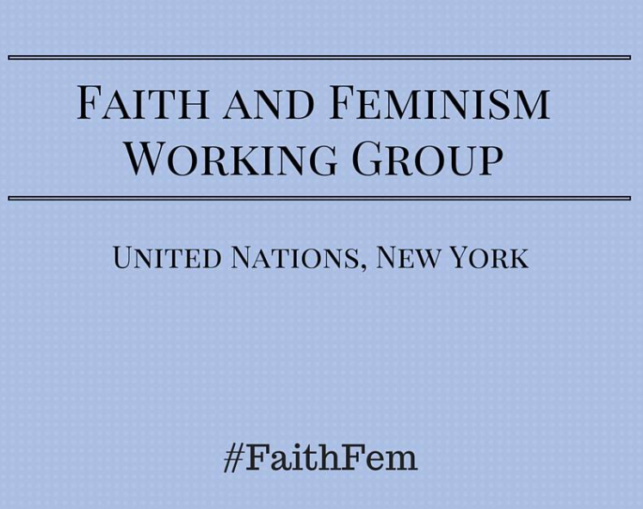
A NEW POLITICS OF ENGAGEMENT:
THE BAHÁ’Í INTERNATIONAL COMMUNITY, THE UNITED NATIONS, AND GENDER EQUALITY
Notes:
When I began looking at this field of religious engagement at the UN, in 2001 (14 years ago) – there was very little to go on, it hadn’t really been identified as a “thing” worthy of study. However, already at that time there were about 300 (depending on who you ask) religious organizations that the UN was formally associated with through its Economic and Social Council.
-But still, if you searched “religious NGOs” on google, you would get almost no hits.
-fast forward to 2015…
-research about religious actors in the international arena has grown rapidly over the last 15 years
-we’ve seen a re-awakened consciousness of religion in the public sphere and an effort to understand this phenomenon, which political scientists have ominously referred to as a “resurgence” of religion; some claim that the 21st century was “God’s century” in the sense that Religious organizations, individuals, leaders “enjoy greater capacity for political influence today than at any time in modern history—and perhaps ever."

Slide 3
The Faith and Feminism Working Group is a Civil Society led coalition, based at the United Nations in New York, comprised of faith­based organizations, feminists, secular organizations and social justice movements working towards gender equality
This group commits to expanding the space for constructive dialogue among academics, policymakers and civil society and UN agencies, in order to foster more effective analysis and advocacy with the aim of achieving gender equality in the implementation of Agenda 2030.
FAITH BASED AND FEMINIST NGOs: FORGING A COMMON AGENDA

Slide 4
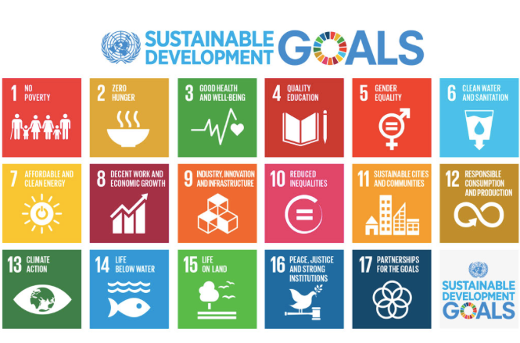
AGENDA 2030

Slide 5
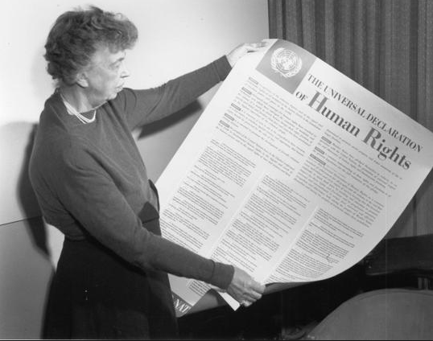
THE UN AND GENDER EQUALITY
WE THE PEOPLES of the United Nations determined…to reaffirm faith in fundamental human rights, in the dignity and worth of the human person, in the equal rights of men and women and of nations large and small…
-UN Charter
FAITH BASED AND FEMINIST NGOs: FORGING A COMMON AGENDA
Notes:
2 MINUTES
Throughout the past 70 years, the UN has played a pivotal role in catalysing and facilitating an international discourse about the equality between women and men.
The conceptual foundations for the UN’s work in this area are rooted in the UN Charter, which reaffirms “faith in fundamental human rights, in the dignity of the human person, in the equal rights of men and women and of Nations large and small”.
In June 1946, the UN created the Commission on the Status of Women with a mandate to “prepare recommendations and reports to the Economic and Social Council on promoting women's
One of the Commission’s first tasks was contributing to the drafting to the Universal Declaration of Human Rights, which resulted in the inclusion gender-sensitive language.
From 1975-1995, which witnessed four UN World Conferences on women, the women’s movement had gained tremendous momentum and
2010: Creation of UN Women: Phumzile Mlambo-Ngcuka is a United Nations Under-Secretary-General and the Executive Director of UN Women. Previously she was a South African politician who was Deputy President of South Africa from 2005 to 2008
In the following section, I examine the dynamics of the gender equality discourse at the UN.

Slide 6
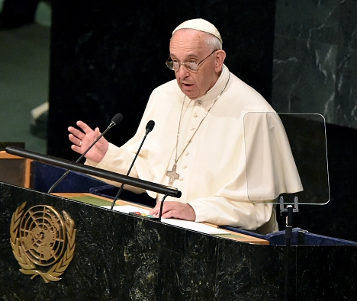
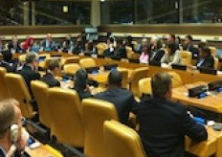
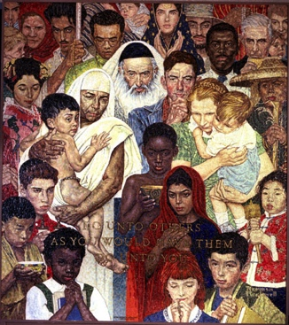
RELIGION AT THE UN?
OFFICIAL RELIGIONS/ CONSTITUTIONS OF MEMBER STATES
ORGANIZATION FOR ISLAMIC COOPERATION
(57 MEMBER STATES)
HOLY SEE PERMANENT OBSERVER MISSION
UN AGENCY COLLABORATION WITH FAITH-BASED NGOs
FAITH-BASED NGOs ACCREDITED TO THE UN ECONOMIC AND SOCIAL COUNCIL (~400 ORGS)
Notes:
-The presence of religion at the UN, more visible today than at any other time during its history
-we’ve seen a re-awakened consciousness of religion in the public sphere and an effort to understand this phenomenon, which political scientists have ominously referred to as a “resurgence” of religion; some claim that the 21st century was God’s century in the sense that Religious organizations, individuals, leaders “enjoy greater capacity for political influence today than at any time in modern history—and perhaps ever.”
-The UN is no exception, and a number of studies have looked at the presence of religion at the UN (including a 3 yr study at the University of Kent, led by Prof. Carrette)
-Let’s just quickly identify a few
-Organization of Islamic Cooperation – comprised of 57 countries (UN member states, about 1/3 of member states), is the second largest intergovernmental organization after the UN, sees itself as the “collective voice of the Muslim World” – the largest voting block at the UN; permanent observer status – can participate in the work of the GA, though with limitations
-Permanent Observer Status with the UN – free access to most meetings and documents;
-the Holy See – permanent Observer at the UN – collective voice of the Catholic world
- non-governmental (e.g. religious or faith-based NGOs accredited to the UN - 400), discursive (e.g. content of UN deliberations)
-the presence and actions of religious actors in the international arena has challenged the influential theory of “secularization”, as Talal Asad has noted: the end of the 20th century brought about the realization that “a straightforward narrative of progress from the religious to the secular” was grossly inadequate (source).
-slide Pope Francis in his much anticipated address to the United Nations (fourth pope to address the General Assembly, fifth time that a pope has addressed the UN in its 70 years)
-prominently displayed at the UN, giant mosaic work “Do unto others” (gift from US to UN)
-in the midst of the many crises in the world today, needless to say that the Security Council is also occupied with questions of religious extremism
-physical environment – many gifts of art from member states, the majority of which have religious symbolism, gift from the US is a mosaic bearing the words, Do unto others and you would have them do unto you…

Slide 7




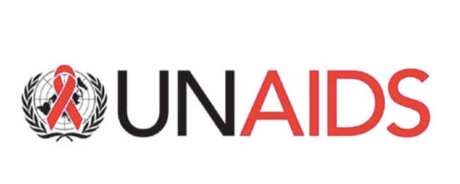
GUIDELINES FOR ENGAGING WITH FAITH-BASED ORGANIZATIONS

Slide 8
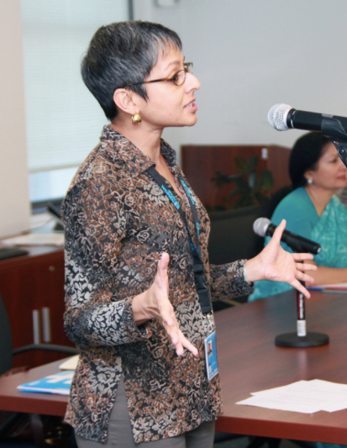
“Faith-based organizations, institution and communities have a pivotal role to play in both interrogating, challenging and proposing alternative power structures so that we can work across race, class, and gender so as to leave no one behind.”
Lopa Banerjee, Civil Society Section, UN Women
FAITH BASED AND FEMINIST NGOs: FORGING A COMMON AGENDA

Slide 9
UN WOMEN’S PERSPECTIVE: BARRIERS TO FBO PROMOTION OF THE EQUALITY OF WOMEN AND MEN Failure to challenge structural determinants of gender inequality Absence of women in positions of religious authority Alliance between conservative religious forces and political elites Reluctance of secular development organizations to collaborate with FBOs
FAITH BASED AND FEMINIST NGOs: FORGING A COMMON AGENDA

Slide 10
A NEW POLITICS OF ENGAGEMENT:
THE BAHÁ’Í INTERNATIONAL COMMUNITY, THE UNITED NATIONS, AND GENDER EQUALITY
Notes:
When I began looking at this field of religious engagement at the UN, in 2001 (14 years ago) – there was very little to go on, it hadn’t really been identified as a “thing” worthy of study. However, already at that time there were about 300 (depending on who you ask) religious organizations that the UN was formally associated with through its Economic and Social Council.
-But still, if you searched “religious NGOs” on google, you would get almost no hits.
-fast forward to 2015…
-research about religious actors in the international arena has grown rapidly over the last 15 years
-we’ve seen a re-awakened consciousness of religion in the public sphere and an effort to understand this phenomenon, which political scientists have ominously referred to as a “resurgence” of religion; some claim that the 21st century was “God’s century” in the sense that Religious organizations, individuals, leaders “enjoy greater capacity for political influence today than at any time in modern history—and perhaps ever."

Slide 11
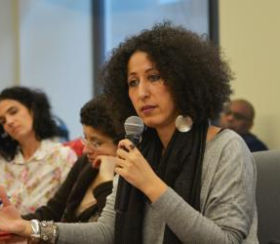
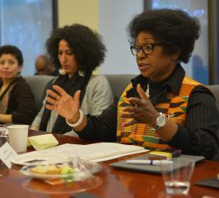
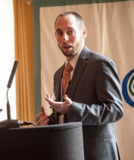
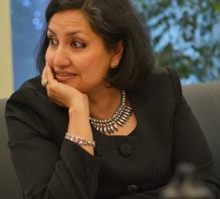
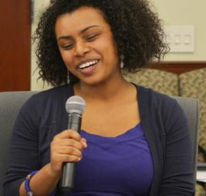
“Equally important will be efforts to replace the often confrontational dynamic between secular and faith-based proponents of gender equality…Religious and secular actors will need to work together to create a narrative that encompasses the ideals inherent in respective worldviews—a narrative that focuses on our common humanity, on justice and the establishment of peace.”
-Civil Society Working Group of Faith Based Organizations and Feminists for Gender Equality
Notes:
-Recently, UN Women has begun to take steps to encourage the formation of a working group which brings together secular and religious advocates of gender equality. Bahá’í International Community has been asked for help in organizing such a working group: Aim of the group is to “ draws insight from secular and religious perspectives and experiences in order to lend fresh insight and momentum to advancing gender equality worldwide; to explore the as-yet unrealized potential for collaboration…”

Slide 12

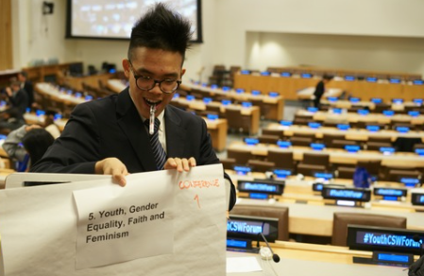
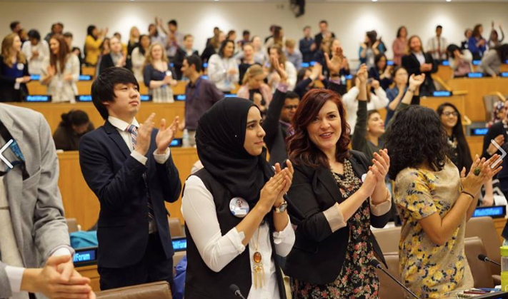
FAITH BASED AND FEMINIST NGOs: FORGING A COMMON AGENDA

Slide 13
CURRENT MEMBERSHIP
162 Members
70 ‘secular’ organizations
92 religious/ faith-based organizations
and women of faith
FAITH BASED AND FEMINIST NGOs: FORGING A COMMON AGENDA
Notes:
When I began looking at this field of religious engagement at the UN, in 2001 (14 years ago) – there was very little to go on, it hadn’t really been identified as a “thing” worthy of study. However, already at that time there were about 300 (depending on who you ask) religious organizations that the UN was formally associated with through its Economic and Social Council.
-But still, if you searched “religious NGOs” on google, you would get almost no hits.
-fast forward to 2015…
-research about religious actors in the international arena has grown rapidly over the last 15 years
-we’ve seen a re-awakened consciousness of religion in the public sphere and an effort to understand this phenomenon, which political scientists have ominously referred to as a “resurgence” of religion; some claim that the 21st century was “God’s century” in the sense that Religious organizations, individuals, leaders “enjoy greater capacity for political influence today than at any time in modern history—and perhaps ever."

Slide 14
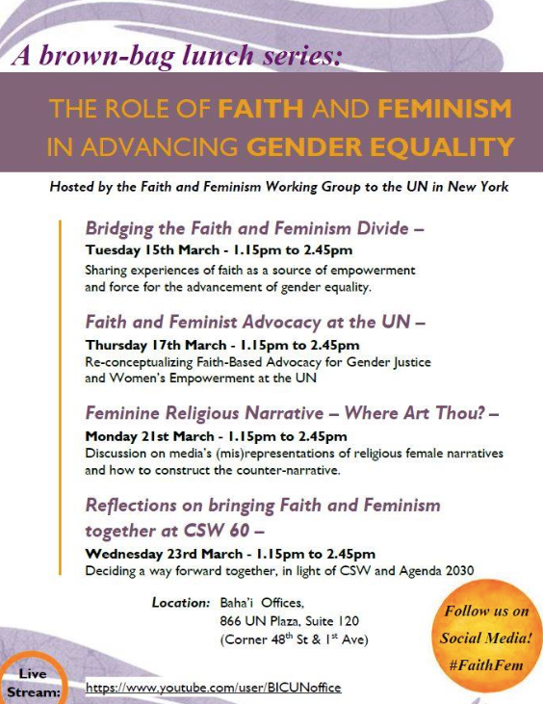
The Working Group seeks to foster a new discourse at the UN about the means for the transformation of structures and attitudes that sustain gender discrimination and inequality.

Slide 15
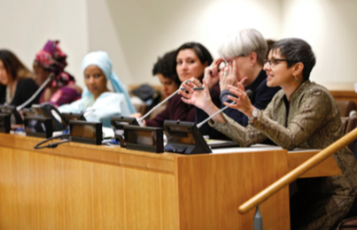
WORKING GROUP STATEMENT TO THE 2017 UN COMMISSION ON THE STATUS OF WOMEN
Re-conceptualizing Women and Girls’ Economic Empowerment through a Feminist Spiritual Perspective
[excerpt]
How can Member States and United Nations agencies intentionally work with feminist faith-based communities to offer positive alternatives to the extremists’ cooptation of religions?
How will these alternatives challenge the capitalist, market-driven model of economics that marginalizes and commodifies women and girls?
How can Member States and United Nations agencies support the re- conceptualization of the nature and purpose of work and wealth through a positive spiritual vision?

Slide 16
QUESTIONS
How do we create a discourse effectively challenges conservative religious voices at the UN?
How do we challenge the binary of secular vs. religious without alienating secular NGOs whose participation is central to our mission?

Slide 17
FAITH BASED AND FEMINIST NGOs: FORGING A COMMON AGENDA
MAHA MAROUAN | Pennsylvania State University
JULIA BERGER | University of Kent
AMERICAN ACADEMY OF RELIGION ANNUAL CONFERENCE 2016
Notes:
-The title of my presentation is…
-My research looks broadly at the role of religion in international affairs—it asks the question: how do we understand this role? What normative assumptions shape our understanding of this role? And even the kinds of questions that we ask. Are there phenomena we might be missing, not seeing because the frameworks and assumptions we bring to the table don’t allow us to see them?
-In the paper I’ll be presenting this morning, I’ll be looking at the engagement of an NGO—active for a long time at the United Nations—the Bahá’í International Community’s UN Office, in the arena of gender equality. From a study of its 70 year engagement in this discourse I will distill insights that shed new light on the question of religious agency/ religious actors in international affairs.

