Slide 1
Training Strategy
July 7, 2014

Slide 2
Table of Contents
Section | Page
Training Framework | 3
Training Strategy & Needs Assessment | 7
Training Lifecycle Management | 11
Knowledge Transfer | 19
Appendix A: Assumptions | 25

Slide 3
Training Framework

Slide 4
Training Objectives
Training Objective 1: Prepare Affected Business Users
Business users will need to know what to do (the new business processes) and how to perform those tasks in the new system
Training will minimize the performance dip caused by lack of familiarity with new processes and systems
Training
Delivery
Time
Performance
Reduced performance dip
Managed Change
Unmanaged Change
Go-Live
*Source: Prosci’s 2009 Benchmarking Report

Slide 5
Training Objectives
Training Objective 2: Prepare Project Team
MSU project team members need to have the knowledge and skills necessary to successfully implement and support the new business processes and system
Knowledge Transfer will manage the transition of skills from Cognizant to their project team counterparts
OCM Issue
Non-OCM Issue
*Source: Deloitte Consulting study of Fortune 500 ERP failures

Slide 6







Training Framework
The Training component of the MSU OCM Framework has three elements:
Training Strategy & Needs Assessment The vision for how end-user training will be performed, along with an initial assessment of the training needs of each group.
Training Lifecycle Management Design, development, and delivery of training courses, including assessment of session attendees.
Knowledge Transfer How project team subject matter experts will be prepared for their involvement in the project, and their roles after Go-Live.

Slide 7
Training Strategy & Needs Assessment

Slide 8
Strategy & Needs Assessment
The Training component of the MSU OCM Framework has three elements:
Training Strategy & Needs Assessment The vision for how end-user training will be performed, along with an initial assessment of the training needs of each group.
Training Lifecycle Management Design, development, and delivery of training courses, including assessment of session attendees.
Knowledge Transfer How project team subject matter experts will be prepared for their involvement in the project, and their roles after Go-Live.

Slide 9
Training Needs Assessment
A Training Needs Assessment is performed to identify the high-level scope of training materials development and training delivery needed for a successful training program.
A Training Needs Assessment includes:
Affected Audience – who will be using the new system to perform their job tasks
Training Subject – an initial assessment of the training subject matter that will need to be covered for each affected training audience (by Oracle module)
Audience Size – how big of an audience needs to be trained in each major topic
This information will be used to inform the Training Curriculum work product during the beginning of Training Lifecycle Management.
The Training Needs Assessment has been completed and is included as an attached work product.

Slide 10
Delivery Modes
OneMontclair Finance training will be delivered via two modes, dependent on the complexity of content and size of student audience.
Delivery Mode | Description | Advantages | Disadvantages
Instructor-Led Classroom | Scheduled, instructor led training delivered face-to-face in a computer-equipped facility | Most effective training delivery method Availability of personalized attention and Q&A | Additional training logistics requirements for facilities Decreased accessibility for student audiences
Virtual Classroom | Scheduled, instructor led training delivered online via web-enabled technology (e.g., Web-Ex) | Increased scalability of training delivery to large student audiences Ability to receive training from remote facilities or at the student’s desk | Less effective training delivery method Less effective training Q&A

Slide 11
Training Lifecycle Management

Slide 12
Training Lifecycle Management
The Training component of the MSU OCM Framework has three elements:
Training Strategy & Needs Assessment The vision for how end-user training will be performed, along with an initial assessment of the training needs of each group.
Training Lifecycle Management Design, development, and delivery of training courses, including assessment of session attendees.
Knowledge Transfer How project team subject matter experts will be prepared for their involvement in the project, and their roles after Go-Live.

Slide 13
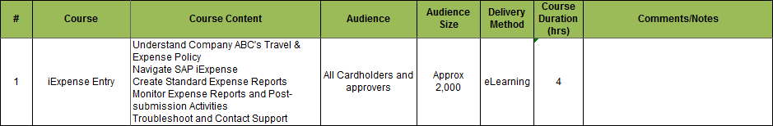
Curriculum Design
A detailed Course Curriculum will be developed to document the full needs of the OneMontclair Finance training program. This will include:
Course Name – a unique, brief name for each OneMontclair Finance course
Content – the course content that will be covered in each course; this content will determine the associated simulations, exercises, and quick reference guides
Audience – the business roles expected to attend the training course
Audience Size – the estimated size of the course audience
Delivery Mode – the manner in which the training content will be delivered to end users (e.g., Instructor-Led or Web-Based Training)
Duration – the expected duration of the training course (in hours)
Sample Training Curriculum

Slide 14
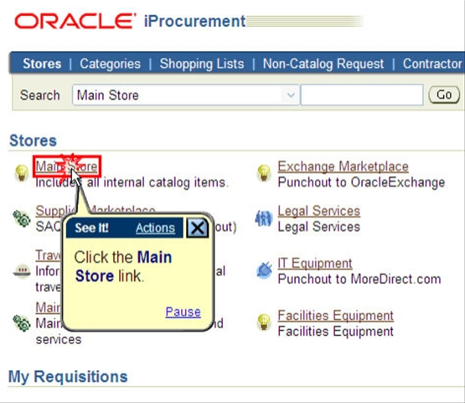
Materials Development
Training delivery will be executed using the following types of training materials/documentation:
Business Process Simulations – recordings demonstrating how to perform business process activities in Oracle (performed via UPK “See It!” functionality)
Business Process Exercises – prompted business process exercises in a simulated environment (performed via UPK “Try It!” functionality)
Quick Reference Guides – short documents providing context or reference information, such as business process documentation
Sample UPK Simulation

Slide 15
Logistics Planning
Training Logistics encompasses the coordination of all the elements necessary for successful training delivery. This includes the following responsibilities:
Room Identification & Setup – identification of all training facilities, and setup of all necessary computer hardware, software, and connections necessary to enable training content delivery
Room Scheduling – coordination of training facility availability for each class, based on the size and duration of each course
Resource Scheduling – scheduling of all training delivery staff (instructors and subject matter experts) for each class
Materials Printing – printing of any physical training media (e.g., Quick Reference Guides) or assessments (course reaction assessments) for each class

Slide 16
Training Assessments
After each training course, Reaction (level 1) and Learning (level 2) assessments will be completed by course attendees. The assessment results can be used to track course completion and acquisition of the role’s required business process knowledge and Oracle skills.
Assessment Level* |  | Description | Assessment Mechanism | Assessment Feedback Outputs
1 | Reaction | What participants thought and felt about the training session | Post-Training “Smile Sheets” | Course attendance Material/delivery improvements
2 | Learning | Acquisition of the training subject matter (e.g., technical skills) | Exercise-Driven Evaluations | System security access permissions
3 | Behavior | Application of the training subject matter during job performance | Supervisor Observations | Peer coaching or remediation training
4 | Results | Business results generated from job performance improvements | Program KPI Metric Tracking | ROI Assessments
During Training
After Training
*Source: Donald Kirkpatrick course evaluation model (Evaluating Training Programs, 1994)

Slide 17
Process & Timeline
Stage:
Build
Test
Support
Dec
Jan
Feb
Mar
Apr
May
Jun
Jul
Training Lifecycle Management
Curriculum Design
UAT
Training Materials Development
Logistics Planning
Training Delivery
Activity | Description
Curriculum Design | Development of a Training Curriculum to document course content, audience, delivery method, and duration
Training Materials Development | Development of all training course content, including exercises, quick reference cards (as necessary), and assessments
Logistics Planning | Coordination of all aspects of training course delivery, including rooms, computers, students, and subject matter experts
Training Delivery | Delivery of training course material to students, and analysis of the resulting training course assessments

Slide 18
Roles & Responsibilities
Role | Responsibilities | Necessary Capabilities
Training Lead | Manage the overall training design, development, and delivery effort | Experience in the full lifecycle of training development and delivery for process/technology projects
Training Developers | Develop training materials Deliver Train-the-Trainer (TTT) sessions to Trainers | Course design experience Experience developing materials using the UPK software
Logistics Coordinator | Schedule training courses Prepare training rooms & materials Collect and analyze assessments | Access to reserve facilities Detail-oriented and analytical
Trainers | Learn course materials (in TTT) Deliver training to end-users | Understands current business processes and systems Communicates clearly
SMEs | Provide input to training materials Attend training delivery to support Trainers by answering questions | Understands the new processes and systems in depth (project SME)

Slide 19
Knowledge Transfer

Slide 20
Knowledge Transfer
The Training component of the MSU OCM Framework has three elements:
Training Strategy & Needs Assessment The vision for how end-user training will be performed, along with an initial assessment of the training needs of each group.
Training Lifecycle Management Design, development, and delivery of training courses, including assessment of session attendees.
Knowledge Transfer How project team subject matter experts will be prepared for their involvement in the project, and their roles after Go-Live.

Slide 21
Needs Identification
Knowledge Transfer begins with the identification of the knowledge and skills that each project team member will need to support the project and the business after go-live.
Knowledge
Skills
Abilities
The information needed to understand what to do and put the work in appropriate context
New business processes
Inputs and outputs of each process activity
Oracle foundational system knowledge
The tool-specific understanding of how to perform the specific job responsibilities/tasks
Execution of business processes using Oracle
Configuration of Oracle for future updates
The competencies required to successfully meet the requirements and objectives of a job
Knowledge Transfer will not address staff Ability gaps

Slide 22
Knowledge Transfer Plans
Once required knowledge and skills are identified, each MSU project team member will have a specific Knowledge Transfer Plan, identifying what knowledge transfer they need, how they will receive it, and who from the implementer will facilitate the acquisition.
For each identified knowledge or skill item, the knowledge transfer mechanism will be identified from the following options:
Project Team Training – formal training provided from a third party (e.g., Oracle functional training courses)
Project Team Mentoring – partnering between MSU project team member and a corresponding implementer staff member to transfer knowledge and skills via on-the-job mentoring and project implementation activities
Documentation Sharing – review of project documentation by MSU project team member; implementer staff member will be identified for each documentation topic as a point person for MSU project team member questions

Slide 23
Process & Timeline
Stage:
Design
Build
Test
Support
Aug
Sep
Oct
Nov
Dec
Jan
Feb
Mar
Apr
May
Jun
Jul
Knowledge Transfer
KT Needs Identification
KT Plan Development
KT Execution & Tracking
Activity | Description
Knowledge Transfer Needs Identification | Determination of what knowledge and skills each MSU project team member will need based on their project role and MSU position
Knowledge Transfer Plan Development | Identification of how each knowledge transfer need will be met, including the transfer mechanism (e.g., formal training, coaching, etc.) and which implementer employee will be responsible
Knowledge Transfer Execution & Tracking | Tracking the performance of knowledge transfer activities and confirming the acquisition of the expected knowledge and skills for MSU staff

Slide 24
Roles & Responsibilities
Role | Responsibilities | Necessary Capabilities
Knowledge Transfer Analyst | Co-develop KT Plans, focusing on comprehensive coverage across subject areas Track progression of KT Plan against agreed upon timelines Escalate KT gaps and issues | Understands the knowledge and skills necessary for MSU project team members Detail oriented enough to identify KT needs and track progress against KT execution
Knowledge Holders | Co-develop KT Plans, focusing on the content in their subject areas | Pillar implementer business process or technology specialists
Knowledge Recipients | Fully engage in KT sessions Accept ownership of domain expertise after project close | MSU pillar team members
OneMontclair Pillar & Program Leadership | Validate knowledge transfer is progressing as expected according to the KT Plan timelines Address any escalated KT gaps | Project leadership (sponsors and PMs) within OneMontclair (Executive PMO and Pillar)

Slide 25
Appendix A:
Assumptions

Slide 26
Assumptions
Assumption 1: Baseline Staff Knowledge and Skills
The MSU Finance training will be delta training, focusing on training staff on the knowledge and skills that are different from what they currently need to perform their jobs in the new system. This assumes the MSU staff already has the necessary baseline knowledge and skills.
Knowledge
Skills
The information needed to understand what to do and put the work in appropriate context
Existing business processes
Current MSU business policies
Job-specific foundational knowledge (e.g., accounting practices, etc.)
The tool-specific understanding of how to perform the specific job responsibilities/tasks
Basic computer skills, including mouse and keyboard proficiency
Proficiency in using non-Oracle business applications (e.g., Adaptive Planning, etc.)

