Slide 1
Cayuse IRB - Initial Training
Completing your initial submission

Slide 2
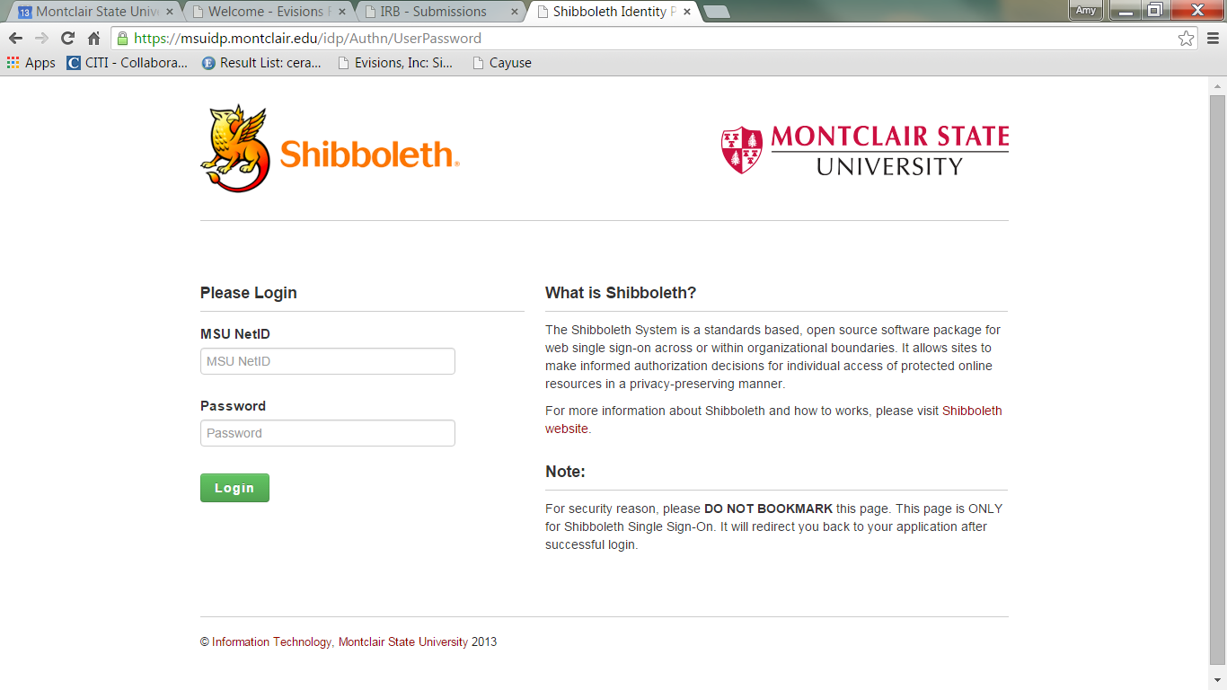
Logging in to Cayuse IRB
Faculty and Staff (as of Oct. 2015)
You will use your netID and regular Montclair password
Students, New Staff and New Faculty
If you are a student or relatively new faculty or staff member, you will not be in our system
You will request an account at our website, www.montclair.edu/irb/cayuse
We will not ask you for your password or CWID
Your account will be activated in 1-2 business days, after which

Slide 3
Before you begin…
You may have best results using Chrome
Must enable pop-ups

Slide 4
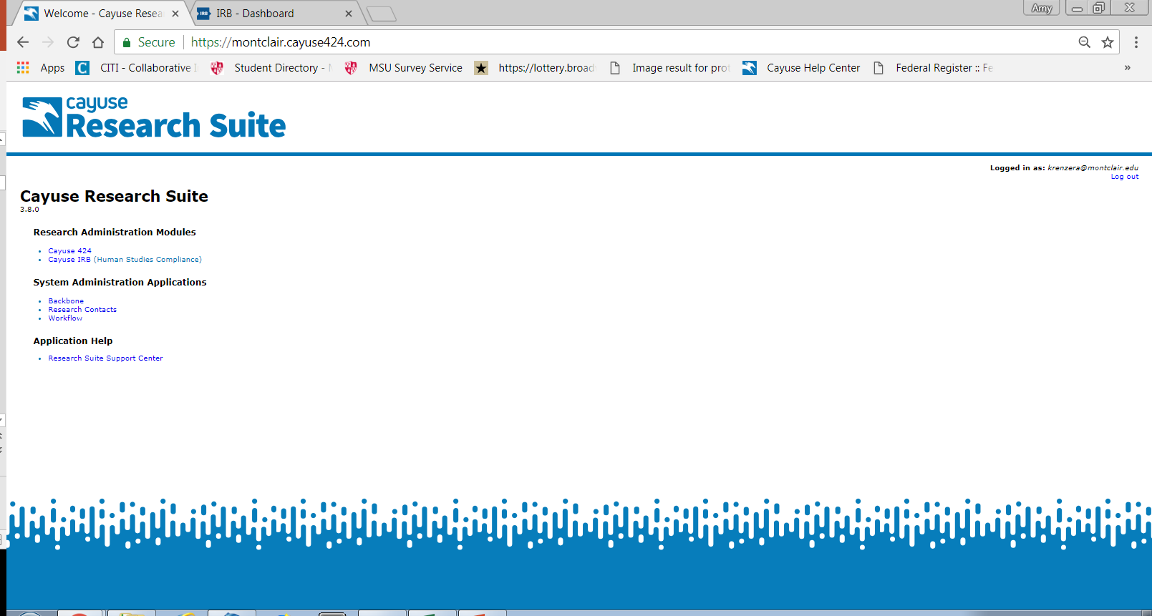

Slide 5
Your Dashboard
When you sign in, every time you will come to this page!

Slide 6
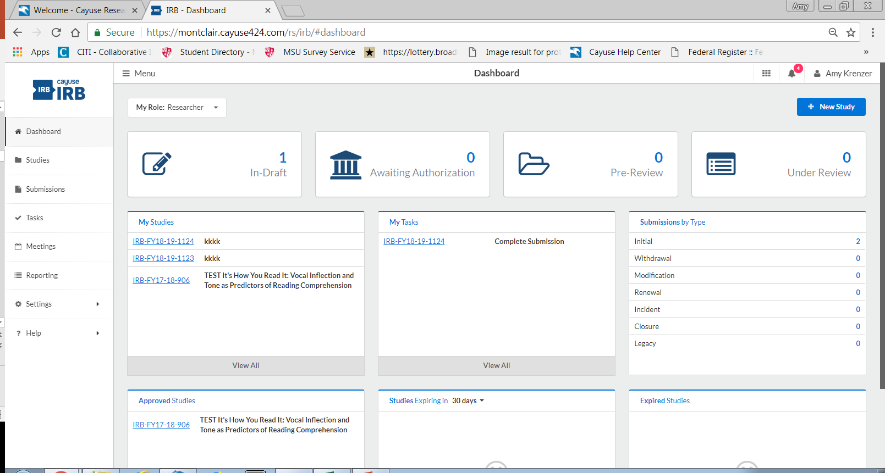
Shows the statuses of your submissions
Shows you all your submissions
Shows all incomplete tasks
Shows all your studies
Other ways to access the same things
Shows you your approved studies
Shows soon-to-expire studies
Shows expired studies
Notes:
Add directions on help

Slide 7
What are notifications?
Emails that will alert you that your submission requires attention
i.e. revise submission to answer IRB questions, certification required
Notifications will appear in-system AND be sent to your MSU email
When you are required by the IRB to make corrections or revisions, it will also show up in your “Tasks” section of the dashboard

Slide 8
Study vs. Submission
Study refers to your entire research project
Submission refers to specific applications- e.g. initial application, modification, renewal, closure, etc.

Slide 9
Steps to creating an initial submission
Click on blue “+ New Study” button on top right hand side
Give your study a title. If it is a student led research project, preface your title with “SS” ex: “SS Sample Study Title.” Click on blue checkmark on right-hand side to confirm study title.
You will see an IRB number such as “IRB-FY15-16-45” and you will see a pink banner on left side which states status “Unsubmitted”.
Click on blue “+ New Submission” button on top right hand side.
A drop down will appear with the word “INITIAL” – click on it.
You are now able to “Edit” your new submission!

Slide 10
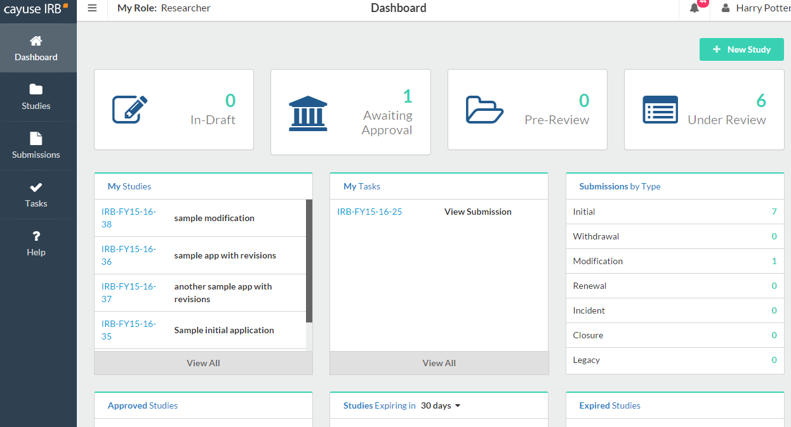

Click new study to begin

Slide 11
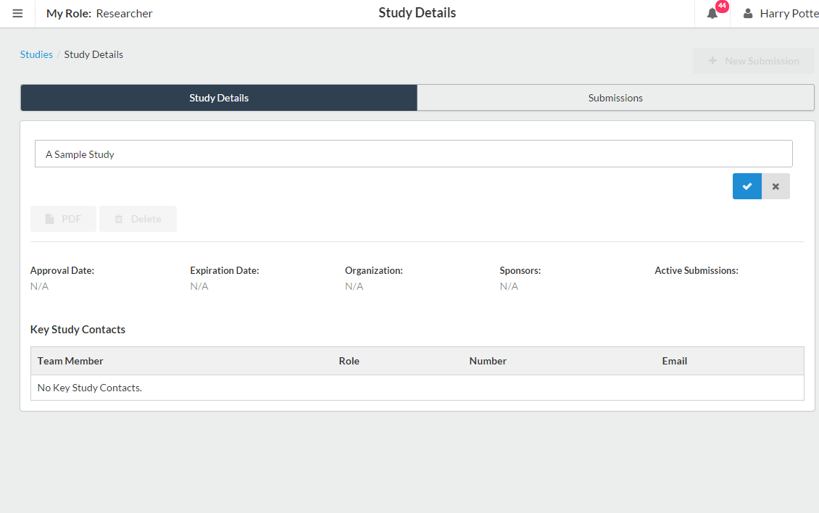
Type the name of your study here
…and then click the check

Slide 12
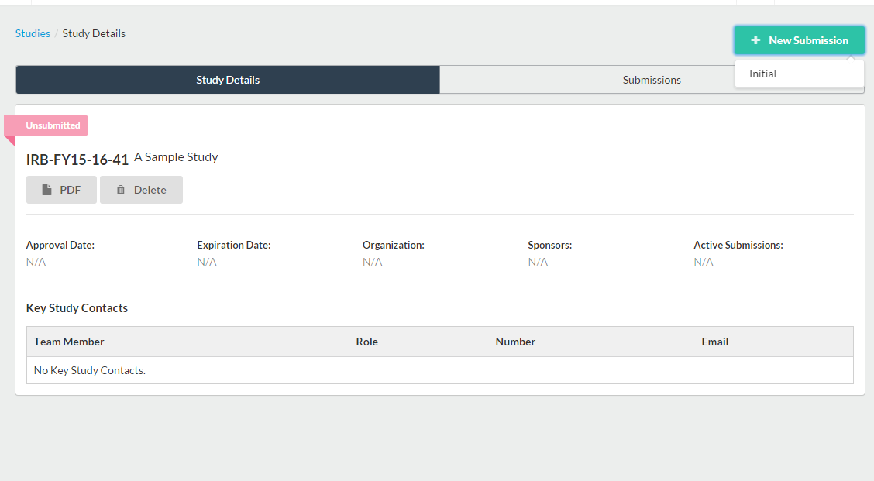

Click “new submission” and select “Initial”

Slide 13
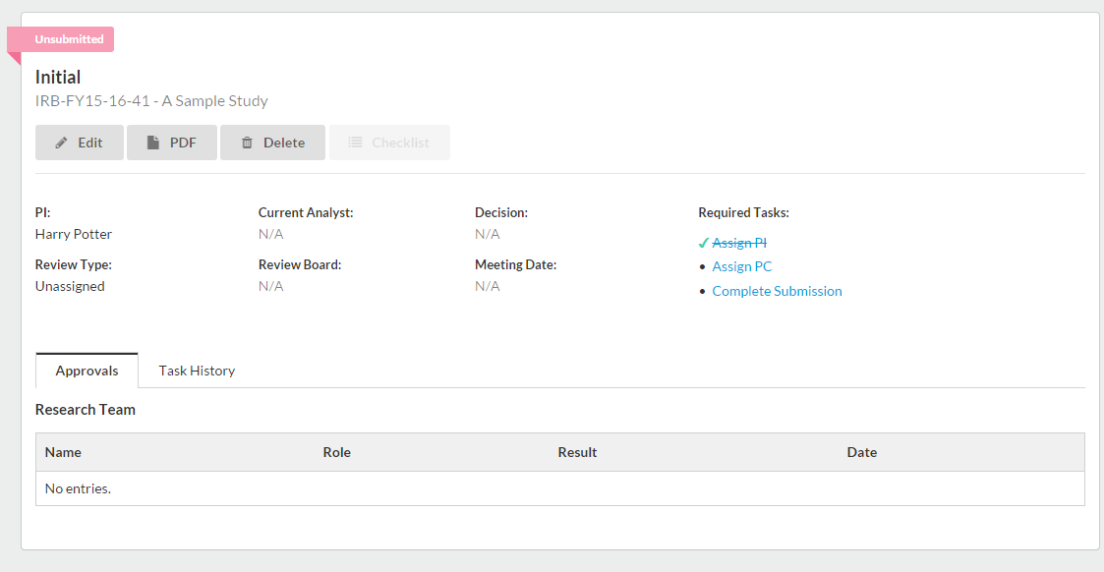
You can select “Edit” to begin the submission.
You can also click on “Complete Submission to start application.

Slide 14
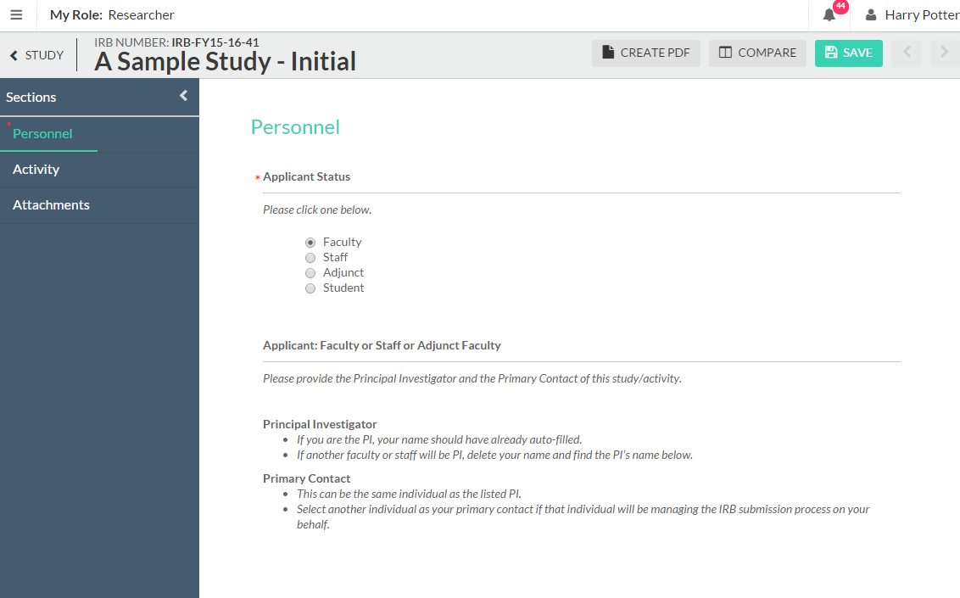
This brings us to the submission. The PI and PC distinction is also explained here!

Slide 15
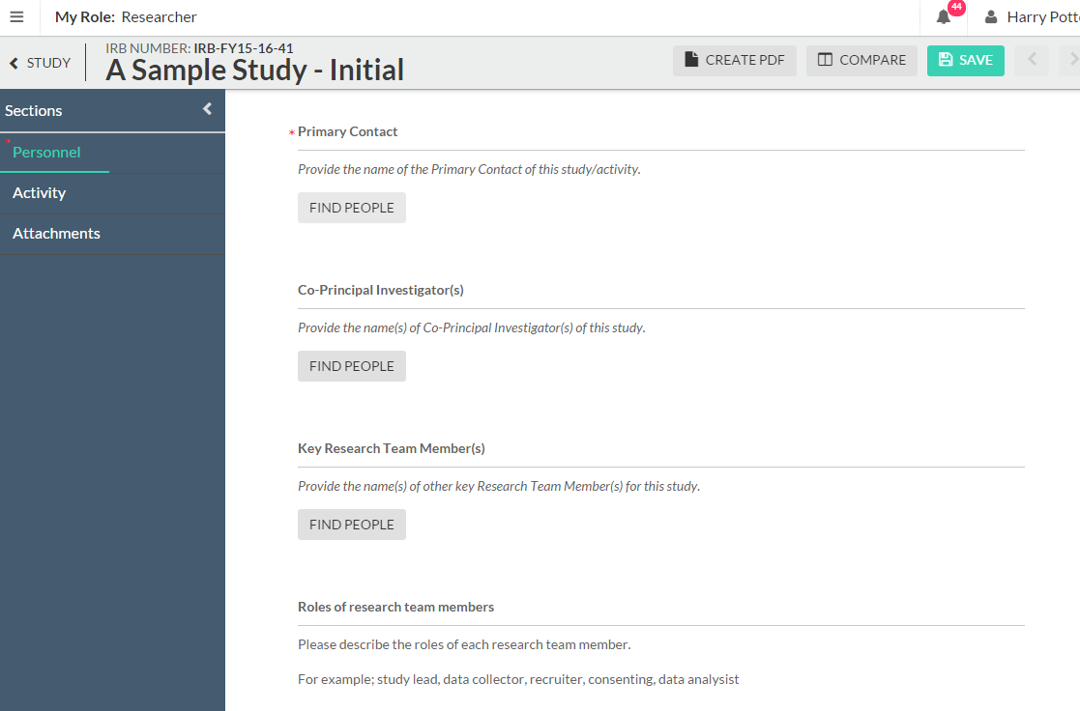
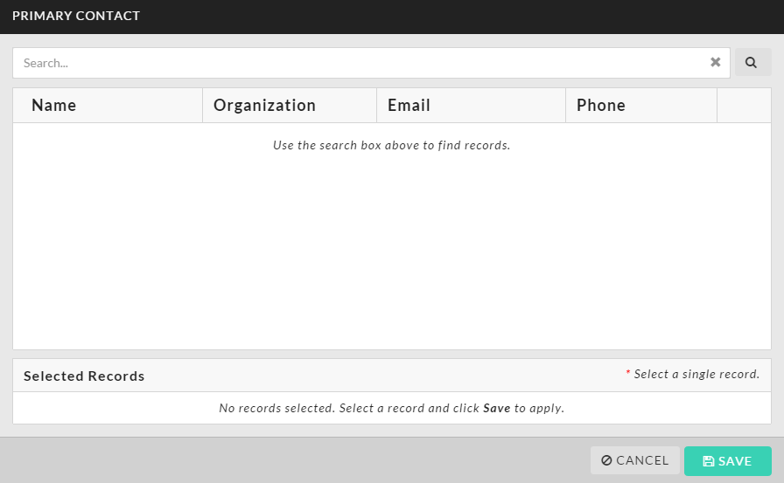
You will click “find people” to assign the PC
You will be presented with this pop-up in which you will search for the designated person and click their name to select. Then click “Save”

Slide 16
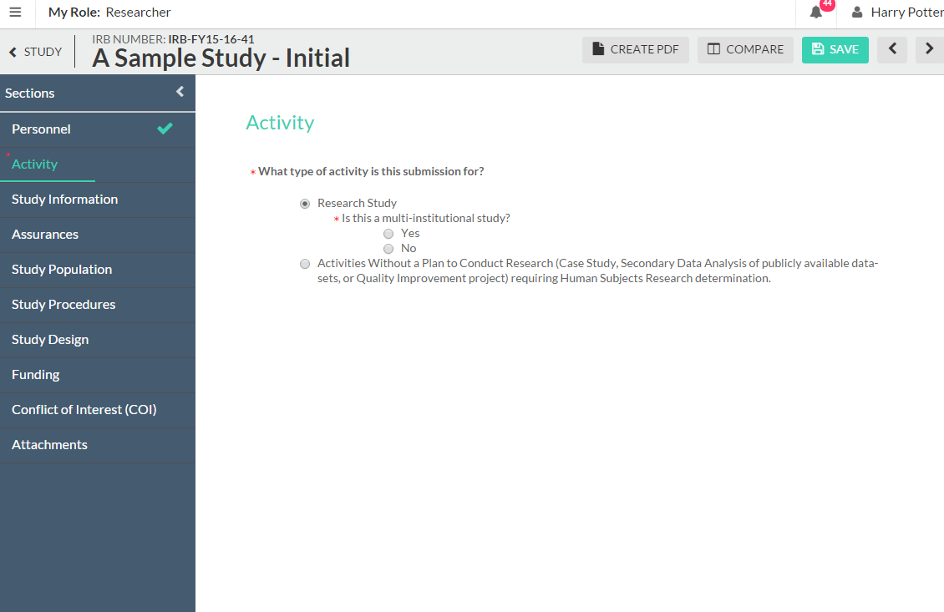
Click the save button at any time. You can leave Cayuse IRB and complete your submission at a later time.
These arrows are used to tab through the submission
Sidebar lists all the subsections of the submission. The green bar is a status bar. When the section is complete, the green check mark will show.

Slide 17
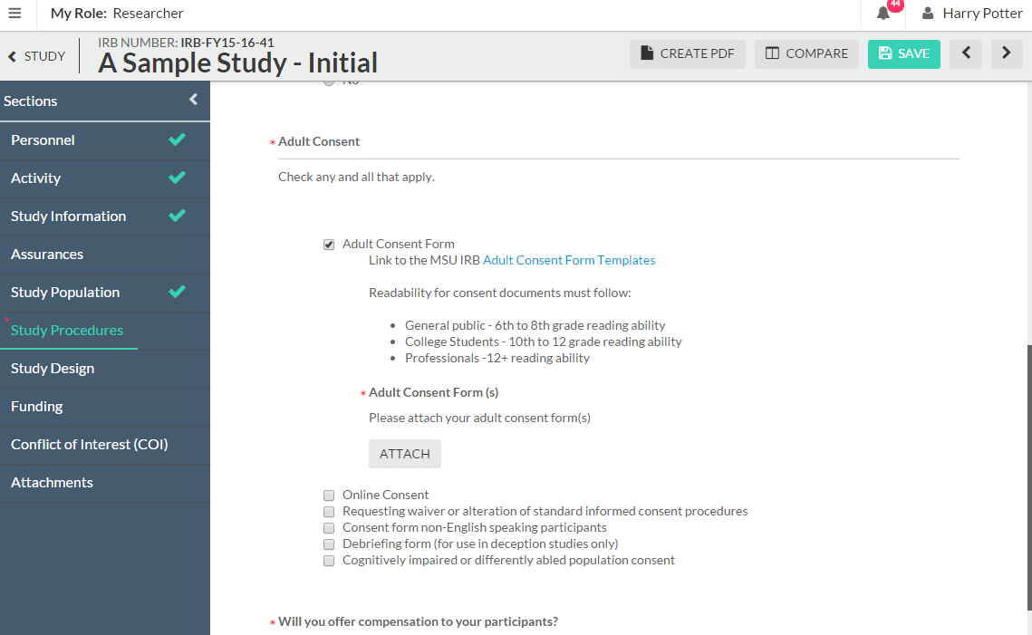
You will likely have to attach several things to your submission. You’ll click the “Attach” button and follow the instructions of the pop-up. You can now attach a link OR a document

Slide 18
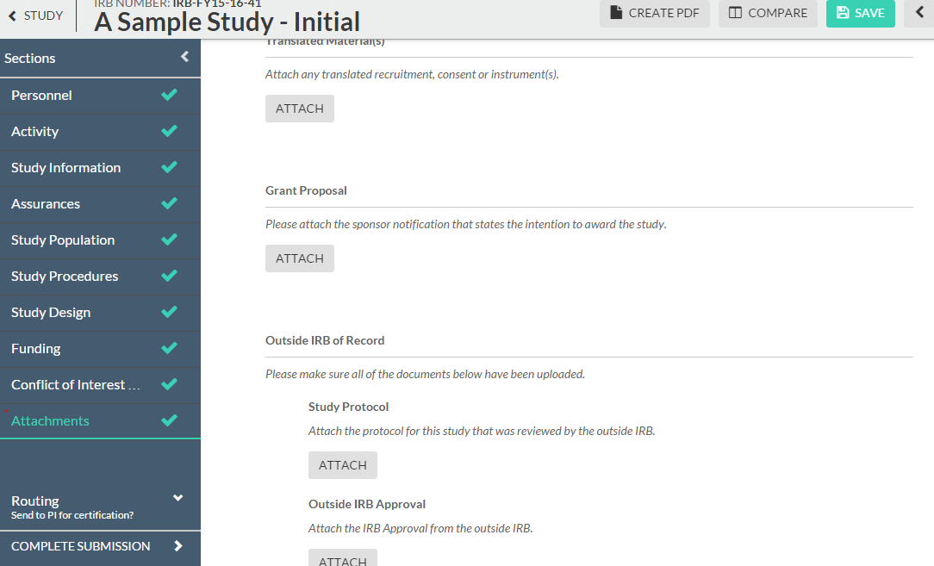
*If you are not the PI, you will have to select the “Send to PI for certification” option for the PI to sign off on the submission
When you are finished with your submission, click “complete submission”

Slide 19
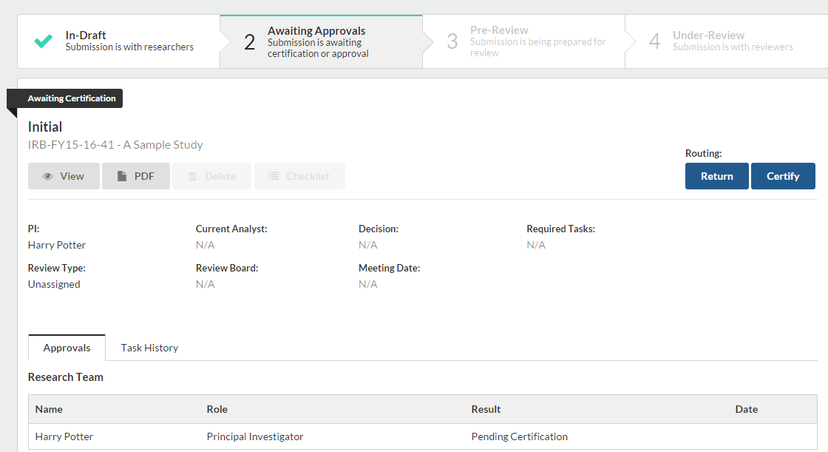
Now we are back to the general “Study page.” On the study page you can see the status of your submission
In-Draft
Needs to be certified
With IRB Staff
With IRB Reviewer(s)
Even though we clicked “complete submission” in the earlier page, we aren’t done with our submission. As we can see, it is still in the “awaiting approval” stage. It needs to be “certified,” or signed, by the PI.
If the research team needs to make changes, click “return.” If it is ready to be submitted, click “certify.”

Slide 20
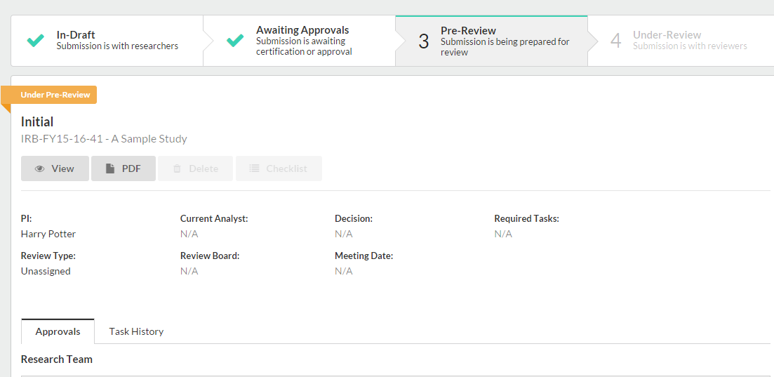
The submission has been sent to the IRB Staff and is now in pre-review!

Slide 21
Making revisions and replying to IRB requests
In most cases, you will be required to make some revisions to your submission before receiving IRB approval
In Cayuse IRB, this takes the form of both making changes to your submission and replying directly to comments
You will receive an email notification for revisions, and you will find your ‘tasks’ on the dashboard.

Slide 22
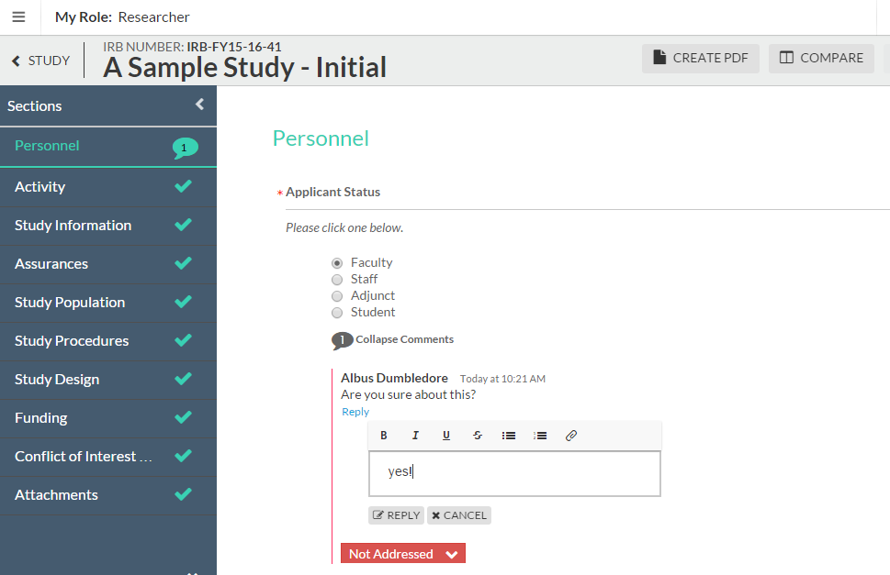
There is a comment that needs our attention
You’ll click “Expand comments” here to view
Type your response and click “reply”
Change the status to “Addressed”

Slide 23
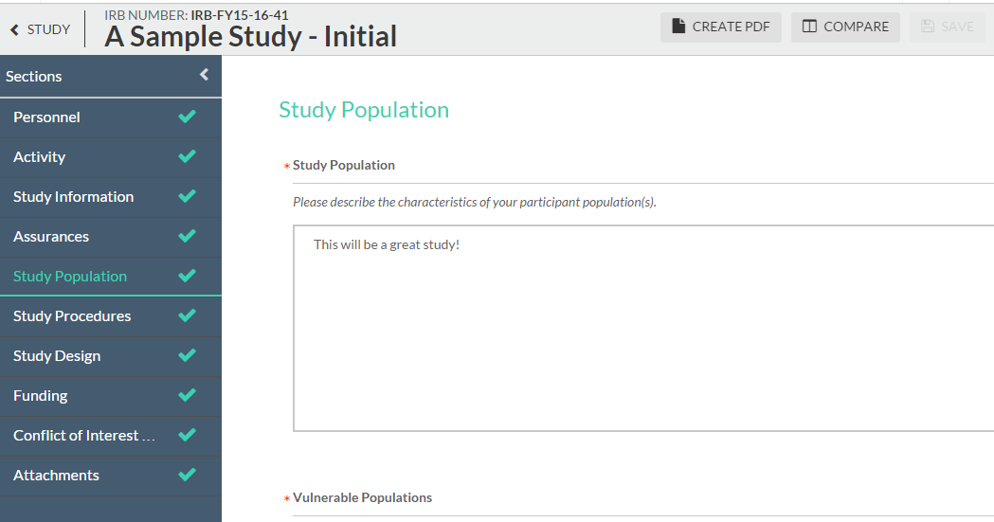
You can click “compare” to view a revised submission against its original

Slide 24
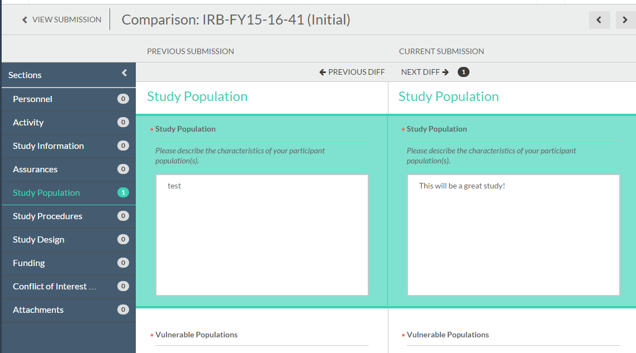
Revisions will be noted in the sidebar and highlighted

Slide 25
How will I know my study has been approved?
You will be notified via email!
Study will appear on your dashboard under “Approved Studies”.
All approved documents will appear under your approved study – those are the documents you need to use for your active research.

Slide 26
So do I still need to…?
Complete CITI Training?
Pick up my approval documents?
Use the Montclair templates for consent forms/site approval letters?
Apply for continuing review?
Yes, all research team members will still have to complete CITI training every 3 years
No, you will also not be sent physical approval documents
Yes, these templates will continue to be available on our website
Yes, you will eventually have to fill out a renewal submission if your study is not exempt

