Slide 1
It’s a New year and a new common rule: What researchers need to know
MSU institutional review board

Slide 2

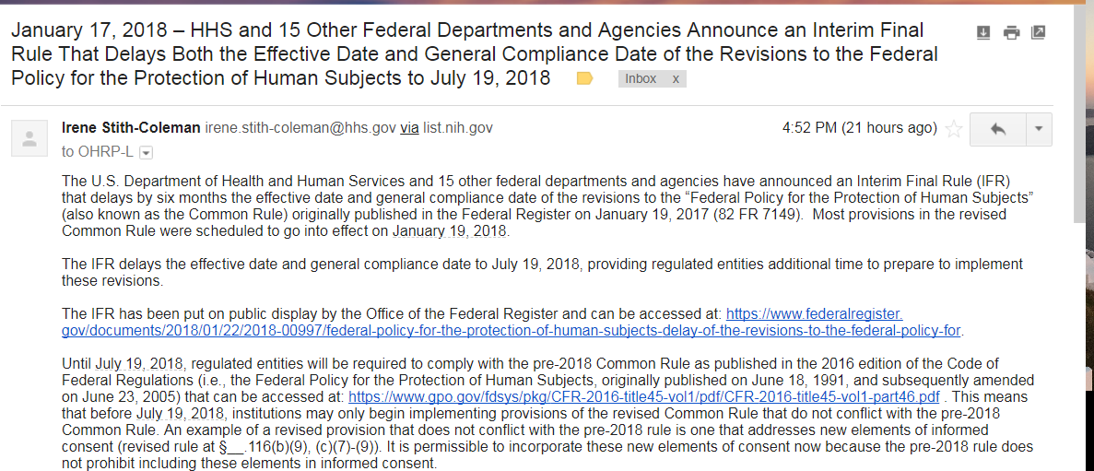
January 17 DELAY from FEDS

Slide 3
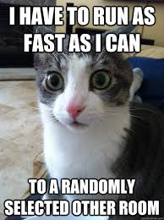

Slide 4

Why changes?
No previous changes in last 25 years
Changes in data collection techniques and technology since the regulations first written
Ease of burden on researchers, especially social/behavioral

Slide 5
Big changes
Benefits to researchers
Benefits to student researchers
Many studies will no longer require annual continuing review
Less oversight for social/behavioral researchers w. introduction of new categories
Expecting more studies to fall under expanded exempt categories which tends to have a faster review times
Potential of research to be done in one semester

Slide 6

Renewals
Annual renewals of new studies are no longer required for any study that is not full board/high risk or federally funded
Only administrative check-in every two years or project closure at time of completion
Current existing studies must go through one Renewal before transitioning to administrative check-in

Slide 7

Changes to definitions and signatures on consent form
Definition of Vulnerable populations – Pregnant women and “handicapped” removed; replaces “mentally disabled” with “individuals with impaired decision-making capacity”
Electronic signatures - 46.117(a) now specifically allows electronic signatures and specifies that a written copy must be given to the person signing the consent form

Slide 8


NEW exempt categories
Category 3- Benign Behavioral Interventions (BBI)
Category 7- storage or maintenance of data involving broad consent for future use
  This category is for the storage of identifiable biospecimens & identifiable private information, prior to secondary data analysis, for the purposes of secondary research use.
Category 8- secondary research that requires broad consent
  Allows for secondary analysis of existing private identifiable data & identifiable biospecimens provided that broad consent was secured or documentation of consent was either secured or waived, (also for secondary research use).
Notes:
The Common Rule defines three levels of review for human subjects research:
exempt,
expedited,
and full (board).
The new Common Rule broadens the types of research that can be reviewed at the exempt level, which is the level requiring the least oversight.

Slide 9
NEW exempt category 3
Benign behavioral interventions (BBI)
Brief in duration
Adults only
Harmless & painless (not embarrassing)
No physically invasive procedures (i.e. no EEGs, blood pressure)
Complies with certain data & privacy regulations
“Limited IRB Review” aka Privacy Review required for projects collecting sensitive and identifiable data
Information collected via
  Verbal or written responses, including data entry and/or
  Observation – including audio and/or visual recording

Slide 10
BBI Examples* (all non-funded)
Business students are asked to participate in non-funded research examining the influence of surfing a social media site, they were assigned random social media sites or new sites, they were timed in their efforts to solve a complex word puzzle (for which there was no solution). No identifiers were recorded.
  YES ( adults, brief, harmless, non-invasive)
Nursing home staff interview patients to complete a brief self-report scale measuring mood and anxiety at baseline and two weeks after music is played nightly in patient rooms on half of the wards. All subjects are informed that a study of the effect of music is planned, and music is played only the rooms of those patients who agree to the intervention and ratings.
  NO – not brief in duration, does not occur all on one day.
Adult learners agree to be videotaped while reading a passage from a standard text while alone in a quiet room. Ratings of vocal inflection and tone are assessed as for comprehension and compared with the results of a written test of the subject’s ability. The procedures take 90-120 minutes.
  YES
*from Secretary's Advisory Committee on Human Research Protections (SACHRP)

Slide 11
NEW exempt category 3
Benign behavioral interventions (BBI)
For now, only applies to non-federally funded studies
New questions in Cayuse submission form
Checklist to help determine if study may be BBI
Sample BBI application available online
Option to use Prospective Agreement form in place of traditional consent form

Slide 12
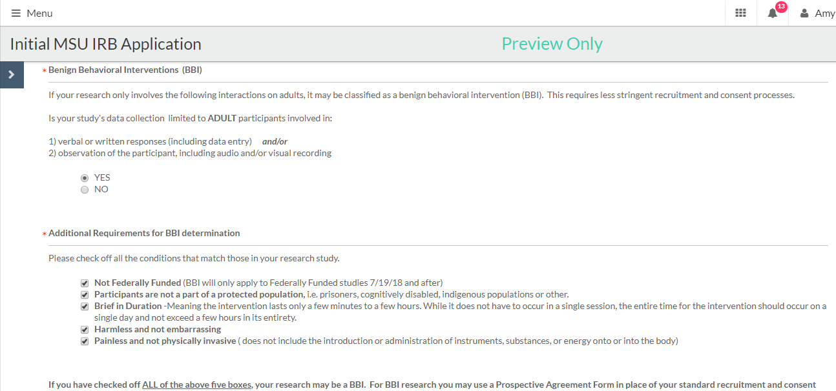

Slide 13
If you fit BBI or any Exempt Category - Say Goodbye to your current idea of recruitment and consent!
Old requirements for most exempt studies:
  Traditional Recruitment
  Traditional Consent Forms
New Option
  Prospective Agreement covers both, no signature necessary
OLD
Recruitment
CONSENT
NEW EXEMPT
PROSPECTIVE AGREEMENT

Slide 14



CONSENT for BBI
Prospective agreement form/information sheet
No signature
New templates on MSU website
  In-person survey
  Focus group
  Online survey
  Interview

Slide 15
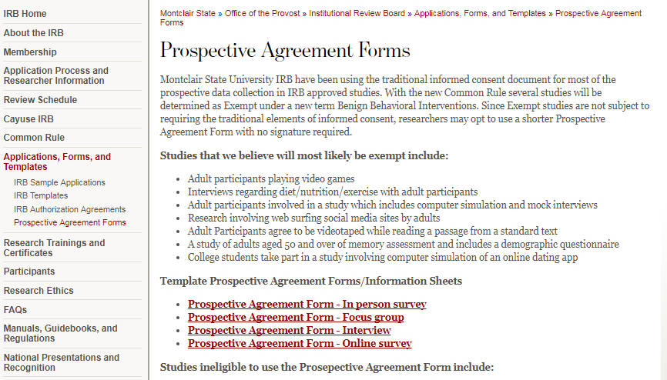

Slide 16
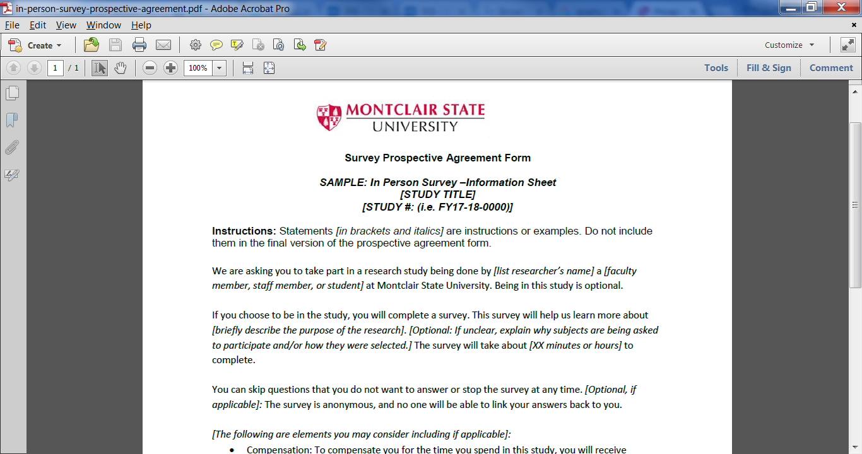
prospective agreement form

Slide 17
Do I need to submit a Modification to change/add/remove personnel?
Not Federally Funded Currently Approved Studies |  | Not Federally Funded New Studies – Approved in 2018
Expedited or Exempt – Submit Modification (first time) check approval letter for verification. After that …….. |  | Expedited or Exempt – No Modification submission needed unless you are changing PI or FS (Faculty Sponsor)
Full Board category – Submit Modification |  | Full Board category – Submit Modification
Federally Funded Currently Approved Studies |  | Federally Funded New Studies
All categories of review submit Modification for any research team personnel changes * |  | All categories of review submit Modification for any research team personnel changes *
* May change in the future for expedited and exempt categories.

Slide 18
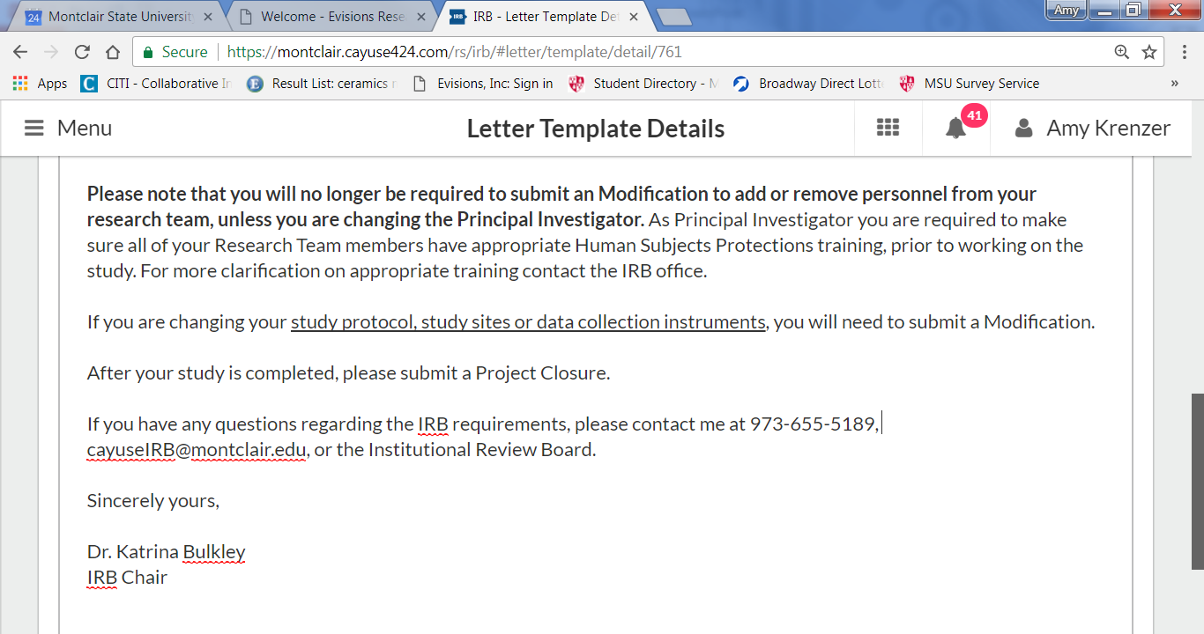

Slide 19
Other changes
To lengthy consent forms (>2 pages) must contain “key information” section. Not applicable to most of MSU research
Pregnant women no longer considered “vulnerable”
“Handicapped” changed to “individuals with impaired decision-making capacity”
Added “economically or educationally disadvantages persons” as vulnerable
Definition of NIH Clinical Trial changed:
  A research study in which one or more human subjects are prospectively assigned to one or more interventions (which may include placebo or other control) to evaluate the effects of those interventions on health-related biomedical or behavioral outcomes.

Slide 20
New term: “Limited IRB REVIEW”/Privacy review for exempt studies
What prompts LIR/Privacy Review – identifiability of data
Focus on privacy and data protection
Only required for certain types of exemptions

Slide 21
Myths and truths
MYTH: You do not need to submit to the IRB anymore if you are sure your research is an exempt category.
  Truth: You still need to submit to the IRB. The IRB will always determine the category of review. MSU IRB does not allow self-determination at this time.
MYTH: All consent forms for research now need to be made publicly available.
  Truth: Only consent forms for (funded) clinical trials must be made available at clinicaltrials.gov

Slide 22
Does this new rule apply to me TODAY?
STATUS |  | Note
Newly submitted | YES
Newly submitted (federally funded) | NO ☹ | *coming July 19, 2018
Existing studies (expedited/exempt) | YES | Transition to new rule at time of your next submission (renewal/modification)
Existing studies (expedited/exempt) (federally funded) | NO | *coming July 19, 2018

Slide 23
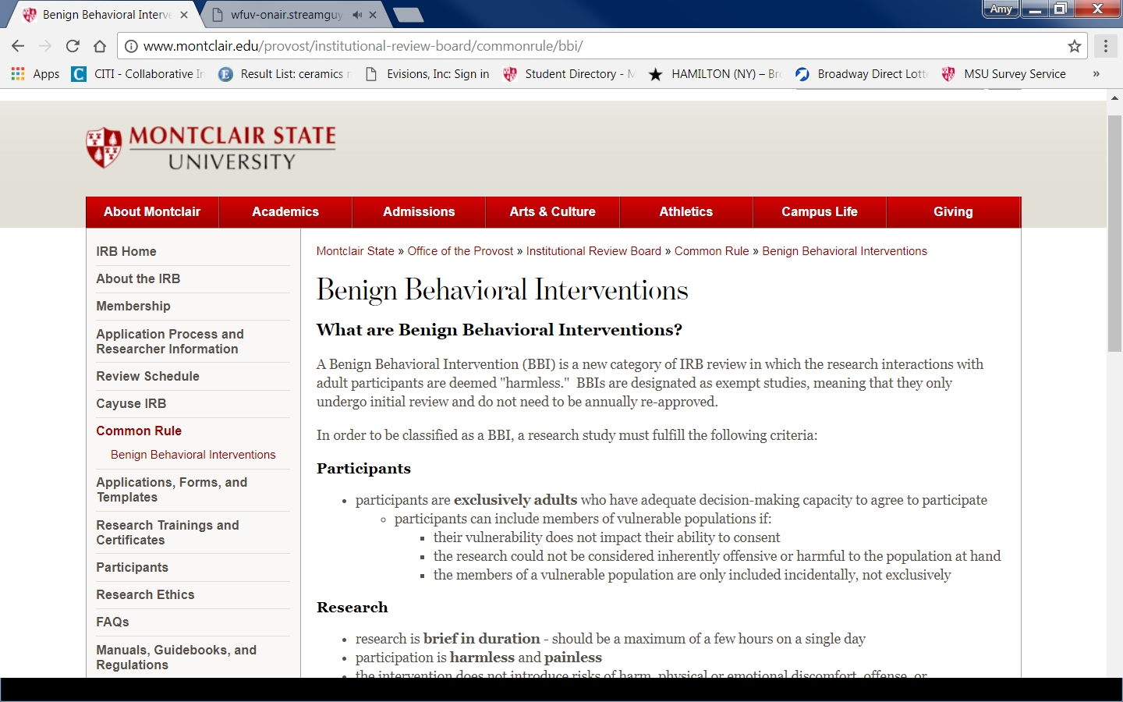
But I’ll never remember all that..
You don’t have to!

Slide 24


