Slide 1
National Science Foundation Update
National Council of University Research Administrators
54th Annual Meeting
Washington, DC

Slide 2
Ask Early, Ask Often
Jennifer Rodis
Grant & Agreement Policy Specialist
Policy Office, Division of Institution & Award Support
Office of Budget, Finance & Award Management
jrodis@nsf.gov; 703.292.2540
Jean Feldman
Head, Policy Office
Division of Institution & Award Support
Office of Budget, Finance & Award Management
jfeldman@nsf.gov; 703.292.4573

Slide 3
Topics Covered
NSF Organizational Structure
NSF Personnel Update
NSF Fiscal Year 2013 Budget Request
ARRA Waiver Process and Update
Revised NSF Merit Review Criteria
Upcoming PAPPG Revisions
Cost Sharing Update

Slide 4
NSF Organizational Chart
Office of Cyberinfrastructure
Office of Diversity &
Inclusion
National Science Board
(NSB)
Director
Deputy Director
Office of the General Counsel
Office of Integrative Activities
Office of the
Inspector General
(OIG)
Office of International
Science & Engineering
Office of Legislative &
Public Affairs
Office of Polar Programs
Biological
Sciences
(BIO)
Computer &
Information
Science &
Engineering
(CISE)
Engineering
(ENG)
Geosciences
(GEO)
Mathematical
& Physical
Sciences
(MPS)
Social,
Behavioral
& Economic
Sciences
(SBE)
Education
& Human
Resources
(EHR)
Budget, Finance
& Award
Management
(BFA)
Information
& Resource
Management
(IRM)

Slide 5
Personnel Update
Dr. F. Fleming Crim appointed Assistant Director, for Mathematical & Physical Sciences.
Dr Celeste Rohlfing named Acting Assistant Director, Directorate for Mathematical & Physical Sciences
Dr. Margaret Cavanaugh named Acting Assistant Director, Directorate for Geosciences
Dr. Wanda Ward appointed Head, Office of International & Integrative Activities
Dr. Kelly Falkner named Acting Head, Office of Polar Programs
Notes:
Dr. F. Fleming Crim appointed Assistant Director for Mathematical and Physical Sciences effective January 2013. Dr. Crim is the John E. Willard and Hilldale Professor in the Department of Chemistry at the University of Wisconsin-Madison.

Slide 6
FY 2013 Request: Total R&D by Agency
Budget Authority in Billions of Dollars
Notes:
Federal R&D spending comes from 24 federal departments and independent agencies scattered throughout the budget. Agencies have non-R&D and R&D programs within their overall budgets. R&D funding trends have closely mirrored trends in the overall discretionary budget.
FY 2013 R&D – Request - Highlights
The FY 2013 Budget proposes $140.8 billion for all federal R&D, an increase of 1.4% over the FY 2012 enacted level. This includes a total for non-defense R&D of $64.9 billion, an increase of 5.0% over the 2012 enacted level.
The 13 budget includes increases for a number of Administration priorities where NSF has significant investments, such as:
The U.S. Global Change Research Program (USGCRP) would increase by 5.6% over the 12 enacted level, to a total of $2.6 billion.
The National Nanotechnology Initiative (NNI) totals $1.8 billion, an increase of 4.1% over 12 enacted.
Science, technology, engineering, and mathematics (STEM) education totals $3.0 billion, with an emphasis on evidence-based improvements in teaching and learning.
And finally, support for advanced manufacturing R&D is $2.2 billion, to fund innovative manufacturing processes, advanced industrial materials and robotics, and to encourage greater collaboration with universities and industry.

Slide 7
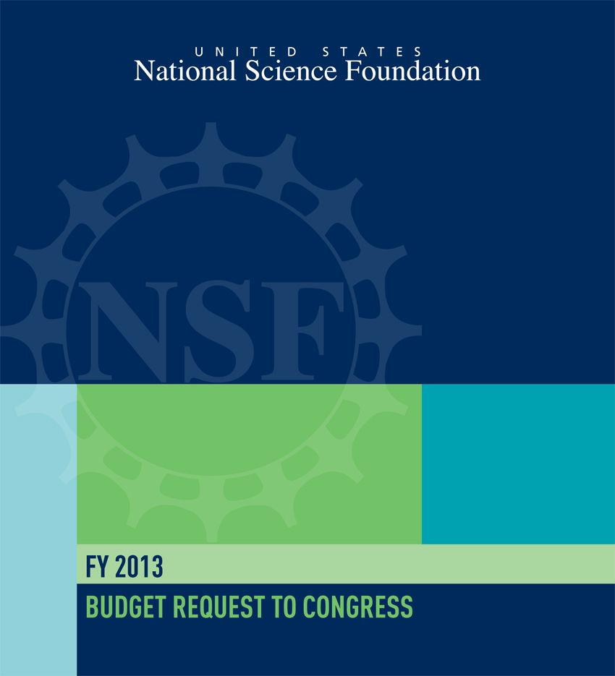
FY 2013 Budget Request
$7.373 billion
Consistent with Administration’s commitment to doubling NSF and basic research agencies
Emphasizes ways that fundamental research contributes to addressing national challenges
Notes:
It totals $7.373 billion, an increase of $340.0 million (4.8 percent) over the FY 2012 budget, consistent with the Administration’s commitment to doubling funding for NSF and other key basic research agencies.
The Request emphasizes the myriad of ways that fundamental research can contribute directly to addressing national challenges:
Fostering the development of a clean energy economy.
Supporting future job creation through advanced manufacturing and emerging technologies.
Protecting critical infrastructure.
Promoting multidisciplinary research in new materials, wireless communications, cyberinfrastructure, and robotics.
Developing the next generation of scientific leaders through support for graduate fellowships and early career faculty.
Advancing evidence-based reforms in science and mathematics education.
At the same time, the request reflects a rigorous prioritization of activities across the Foundation. Approximately $67 million in lower priority education, research, and outreach programs are terminated or consolidated.
FY 2013 Request in the Federal Context
Failure of Super Committee last year resulted in “sequestration” which is set to go into effect in January 2013. This means automatic reductions of about $109 billion per year spread evenly over defense and non-defense agencies.
Many options are open that could change this, including legislation to overturn the “sequestration” law.
Also, with competing budgets on the Hill, there is much ambiguity for a lame-duck session after the November elections.
Latest Updated Information
The Senate Appropriations Committee passed the Commerce, Justice, Science and Related Agencies bill for FY 2013 providing NSF $7.273 billion, $100 million below the request, but $240 million, or 3.4% above the FY ’12 appropriated level.
The House CJS Appropriations Subcommittee passed their FY 2013 bill, providing NSF with $7.333 billion, $41 million below the request, but $299.4 million, or 4.3% above the FY ’12 appropriated level.
The President recently signed a continuing resolution that funds agencies through March 27, 2013. Funding will be at the FY 2012 level, plus an additional 0.612%.

Slide 8
FY 2013 Budget Request
National Science Foundation Funding by Account
(Dollars in Millions)
 | FY 2012 Enacted | FY 2013 Request | Change Over
 |  |  | FY 2012 Enacted
 |  |  | Amount | Percent
Research & Related Activities | $5,689 | $5,983 | $294 | 5.2%
Education & Human Resources | 829 | 876 | 47 | 5.6%
Major Research Equipment & Facilities | 197 | 196 | -1 | -0.4%
Construction
Agency Operations & Award Management | 299 | 299 | - | -
National Science Board | 4 | 4 | - | -
Office of Inspector General | 14 | 14 | - | -
Total, NSF | $7,033 | $7,373 | $340 | 4.8%
Totals may not add due to rounding.
Notes:
FY 2012 Enacted
In FY 2012, NSF funding totals $7.033 billion, a decrease of $733.91 million, or 9.4 percent, below the FY 2012 Request of $7.767 billion.
FY 2013 Request:
Research and Related Activities (R&RA): In FY 2013, funding within the broad and flexible R&RA portfolio highlights the Administration's priorities for science and innovation, including:
a focus on interdisciplinary science and engineering;
innovative research on clean energy and sustainability;
key investments in advanced manufacturing, break-through materials, wireless communications, and smart systems;
an emphasis on bolstering our Nation’s cybersecurity; strong support for new faculty and young investigators; and
vital evidence-based educational activities at every level of learning that build th e science and engineering workforce of tomorrow.
Education and Human Resources (EHR): The priorities in the FY 2013 Budget Request for EHR are driven by the critical importance to the Nation of a coherent and growing STEM education research and development (R&D) knowledge base.
EHR is spearheading collaboration with the White House Office of Science and Technology Policy, federal science mission agencies, and the Department of Education (ED) to address national priorities in STEM education through a coordinated STEM education investment strategy.
MREFC: The MREFC account supports the acquisition, construction, and commissioning of major research facilities and equipment that provide unique capabilities at the frontiers of science and engineering. Initial planning and design, and post-construction operations and maintenance of the facilities are funded through the R&RA account.

Slide 9
FY 2013 Budget Request – Congressional Action
National Science Foundation Funding by Account
(Dollars in Millions)
 | FY 2013 Request | FY 2013 House Mark | FY 2013 Senate Mark | FY 2013 Continuing Resolution
Research & Related Activities | $5,983 | $5,943 | $5,883 | $2,806
Education & Human Resources | 876 | 876 | 876 | 407
Major Research Equipment & Facilities | 196 | 196 | 196 | 82
Construction
Agency Operations & Award Management | 299 | 299 | 299 | 147
National Science Board | 4 | 4 | 4 | 2
Office of Inspector General | 14 | 14 | 14 | 7
Total, NSF | $7,373 | $7,333 | $7,273 | $3,451
Totals may not add due to rounding.
Notes:
FY 2013 House Mark
The fiscal year 2013 House mark is below the FY 2013 Request by 40 million. This reduction is all within the Research and Related Activities account.
FY 2013 Senate Mark
The fiscal year 2013 Senate mark is below the FY 2013 Request by 100 million. As with the House, this reduction is all within the Research and Related Activities account.
FY 2013 Continuing Resolution
In September, a six month continuing resolution was passed. This will take us to March 27, 2013.

Slide 10

ARRA Acceleration: NSF Implementation of OMB Memorandum M-11-34

Slide 11
What Recipients Need to Know
Responsible expenditure acceleration now!!
Award specific: Consider the program plan and the Ts & Cs and facts and circumstances of each specific award
Communicate with the cognizant NSF program officer and check the NSF ARRA web page for guidance
http://www.nsf.gov/recovery/
Grantee approved no-cost extensions (NCE)
ARRA grantees may ONLY issue themselves NCE through 9/30/2013, but NOT beyond 9/30/2013
Waiver requests
NSF will only go forward with requests that have a compelling and defendable rationale in accordance with the OMB waiver criteria.

Slide 12

NSF Merit Review Criteria Revision Background

Slide 13
NSB Task Force on Merit Review
Established Spring 2010
Rationale:
More than 13 years since the last in-depth review and revision of the review criteria
Opportunity to align review criteria with NSF’s new Strategic Plan
Persistent anecdotal reports about confusion related to the Broader Impacts criterion, and inconsistency in how the criterion was being applied.

Slide 14

Final Report
Task Force used input from the community to revise the description of the review criteria and underlying principles
Presented the final report to the National Science Board on December 13, 2011

Slide 15
Final Report: Conclusions
The Intellectual Merit and Broader Impacts review criteria together capture the important elements that should guide the evaluation of NSF proposals.
Revisions to the descriptions of the Broader Impacts criterion and how it is implemented are needed.
Use of the review criteria should be informed by a guiding set of core principles.

Slide 16

Final Report: Recommendations
Three guiding review principles
Two review criteria
Five review elements

Slide 17
Merit Review Criteria Guiding Principles
All NSF projects should be of the highest quality and have the potential to advance, if not transform, the frontiers of knowledge.
NSF projects, in the aggregate, should contribute more broadly to achieving societal goals.
Meaningful assessment and evaluation of NSF funded projects should be based on appropriate metrics, keeping in mind the likely correlation between the effect of broader impacts and the resources provided to implement projects.

Slide 18
Merit Review Criteria
When evaluating NSF proposals, reviewers should consider what the proposers want to do, why they want to do it, how they plan to do it, how they will know if they succeed, and what benefits would accrue if the project is successful. These issues apply both to the technical aspects of the proposal and the way in which the project may make broader contributions. To that end, reviewers are asked to evaluate all proposals against two criteria:
Intellectual Merit: The intellectual Merit criterion encompasses the potential to advance knowledge; and
Broader Impacts: The Broader Impacts criterion encompasses the potential to benefit society and contribute to the achievement of specific, desired societal outcomes.

Slide 19
Five Review Elements
The following elements should be considered in the review for both criteria:
1. What is the potential for the proposed activity to:
a. advance knowledge and understanding within its own field or across different fields (Intellectual Merit); and
b. benefit society or advance desired societal outcomes (Broader Impacts)?
2. To what extent do the proposed activities suggest and explore creative, original, or potentially transformative concepts?
3. Is the plan for carrying out the proposed activities well-reasoned, well-organized, and based on a sound rationale? Does the plan incorporate a mechanism to assess success?
4. How well qualified is the individual, team, or institution to conduct the proposed activities?
5. Are there adequate resources available to the PI (either at the home institution or through collaborations) to carry out the proposed activities?

Slide 20

Proposal & Award Policies & Procedures Guide (PAPPG) Changes & Clarifications

Slide 21
PAPPG Revision Process
Federal Register Notices issued in January 2011 and May 2012 to alert the public to NSF’s intent to revise PAPPG
Disseminated draft document with changes highlighted to research community
Comments submitted to OMB/NSF (were due July 12th)
Updated PAPPG released October 4, 2012; effective for proposals submitted or due on or after January 14, 2013

Slide 22
PAPPG Changes Topic List
Significant Changes
Implementation of revised Merit Review Criteria
New Proposal Certifications
Revised Biographical Sketch requirements
Indirect Costs
Proposals Not Accepted
Increased clarity on submission of required sections of the proposal
NSF Award Cash Management $ervice (ACM$)

Slide 23
PAPPG Changes Topic List (Cont’d)
Clarifications
Proposals that include High-Resolution Graphics
Proposals for Conferences, Symposia & Workshops
Proposal Preparation Checklist
Conflict of Interest Policies
Wildlife Research

Slide 24
Merit Review Criteria Funding Opportunities
Boilerplate text has been developed and is being incorporated into Program Announcements and Solicitations
Program websites have been updated with important revision notes

Slide 25
Merit Review Criteria For Proposers
Project Summary will require text boxes in FastLane not to exceed 4,600 characters and will include
Overview
Statement on Intellectual Merit
Statement on Broader Impacts
Proposals with special characters may upload Project Summary as a PDF document
Text boxes must be filled out or a project summary must be uploaded or FastLane will not accept the proposal.

Slide 26
Merit Review Criteria For Proposers (Cont’d)
Project Description
Must contain a separate section with a discussion of the broader impacts of the proposed activities
Results from Prior Support (if any) must address intellectual merit and broader impacts
New certification regarding Organizational Support
Requires AOR certification that organizational support will be made available as described in the proposal to address the broader impacts and intellectual merit activities to be undertaken
Annual and Final Project Reports
Must address activities intended to address the Broader Impacts criterion that are not intrinsic to the research
FastLane help to be updated for proposers

Slide 27
Merit Review Criteria Reviewers
Guiding Principles, Revised Review Criteria, and five review elements incorporated into GPG Chapter III
Reviewer and Panelist Letters
Give due diligence to the three Merit Review Principles
Evaluate against the two Merit Review Criteria
Consider the five review elements in the review of both criteria
Panel and Proposal Review Form in FastLane
Updated to incorporate consideration of review elements in addressing the two criteria
Text box added for reviewers to address solicitation-specific criteria

Slide 28
Merit Review Criteria Reviewers (Cont’d)
Examples document has been deleted
FastLane help to be updated for reviewers

Slide 29
Merit Review Criteria Resources
NSF Merit Review Website
www.nsf.gov/bfa/dias/policy/merit_review/
Resources for the Proposer Community
www.nsf.gov/bfa/dias/policy/merit_review/resources.jsp

Slide 30
Merit Review Criteria FAQ Development
We need your assistance in development of Frequently Asked Questions (FAQs)!!
Please submit questions to policy@nsf.gov.

Slide 31
New Proposal Certifications
Proposal Certifications have been updated to include:
a new Organizational Support Certification to address Section 526 of the America COMPETES Reauthorization Act (ACRA) of 2010.
additional certifications on tax obligations/liability and felony conviction. These certifications were added to implement provisions included in the Commerce, Justice, and Related Agencies Appropriations Act of 2012.
Parallel language also will be added to the award terms and conditions on tax obligations/liability and felony conviction.

Slide 32
Biographical Sketch(es)
The “Publications” section to of the Biosketch has been renamed “Products”.
This change makes clear that products may include, but are not limited to, publications, data sets, software, patents, and copyrights.

Slide 33
Indirect Costs
Except as noted in the Grant Proposal Guide:
Participant support section;
International Travel Grants Section; or
In a specific program solicitation.
Institutions must use the applicable indirect cost rate (F&A) that has been negotiated with the cognizant federal agency.
Foreign grantees and subawardees also are generally not eligible for indirect cost recovery.

Slide 34
Proposals Not Accepted
Formally recognizes a new category of non-award decisions and transactions: Proposal Not Accepted
Is defined as “FastLane will not permit submission of the proposal”
This new category applies to:
Data Management Plans
Postdoctoral Mentoring Plans
Project Summaries

Slide 35
Required Sections of the Proposal
Cover Sheet – including certifications
Project Summary
Project Description – including Results from Prior NSF Support
References Cited
Biographical Sketch(es)
Budget & Budget Justification
Current and Pending Support
Facilities, Equipment & Other Resources
Supplementary Documentation
Data Management Plan
Postdoctoral Mentoring Plan (where applicable)

Slide 36
Awardee Cash Management $ervice (ACM$)
ACM$ will replace the current FastLane Cash Function
When implemented, NSF will discontinue payments under the cash pooling method where awardee institutions request funds on a lump sum basis to cover the cash requirements for their awards
Requires award level detail with each payment request
Implemented in Research.gov with all awardees required to use by April 2013.

Slide 37
ACM$ Payment Request Screen

Slide 38
High-Resolution Graphics
Coverage regarding submission of proposals that contain high-resolution graphics has been deleted due to small usage by the research community.
The Proposal Cover Sheet also will be modified to remove the checkbox.

Slide 39
Conferences, Symposia & Workshops
Coverage on Proposals for Conferences, Symposia, and Workshops, was supplemented to:
clarify what information should be included in different sections of the proposal; and
provide greater consistency, where necessary, with instructions provided for preparation of research proposals.

Slide 40
Proposal Preparation Checklist
The Proposal Preparation Checklist was modified for consistency with changes made to the Grant Proposal Guide.

Slide 41
Conflict of Interest Policies
When the NSF Office of General Counsel (OGC) is notified of an unmanageable conflict of interest, the OGC will:
Examine a copy of the institution’s COI policy;
Contact the awardee institution’s representative to determine what actions the institution plans/has taken;
Request confirmation from awardee when proposed actions have been accomplished.

Slide 42
Proposals Involving Vertebrate Animals
Coverage included in both the GPG and AAG was revised to include language regarding proposals involving the study of wildlife
Organizations must establish and maintain a program for activities involving animals in accordance with the National Academy of Science publication, Guide for the Care and Use of Laboratory Animals.

Slide 43

Grants.gov Application Guide - Revisions
Revisions made for consistency with those released in the PAPPG
For applications submitted or due on or after January 14, 2013

Slide 44
Grants.gov Application Guide - Revisions
Project Summary/Abstract contents must include three separate statements covering (1) Overview; (2) Intellectual Merit; (3) Broader Impacts
Revised instructions for attachments
Facilities & Other Resources
Equipment Documentation
Other Attachments – Data Management Plan
Biographical Sketch
Current & Pending Support
Budget – Total Direct Costs modified per PAPPG changes
Other Information – High Resolution Graphics

Slide 45

Cost Sharing at NSF
Progress Update
November 9, 2011

Slide 46
Cost Sharing Update
As recommended by the National Science Board and implemented by NSF, inclusion of voluntary committed cost sharing is prohibited in solicited & unsolicited proposals, unless approved in accordance with agency policy.
Only 6 programs have been approved to require cost sharing:
Major Research Instrumentation Program (MRI);
Robert Noyce Scholarship Program;
Engineering Research Centers (ERC);
Industry/University Cooperative Research Centers (I/UCRC);
Experimental Programs to Stimulate Competitive Research (EPSCoR); and
Innovation Corps (I-Corps)

Slide 47
Cost Sharing Update
Removal of PI from Budget
If no person months are requested for senior personnel, they should be removed from the budget.
Their names will remain on the coversheet
Role should be described in the Facilities, Equipment and Other Resources section of the proposal.

Slide 48
Cost Sharing Update
Facilities, Equipment & Other Resources
New format will assist proposers in complying with NSF cost sharing policy and is a required component of the proposal.
Provides an aggregated description of the internal and external resources (both physical and personnel) that the organization and its collaborators will provide to the project.
No reference to cost, date of acquisition, and whether the resources are currently available or would be provided upon receipt of award
If there are no resources to describe, a statement to that effect should be included in this section of the proposal and uploaded into FastLane.

Slide 49



Key Documents
Proposal & Award Policies & Procedures Guide (PAPPG)
FY 2013 Budget Request to Congress
Science & Engineering Indicators
Report to the NSB on NSF Merit Review Criteria

Slide 50
Key Document Sites
Proposal & Award Policies & Procedures Guide
Fiscal Year 2013 Budget Request
NSF Strategic Plan for Fiscal Years 2011-2016
NSB Report on Merit Review
http://www.nsf.gov/publications/pub_summ.jsp?ods_key=papp
http://www.nsf.gov/about/budget/fy2013/index.jsp
http://www.nsf.gov/news/strategicplan/nsfstrategicplan_2011_2016.pdf
http://www.nsf.gov/nsb/publications/2011/meritreviewcriteria.pdf

Slide 51

Ask Early, Ask Often!

