Slide 1


Campus Security Authority (CSA) Training and Reporting
Montclair State University

Slide 2
Goal and Objective
Increase your understanding of the Clery Act and your roles and responsibilities as a Campus Security Authority (CSA) in reporting Clery Act crimes.
You will be able to carry out your responsibilities as a CSA to report, in good faith, allegations of Clery Act crimes to campus police

Slide 3

Overview
What is the Clery Act?
Who is a Campus Security Authority?
What are the responsibilities of a CSA?
Who is included and exempt from reporting?
Which crimes should you report?
How do you report Clery Act crimes?

Slide 4

Jeanne Clery Disclosure of Campus Security Policy & Crime Statistics Act
Jeanne Clery was raped and murdered in her dorm room at Lehigh University in 1986. Her killer was another student.
Her parents believe she would have been more cautious if she had known about other violent crimes at Lehigh. Her parents advocated for legislation that would require universities to disclose information regarding crime on college campuses.

Slide 5
What is the Clery Act?
Federal law that requires institutions of higher education in the United States to disclose campus security information including crime statistics for the campus and surrounding areas.
All public and private postsecondary institutions participating in federal student aid are subject to the law. Violators can be fined by the Department of Education for violating the law and risk loss of federal aid.

Slide 6
Who is a Campus Security Authority (CSA)?
Campus Police Departments
Individuals with Campus Security Responsibilities
Individuals Designated by the Campus
Officials with Significant Responsibility for Student and Campus Activities who are likely to receive complaints from a victim of crime.
CSAs are defined and identified by their function, not by their title.

Slide 7

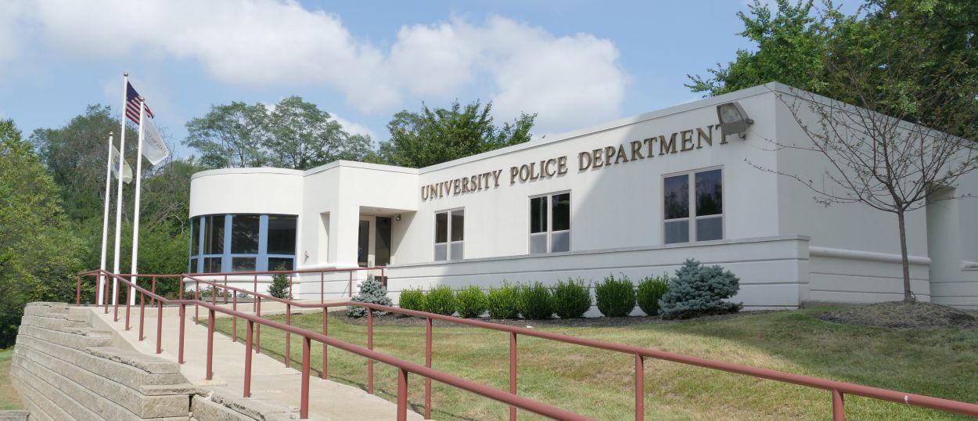
Category 1 – Campus Police Departments
All Officers of the Montclair State Police Department.

Slide 8
Category 2 – Individuals with Campus Security Responsibilities
Persons responsible for monitoring or controlling entrance to campus property
Campus safety personnel & community assistants who routinely monitor entrances to buildings and secured areas are likely to assist with reporting crime.
Parking / Information kiosk staff
Building managers
Resident Assistants

Slide 9
Category 3 – Individuals Designated by the Campus
President’s Office and Staff
Student Affairs Director, Deans and Administrators
Residence Life Staff, Residence Hall Directors
Title IX Coordinator
Others as designated

Slide 10
Category 4 – Officials with Significant Responsibility for Student & Campus Activities
Focus on Function of official, not just title
Significant Contact with Students
Line Responsibility
May include Officials not specifically employed as “Faculty” or “Staff

Slide 11
CSA’s with significant responsibility for Student and Campus Activities
Examples Include:
Deans of Students
Provost and Staff
Representatives of Housing and Resident Life
Student Judicial Programs / Other Discipline Officials
Directors or Managers of student related programs
Officials who oversee extracurricular activities
Director of Athletics, Coaches, Trainers, Staff
Student Health Directors
Faculty Advisors and Advisors to Student Groups

Slide 12

Some examples of those exempt are
Faculty with no responsibility for student activities beyond the classroom
Individual campus health center physicians
Clerical staff
Food service staff
Non-professional and contract staff

Slide 13
YOU DO NOT HAVE TO REPORT IF
You are a licensed mental health counselor or a pastoral counselor (employed by a religious organization to provide confidential counseling) AND
You are working within the scope of your license or religious assignment at the time they receive the crime report

Slide 14
Confidential Reporting
Even if you are exempt and don’t have to report, you can tell the person how they can report the crime anonymously to Police.
Victims can report crimes confidentially (no names or criminal investigation) to the anonymous reporting line on campus at x8477(TIPS), to be included in crime statistics.

Slide 15
What crimes must I report?
Murder and Non-negligent Manslaughter
Manslaughter by Negligence
Sex offenses—forcible & non-forcible
Robbery
Aggravated Assault
Burglary
Motor Vehicle Theft
Arson
Arrests & disciplinary referrals for violations of liquor, drug, & weapons laws
Hate crimes
Domestic/Dating Violence
Stalking

Slide 16
Criminal Offenses
Murder/Manslaughter: The willful killing of one human being by another.
Negligent Manslaughter: The killing of another person through gross negligence.
Robbery: The taking or attempting to take anything of value from the care, custody, or control of a person or persons by force or threat of force or violence and/or by putting the victim in fear.
Aggravated Assault: An unlawful attack by one person upon another for the purpose of inflicting severe or aggravated bodily injury. This type of assault usually is accompanied by the use of a weapon or by means likely to produce death or great bodily harm.

Slide 17
Criminal Offenses (continued)
Burglary: The unlawful entry of a structure to commit a felony or a theft.
Motor Vehicle Theft: The theft or attempted theft of a motor vehicle.
Arson: Any willful or malicious burning or attempt to burn, with or without intent to defraud, a dwelling house, public building, motor vehicle or aircraft, personal property of another, etc.

Slide 18
Criminal Offenses (Sex Offenses)
Forcible sex offenses: rape, fondling, sexual assault with object
Non-forcible: statutory rape and incest

Slide 19
Violence Against Women Act (VAWA) Offenses
Domestic violence includes felony or misdemeanor crimes of violence committed by—
A current or former spouse or intimate partner of the reporting party;
By a person with whom the reporting party shares a child in common;
By a person who is cohabitating with or has cohabitated with the reporting party as a spouse;
By a person similarly situated to a spouse of the reporting party under the domestic or family violence laws of the jurisdiction in which the crime occurred; or,
By any other person against an adult or youth who is protected from that person’s acts under the domestic of family violence laws of the jurisdiction in which the crime occurred.

Slide 20
Violence Against Women Act (VAWA) Offenses
Dating violence: Violence committed by a person who is or has been in a social relationship of a romantic or intimate relationship with the victim.
Stalking: Engaging in a course of conduct directed at a specific person that would cause a reasonable person to fear for their safety or the safety of others or suffer substantial emotional distress.

Slide 21
Domestic/Dating Violence and Stalking (VAWA)
Police must keep statistics on numbers of people involved in any type of domestic or dating violence along with anyone involved in stalking (harassment).
Is the victim in danger?
Was the person in fear for their safety or the safety of others?
What type of abuse or threat of abuse was given?
What type of harassment occurred?
What was the location of the abuse?
What type of relationship did the individuals have?
How many times did the incident occur?

Slide 22
Hate Crimes
The commission of any of the previous listed crimes and the additional crime categories listed below that manifest evidence the victim was chosen because of the perpetrator’s bias against the victim.
Larceny/Theft: Includes, pocket picking, purse snatching, shoplifting, theft from building, theft from motor vehicle, theft of motor vehicle parts or accessories, and all other larceny.
Simple Assault: An unlawful physical attack by one person upon another where neither the offender displays a weapon, nor the victim suffers obvious severe or aggravated bodily injury involving apparent broken bones, loss of teeth, possible internal injury, severe laceration or loss of consciousness.
Intimidation: To unlawfully place another person in reasonable fear of bodily harm through the use of threatening words and/or other conduct but without displaying a weapon or subjecting the victim to actual physical attack.
Destruction/Damage/Vandalism or Property (except Arson): To willfully or maliciously destroy, damage, deface or otherwise injure real or personal property without the consent of the owner or the person having custody or control of it.

Slide 23
Liquor, Drug, Weapons Law Violations
Police must keep statistics on numbers of people arrested for liquor law violations, drug law violations and illegal weapons possession.
Student housing and student judicial affairs officers must keep statistics on number of people referred for disciplinary action for drug, liquor law and weapons violations.
Disciplinary referrals should not include incidents in which the person is also arrested for the same offense.
Statistics must reflect total number of persons involved, not incidents.

Slide 24
Necessary Information for Reporting
Your name or the name of the reporting person and contact information
Type of incident (See Clery Crime Reporting Form)
Date of incident
Location of incident
Description of incident and law enforcement case-number if known
Whether or not the incident was bias motivated
Who, What, When, Where and How?
Were there any witnesses?
Are there any suspects?

Slide 25
Location
You must report if it occurred
On campus
On campus, in residence halls
All public property, including thoroughfares, streets, sidewalks, and parking facilities, that is within the campus, or immediately adjacent to and accessible from the campus.
On non-campus property owned or controlled by the University or a recognized student organization

Slide 26
Location (continued)
These off-campus properties are termed “non-campus property,” defined by law to include:
Property owned or controlled by MSU (e.g. 855 Valley Road, 1515 Broad Street locations) Controlled is meant to be that at the time of the incident MSU sanction the event. Field trips, trips abroad (solely maintained by MSU), sport team travel locations, experiential learning off campus (solely controlled by MSU) are among examples of this.

Slide 27
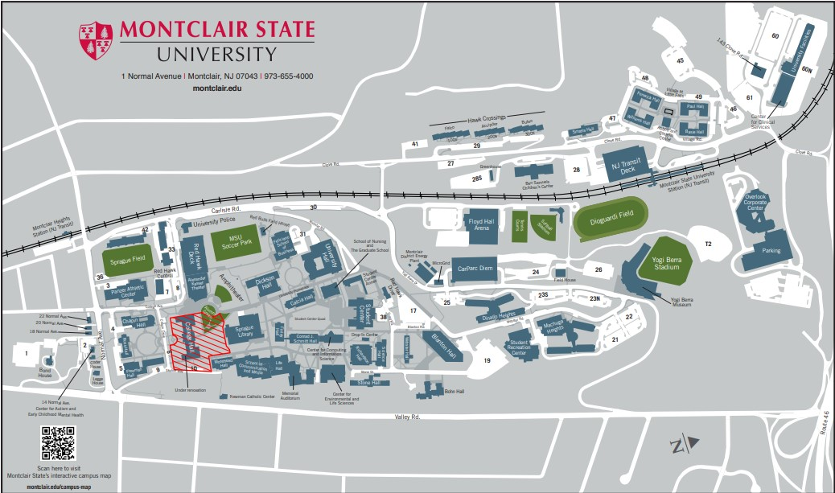

Slide 28
Get the facts
Description of the incident or crime”.
Specific questions will help police assign the crime to the correct category.
Get as accurate and complete a description of what happened as you can.
If not sure, report.
CSA’s should not investigate the crime or attempt to determine whether a crime, in fact, took place.
A victim can choose not to report, however a CSA is still obligated to report.

Slide 29
Find out the following in all cases
Is the victim or assailant a student? Are they acquaintances?
Does the victim wish to remain anonymous?
Has the incident been reported to police or to any other CSA?
Was either party under the influence of alcohol or drugs?

Slide 30
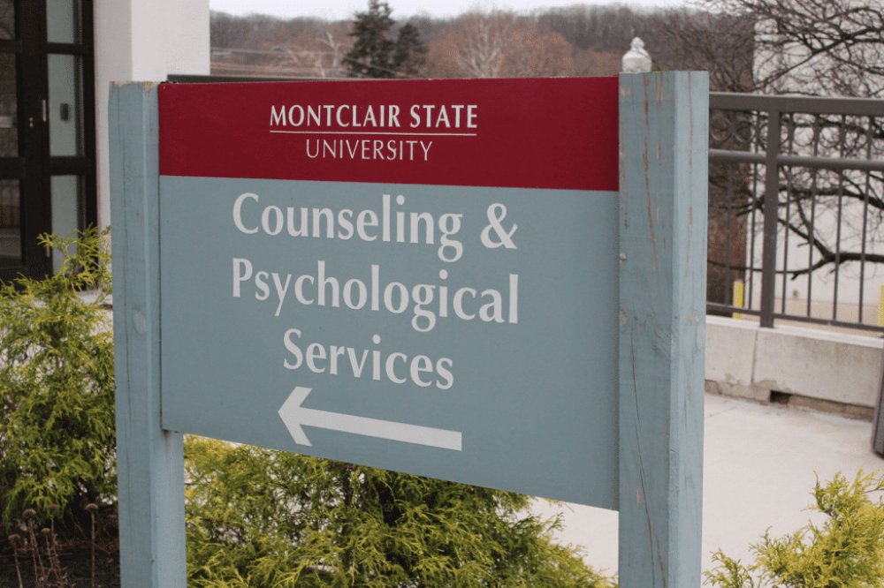


Offer Help
Provide the person with information on:
Reporting to campus police
Campus programs for assisting victims of sexual violence and other assaults
Procedures for seeking medical help

Slide 31
Reporting and Investigating Missing Persons
Must notify the University Police Department within 24 hours of the determination that the student is missing.
Residence Hall staff, building directors, Dean of Students personnel, among others, may many times be first contacts to report missing students. There is no waiting period for an individual to report a missing person.
The Montclair State University Police Department will investigate, following established police protocol, all cases of missing persons that are brought to their attention.

Slide 32
Informing Designated Contact Person
The University Police Department will inform the student’s identified emergency contact person, or persons, that a student is missing within 24 hours of receiving a missing person report.
In cases where the student is under the age of 18 and or unemancipated, or where the missing student may be at risk, University Police shall also notify the student’s custodial parent or guardian within 24 hours of the determination that the student is missing, unless more immediate contact is warranted.

Slide 33
Reporting
Complete the Campus Security Authority Crime Report Form (You may need to wait until the person leaves.)
Tell the person you must report the incident as an anonymous statistic
Complete one form for each crime reported
If no crimes have been committed over the course of a calendar year, you still must complete the annual crime report form.

Slide 34
What if I forget to file a report?
Each year, the Clery Act Coordinator will send an email to all CSA’s that contains a ‘CSA Annual Summary Disclosure’ form. The purpose of this form is to confirm whether CSA’s do or do not have any previously unreported Clery Act-qualifying crimes/incidents that were reported to them the previous calendar year. All CSA’s are required to complete, sign, and return the form to the Coordinator no later than December 31st.

Slide 35
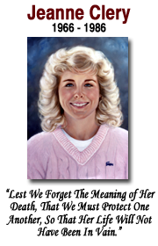
Conclusion
Prevention is key but in the unfortunate event that a crime does occur, these are more than statistics. These are our students, colleagues, family and loved ones. It is our responsibility to make sure we promote a safe and caring community here.
It is important to not make assumptions and, more than ever, to treat each other and ourselves with kindness, empathy, and compassion.

Slide 36

For More Information
Meredith Martin
Compliance Manager
Email: martinm@montclair.edu
Contact University Police at 973-655-5222 or email us at msupolice@montclair.edu
MSUPD website at www.montclair.edu/universitypolice

