Slide 1


Campus Security Authority (CSA)
Training and Reporting
Montclair State University

Slide 2
Goal and Objective
Increase your understanding of the Clery Act and your roles and responsibilities as a Campus Security Authority (CSA) in reporting Clery Act crimes.
You will be able to carry out your responsibilities as a CSA to report, in good faith, allegations of Clery Act crimes to campus police

Slide 3

Overview
What is the Clery Act?
Who is a Campus Security Authority?
What are the responsibilities of a CSA?
Who is included and exempt from reporting?
Which crimes should you report?
How do you report Clery Act crimes?
How does the Clery Act and Title IX intersect?
Notes:
This photo here is a picture of Jeanne Clery’s parents Connie and Howard Clery.
On Capitol Hill, they lobbied for revolutionary policy changes that eventually took the form as the Jeanne Clery Act. They lobbied for accountability and transparency in campus crime policies and statistics. Connie and Howard also worked with allies and advocates to form a 501(c)(3) nonprofit organization that would seek to prevent the kind of violence that had taken Jeanne from them. Today that organization, Clery Center, remains dedicated to guiding institutions of higher education to implement effective campus safety measures.

Slide 4

Jeanne Clery Disclosure of Campus Security Policy & Crime Statistics Act
Jeanne Clery was raped and murdered in her dorm room at Lehigh University in 1986. Her killer was another student.
Her parents believe she would have been more cautious if she had known about other violent crimes at Lehigh. Her parents advocated for legislation that would require universities to disclose information regarding crime on college campuses.
Notes:
This photo here is a picture of Jeanne Clery. Jean’s assailant entered the dorm through a door that had been propped open. He was looking for rooms to rob. After Jeanne’s death it came to light that the university had received reports of 181 situations of auto-locking doors being propped open by residents. There were 38 violent crimes on and around the campus within the last 3 years but this information had not been communicated to the campus community.

Slide 5
What is the Clery Act?
Federal law that requires institutions of higher education in the United States to disclose campus security information including crime statistics for the campus and surrounding areas.
All public and private postsecondary institutions participating in federal student aid are subject to the law. Violators can be fined by the Department of Education for violating the law and risk loss of federal aid.
Notes:
The Clery fine per violation penalty can be up to $67,544 and rises annually. The Clery Act requires every year on October 1st that we publish an annual security and fire safety report. The report includes current policies concerning the security of, and access to, campus facilities and residencies, as well as security considerations in the maintenance of campus facilities. The ASR includes statistics of campus crime for the preceding 3 calendar years, plus details about efforts taken to improve campus safety. This report can be found on the University Police website.
Every institution must issue timely warning notices to the community for any Clery Act crime that represents an ongoing threat to the safety of students or employees. Emergency notifications are issued upon confirmation of a significant emergency or dangerous situation involving an immediate threat to the health or safety of students or employees occurring on campus. University police must maintain and update a daily crime log, and devise and test emergency notifications and evacuation procedures. The Clery Act also requires the University to disclose fire safety information, keep a fire log and publish an annual fire safety report containing policy statements and statistics as well.
In 2020, The University of North Carolina at Chapel Hill was fined $1.5 million and the University of California, Berkeley was fined $2.35 million and will be monitored for two years for Clery Act violations.
Michigan State University was issued $4.5 million for violations relating to the Larry Nassar sexual abuse cases, in addition to general Clery noncompliance.
Penn State was fined $2,397,000 for violating the Clery Act in light of the Pete Sandusky sex scandal.

Slide 6
Who is a Campus Security Authority (CSA)?
Campus Police Departments
Individuals with Campus Security Responsibilities
Individuals Designated by the Campus
Officials with Significant Responsibility for Student and Campus Activities who are likely to receive complaints from a victim of crime.
CSAs are defined and identified by their function, not by their title.
Notes:
The Department of Education uses the term CSA very broadly. They are talking about four groups of individuals on a campus that they have identified as mandatory reporters. Because official responsibilities and job titles vary on campuses, the regulations do not provide an all-inclusive list of specific titles and positions.

Slide 7

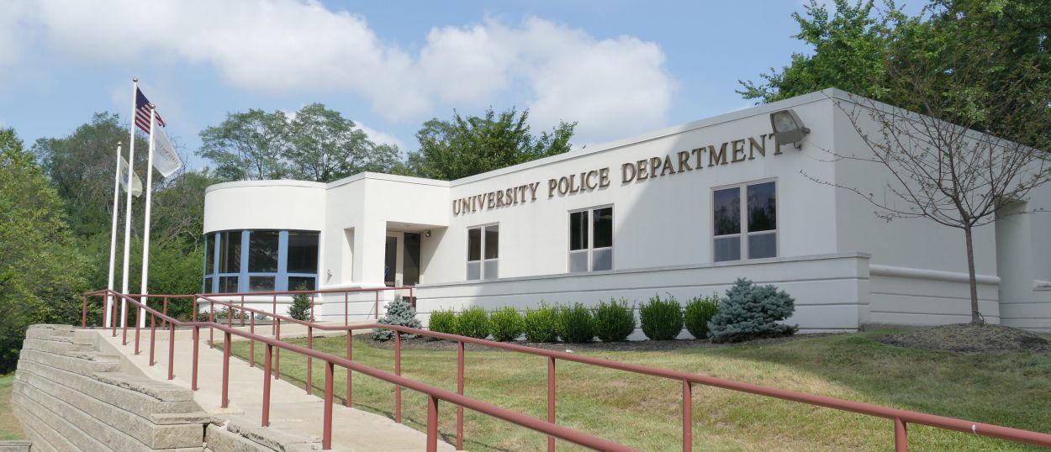
Category 1 – Campus Police Departments
All Officers of the Montclair State University Police Department.
Notes:
The Campus Police department consists of officers and civilians. The headquarters is located on the corner of College Avenue and Carlisle Rd.

Slide 8
Category 2 – Individuals with Campus Security Responsibilities
Persons responsible for monitoring or controlling entrance to campus property
Campus safety personnel & community assistants who routinely monitor entrances to buildings and secured areas are likely to assist with reporting crime.
Parking / Information kiosk staff
Building managers
Resident Assistants
Notes:
RAs and Service Assistants may witness incidents in the residence halls or come across something during their routine inspections. Even though the parking staff is contracted here they are still considered CSAs.

Slide 9
Category 3 – Individuals Designated by the Campus
President’s Office and Staff
Student Affairs Director, Deans and Administrators
Residence Life Staff, Residence Hall Directors
Title IX Coordinator
Others as designated

Slide 10
Category 4 – Officials with Significant Responsibility for Student & Campus Activities
Focus on Function of official, not just title
Significant Contact with Students
Line Responsibility
May include Officials not specifically employed as “Faculty” or “Staff
Notes:
Whether or not the individual is paid is not a factor in determining whether that individual is a CSA. CSAs are officials whose functions involve building relationships with students.

Slide 11
CSA’s with significant responsibility for Student and Campus Activities
Examples Include:
Deans of Students
Provost and Staff
Representatives of Housing and Resident Life
Student Judicial Programs / Other Discipline Officials
Directors or Managers of student related programs
Officials who oversee extracurricular activities
Director of Athletics, Coaches, Trainers, Staff
Student Health Directors
Faculty Advisors and Advisors to Student Groups

Slide 12

Some examples of those exempt are
Faculty with no responsibility for student activities beyond the classroom
Individual campus health center physicians
Clerical staff
Food service staff
Non-professional and contract staff
Notes:
Parking services and Capstone On-Campus Management, under its “shared governance” arrangement, provides day-to-day operations of The Heights, with MSU providing student life and residential programming. These are contracts that are not exempt.

Slide 13
YOU DO NOT HAVE TO REPORT IF
You are a licensed mental health counselor or a pastoral counselor (employed by a religious organization to provide confidential counseling) AND
You are working within the scope of your license or religious assignment at the time they receive the crime report
You are a Campus Interpersonal Violence Advocate working within that scope at the time of the report
Notes:
It is important to remember you must be functioning in that role when it is reported to you. For example if you are a professor as well as a counselor and someone reports it to you while you teaching classes on the side it must be reported because it was not reported to you in that function.

Slide 14
Confidential Reporting
Even if you are exempt and don’t have to report, you can tell the person how they can report the crime anonymously to Police.
Victims can report crimes confidentially (no names or criminal investigation) to the anonymous reporting line on campus at x8477(TIPS), to be included in crime statistics.
Notes:
With such information, the University can keep accurate records of the number of incidents involving students, determine where there is a pattern of crime with regard to a particular location, method or assailant and alert the campus community to potential danger. Reports filed in this manner are counted and disclosed in the annual crime statistics for the institution and may result in a timely warning report.
In addition, individuals can send texts with immediate relay to the University Police Department. You can text a crime tip to the University Police by texting the keyword “E-TIPS”, a space and your message to 67283. University Police will investigate any anonymous report.
Victims do not always want to report a crime to the police, sometimes they feel more comfortable with reporting it to another university official, a friend or colleague that they have built a relationship with.

Slide 15
What crimes must I report?
Murder and Non-negligent Manslaughter
Manslaughter by Negligence
Sex offenses—forcible & non-forcible
Robbery
Aggravated Assault
Burglary
Motor Vehicle Theft
Arson
Arrests & disciplinary referrals for violations of liquor, drug, & weapons laws
Hate crimes
Domestic/Dating Violence
Stalking

Slide 16
Criminal Offenses
Murder/Manslaughter: The willful killing of one human being by another.
Negligent Manslaughter: The killing of another person through gross negligence.
Robbery: The taking or attempting to take anything of value from the care, custody, or control of a person or persons by force or threat of force or violence and/or by putting the victim in fear.
Aggravated Assault: An unlawful attack by one person upon another for the purpose of inflicting severe or aggravated bodily injury. This type of assault usually is accompanied by the use of a weapon or by means likely to produce death or great bodily harm.
Notes:
Just because two people got into a fight that is not a reportable offense

Slide 17
Criminal Offenses (continued)
Burglary: The unlawful entry of a structure to commit a felony or a theft.
Motor Vehicle Theft: The theft or attempted theft of a motor vehicle.
Arson: Any willful or malicious burning or attempt to burn, with or without intent to defraud, a dwelling house, public building, motor vehicle or aircraft, personal property of another, etc.
Notes:
Remind students to lock their cars and dorm rooms and provide them with a list of items not permitted in residence rooms.

Slide 18
Criminal Offenses (Sex Offenses)
Forcible sex offenses: rape, fondling, sexual assault with object
Non-forcible: statutory rape and incest
Notes:
If this occurs, the Student Health Center has a certified professional Sexual Assault Nurse Examiner who can provide victim-centered services (during office hours). If the individual prefers or needs an off-campus hospital evaluation, the Student Health Center will facilitate this referral.
Passaic County SART is on-call 24-hours a day and will respond to the police department or the hospital. The National Sexual Assault Telephone Hotline 800.656.HOPE (4673) routes calls to a local RAINN affiliate organization based on the first six digits of the phone number.

Slide 19
Violence Against Women Act (VAWA) Offenses
Domestic violence includes felony or misdemeanor crimes of violence committed by—
A current or former spouse or intimate partner of the reporting party;
By a person with whom the reporting party shares a child in common;
By a person who is cohabitating with or has cohabitated with the reporting party as a spouse;
By a person similarly situated to a spouse of the reporting party under the domestic or family violence laws of the jurisdiction in which the crime occurred; or,
By any other person against an adult or youth who is protected from that person’s acts under the domestic of family violence laws of the jurisdiction in which the crime occurred.
Notes:
Violence Against Women Act 2013 amended the Clery Act to require policy statements, additional crime reporting and prevention programs for domestic violence, dating violence, sexual assault and stalking. VAWA was the first federal legislation acknowledging domestic violence and sexual assault as crimes and provided federal resources to encourage community-coordinated responses to combating violence against women. Each VAWA reauthorization has built on existing protections and programs to better meet the needs of survivors.
The Campus Sexual Violence Elimination Act, or Campus SaVE Act (SaVE), is a 2013 amendment to the Clery Act. SaVE increased transparency about the scope of sexual violence on campus, guarantees victims enhanced rights and accommodations, provides for standards that protect both the accuser and accused in institutional conduct proceedings, and provides campus community wide prevention educational programming.

Slide 20
Violence Against Women Act (VAWA) Offenses
Dating violence: Violence committed by a person who is or has been in a social relationship of a romantic or intimate relationship with the victim.
Stalking: Engaging in a course of conduct directed at a specific person that would cause a reasonable person to fear for their safety or the safety of others or suffer substantial emotional distress.
Notes:
The most common clery offense we see on campus is dating violence.
On September 23rd, 2022 ATTORNEY GENERAL ADMINISTRATIVE EXECUTIVE DIRECTIVE NO. 2022-10 created the Division of Violence Intervention and Victim Assistance in the Department of Law & Public Safety.

Slide 21
Hate Crimes
The commission of any of the previous listed crimes and the additional crime categories listed below that manifest evidence the victim was chosen because of the perpetrator’s bias against the victim.
Larceny/Theft: Includes, pocket picking, purse snatching, shoplifting, theft from building, theft from motor vehicle, theft of motor vehicle parts or accessories, and all other larceny.
Simple Assault: An unlawful physical attack by one person upon another where neither the offender displays a weapon, nor the victim suffers obvious severe or aggravated bodily injury involving apparent broken bones, loss of teeth, possible internal injury, severe laceration or loss of consciousness.
Intimidation: To unlawfully place another person in reasonable fear of bodily harm through the use of threatening words and/or other conduct but without displaying a weapon or subjecting the victim to actual physical attack.
Destruction/Damage/Vandalism or Property (except Arson): To willfully or maliciously destroy, damage, deface or otherwise injure real or personal property without the consent of the owner or the person having custody or control of it.
Notes:
For Clery Act purposes hate crimes include criminal homicide, robbery, aggravated assault, burglary, motor vehicle theft, arson, and sex offenses. A hate crime is done based on a bias, there are all kinds of biases. The Department of Education identifies race, gender, gender identity, race, religion, sexual orientation, ethnicity/national origin, or disability. Even if the incident does not fit the formal definition of hate crimes under Clery, it might still be a policy violation or a concern that can be formally addressed.

Slide 22
Liquor, Drug, Weapons Law Violations
Police must keep statistics on numbers of people arrested for liquor law violations, drug law violations and illegal weapons possession.
Student housing and student judicial affairs officers must keep statistics on number of people referred for disciplinary action for drug, liquor law and weapons violations.
Disciplinary referrals should not include incidents in which the person is also arrested for the same offense.
Statistics must reflect total number of persons involved, not incidents.
Notes:
Public Drunkenness or Public Intoxication is NOT a Clery reportable offense unless the perpetrator also includes underage drinking.

Slide 23
Location
You must report if it occurred
On campus
On campus, in residence halls
All public property, including thoroughfares, streets, sidewalks, and parking facilities, that is within the campus, or immediately adjacent to and accessible from the campus.
On non-campus property owned or controlled by the University or a recognized student organization
Notes:
We contact Clifton, Little Falls, Bloomfield and Montclair police for statistics on the public property that is included in the Clery geography.

Slide 24
Location (continued)
These off-campus properties are termed “non-campus property,” defined by law to include:
Property owned or controlled by MSU (e.g. 855 Valley Road, 1515 Broad Street locations) Controlled is meant to be that at the time of the incident MSU sanction the event. Field trips, trips abroad (solely maintained by MSU), sport team travel locations, experiential learning off campus (solely controlled by MSU) are among examples of this.
Notes:
Field trips: You are not required to include statistics for crimes that occur on field trips at locations your institution does not own or control.
Overnight, school-sponsored trips: If MSU sponsors students on an overnight trip, for example to see a play, and they rent hotel rooms, we don’t have to include crimes that occur in those rooms in Clery Act statistics because the hotel rooms don’t meet the frequently-used-by-students criterion.
Repeated use of a location for school-sponsored trips: If every year the students stay in the same hotel each year, then we must include portions of the hotel in the noncampus geography. To include any common areas used to access the rooms (lobby, elevators, etc.) for the times and dates specified in the rental agreement
If students study abroad at a location or facility that MSU does not own or control, we don’t have to include statistics

Slide 25
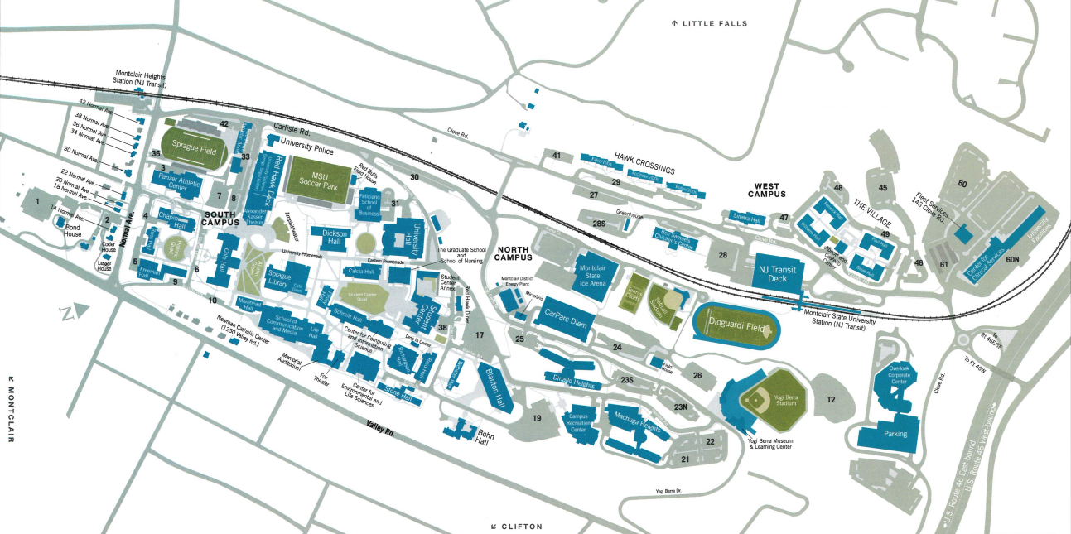
Notes:
This is a map of our campus that is available on the Montclair website. It may be useful for individuals who are not familiar with the campus buildings and can help determine location when reporting. For reporting purposes we also include the Center for Audiology and Speech Language Pathology in Bloomfield.

Slide 26
Reporting and Investigating Missing Persons
Must notify the University Police Department within 24 hours of the determination that the student is missing.
Residence Hall staff, building directors, Dean of Students personnel, among others, may many times be first contacts to report missing students. There is no waiting period for an individual to report a missing person.
The Montclair State University Police Department will investigate, following established police protocol, all cases of missing persons that are brought to their attention.
Notes:
Persons can report students missing to any official of the University, who then must notify the University Police Department
The University Police Department will serve as the lead investigating agency unless superseded by a Prosecutor’s Office or State of New Jersey or federal agency with appropriate jurisdiction. The University Police Department will contact any agency where the missing person may live, work or be reported to be within.
Students can report it in the RAVE tip hotline

Slide 27
Informing Designated Contact Person
The University Police Department will inform the student’s identified emergency contact person, or persons, that a student is missing within 24 hours of receiving a missing person report.
In cases where the student is under the age of 18 and or unemancipated, or where the missing student may be at risk, University Police shall also notify the student’s custodial parent or guardian within 24 hours of the determination that the student is missing, unless more immediate contact is warranted.

Slide 28
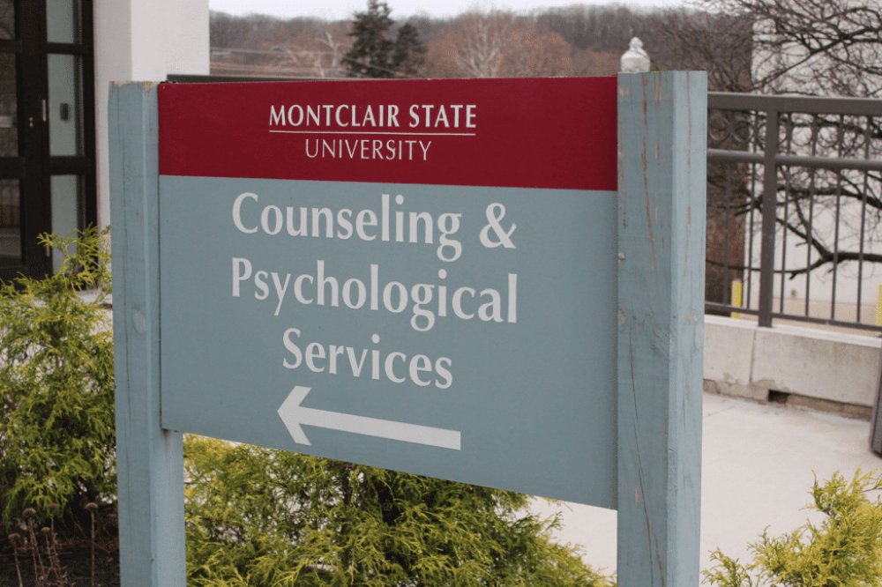

Offer Help
Provide the person with information on:
Reporting to campus police
Campus programs for assisting victims of sexual violence and other assaults
Procedures for seeking medical help
Notes:
There does not have to be disciplinary actions for resources to be available to them. Some people will not want the resources right away but may come back when they are ready and we want to make sure they know what resources are available to them. They may request changes to academic, living, transportation, and working accommodations and other protective measures. These options must be provided if requested and reasonably available, regardless of whether or not the person chooses to report to campus police or local law enforcement.
The University Health Center, Counseling and Psychological Services (CAPS), and Health Promotion provide outreach activities and educational workshops on health and wellness issues. They offer a wide variety of groups that help students. Group therapy, support groups, one on one consultations and drop-ins. Self-defense training, thriving after trauma, and Coping 101. Therapy Assistance Online services offer free services to students and employees.
There is more information on the website if they are interested. Show them where the information is located or where these services are provided if they need that assistance. Community resource information is provided on the University Health Center website.
VAWA 2022 Sec. 303 improves existing campus grant programs to support institutions of higher education in developing and disseminating comprehensive prevention education for all students. This section expands training for school-based personnel and campus health centers to meet the needs of young victims of violence, including by using a victim-centered, trauma-informed interview technique.

Slide 29
Reporting
Complete the Campus Security Authority Crime Report Form (You may need to wait until the person leaves.)
The victim may wish to remain anonymous
Tell the person you must report the incident as an anonymous statistic
Complete one form for each crime reported
If no crimes have been committed over the course of a calendar year, you still must complete the annual crime report form.
Notes:
When a crime is reported to a CSA, they must ask the person if they would like to report it to University Police. If the CSA has firsthand knowledge/confirmation that the reporting party filed a police report with University Police, then they are not obligated to complete and submit a CSA report form. However, if the reporting party says they will file a police report with University Police and leaves (no CSA firsthand knowledge/confirmation that a police report was filed), then the CSA must still complete and submit a Campus Security Authority Crime Report Form.
If the reported crime is made in good faith, meaning that there is a reasonable basis for believing that the information is not rumor or hearsay, then the crime is reportable. When in doubt, a CSA Report Form should be completed and submitted.
University Police reviews Campus Security Authority Crime Report Form and decides if an incident warrants a timely warning/emergency notification of the University community and whether it is a reportable crime
All community members are encouraged to promptly report all campus-related criminal incidents and other public safety-related emergencies to University Police.
For incidents requiring immediate attention, dial 973-655-5222 or use one of the “Blue Light” Emergency Phones located throughout campus.
Like I said before, University police also accept anonymous reports on their TIPS line at 973-655-8477 (TIPS) from any on-campus phone or via text messaging through the Rave E-Tips program. To utilize this system, all you have to do is text keyword “E-TIPS” a space and your message to 67283 from your cellular phone.

Slide 30
Get the facts
Get as accurate and complete a description of what happened as you can.
If not sure, report.
CSA’s should not investigate the crime or attempt to determine whether a crime, in fact, took place. Police will investigate and make that determination, as well as assign the crime to the correct category.
A victim can choose not to report, however a CSA is still obligated to report.

Slide 31
Information for Reporting
Has the incident been reported to the police or any other CSA?
Date of incident
Location of incident
Description of incident and law enforcement case number if known
Is the victim or others in danger?
Were there any witnesses?
Are there any suspects?
Was the incident bias-motivated?
What type of relationship did the individuals have?
How many times did the incident occur?
Who, What, When, Where, and How?
Notes:
The intent of the Clery Act is to provide accurate, complete, and timely information regarding crimes committed. You may need to ask if you can pause them for a minute and say something like it looks like you are about to tell me something significant and I am happy to listen to you and hear to listen, but I do have the obligation to report this to the University to not only assist you but for the safety of the community. The responsibility to report is a way of supporting that individual. The primary function is not sharing it as a requirement but more as something you want to do to help them get the support they need.
If there appears to be an ongoing or serious threat of a similar incident occurring to the victim or others, you must contact the police immediately in addition to completing the required form. A timely warning or emergency notification may need to be issued to the campus community. All members of the Montclair community are signed up for timely warnings automatically.

Slide 32
What if I forget to file a report?
Each year, the Clery Act Coordinator will send an email to all CSA’s that contains a ‘CSA Annual Summary Disclosure’ form. The purpose of this form is to confirm whether CSA’s do or do not have any previously unreported Clery Act-qualifying crimes/incidents that were reported to them the previous calendar year. All CSA’s are required to complete, sign, and return the form to the Coordinator no later than December 31st.

Slide 33
Clery Act and Title IX Intersection
Title IX is a civil rights law that prohibits discrimination on the basis of sex in federally funded educational programs and activities.
Title IX requires institutions to describe the range of sanctions imposed for incidents of dating violence, domestic violence, sexual assault, and stalking, whereas the Clery Act requires that the policy list all possible sanctions.
Under the Clery Act, CSAs are required to report Clery Act crimes to University Police. Victims are provided written explanations of rights and options, law enforcement analyzes whether this is an ongoing threat that warrants a timely warning, and determines if the crime that occurred must be reported in the institution’s statistics.
Under Title IX, an institution has actual knowledge of an incident when information is reported to the Title IX coordinator or to officials with the authority to institute corrective measures. This results in specific actions by the institution, including outreach from the Title IX coordinator to discuss supportive measures available without filing a formal complaint, and the process for filing a formal complaint.

Slide 34
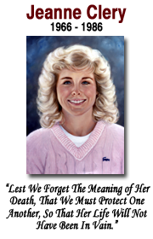
Conclusion
Prevention is key but in the unfortunate event that a crime does occur, these are more than statistics. These are our students, colleagues, family and loved ones. It is our responsibility to make sure we promote a safe and caring community here.
It is important to not make assumptions and, more than ever, to treat each other and ourselves with kindness, empathy, and compassion.
Notes:
Campus security authorities are a critical part of Clery Act compliance, you are trusted members of our community.
“The best education in the world is useless if a student doesn’t survive with a healthy mind and body.” – Connie and Howard Clery

Slide 35

For More Information
Meredith Martin
Compliance Manager
Email: martinm@montclair.edu
Contact University Police at 973-655-5222 or email us at msupolice@montclair.edu
University Police website at www.montclair.edu/universitypolice
Notes:
The ASR is available by going to the University Police website. There is a downloadable PDF as well. Safety needs to be a priority.
Schools are communities, we are an open campus. Please remember to have situational awareness and be approachable for students to come forward and feel comfortable to disclose information and ask questions to.
You role as a CSA does not have to end at receiving and passing on reports. You can be an ambassador for Clery.

